Slide 1

Welcome!
Notes:
Welcome to the Social Origins lab study! My name is Claudine and I’ll be the researcher working with you today.

Slide 2




About today’s game
30 minutes
Where is their pet?
What does your child think?
This game will be recorded.
Notes:
To start off, I’m going to give you a brief overview of what we’ll be doing today.
Completing this game will take about 30 minutes
In this game, [Child] will see some pictures of children who are looking for their pet, and we will ask [Child] questions about these situations.
There are no right or wrong answers in this game—we just want to know what your child thinks!
You are free to sit next to your child during the game or go to another part of the room, whatever you prefer,—we just ask that you let your child participate on their own. So please try to stay very neutral about the content until the very end, and then I am happy to answer any questions at the end of the game.
We will record the game so that we can remember what [child] answered. This video stays in our secure servers and we won’t show it to anyone else without your explicit consent.
Is it OK if I start recording now?
OK, great! You’re going to hear a voice in just a second to announce the recording
In the scheduling email you should have received information about consenting to participate in research. Before you provide your verbal consent here, do you have any questions about the information we shared with you?
[If yes, answer their questions. Once they are comfortable moving forward, proceed. If they decide they are not comfortable proceeding at this point, thank them so much for considering to participate and ask whether they think they would be interested in participating in the future. Regardless of their response, thank them and wish them a good day. End the meeting.]

Slide 3
Consent
I, (Parent’s Name), have read the consent form for this study.
I give my child, (Child’s name), permission to participate in the study.
I understand that either I, or my child, can stop participating at any time.
Notes:
So if we could just have you read this short paragraph out loud, it will serve as your verbal consent.

Slide 4
Step 0: Device and screen size?
Step 1: Are you in full-screen mode?
Yes
No
Notes:
Now we’ll get your screen set-up for the game. First, what device are you using to look at the game?
How big is the screen size? You can estimate it, and that’s totally fine!
Are you in the full-screen mode?
[If yes:] Great! [Click on ‘Yes’.]
[If parents say “no” or “not sure”:] We’d like the game to be in the full screen mode. [Click ‘No’ to proceed to instructions.]

Slide 5
Please enter full screen mode.
The full screen icon looks like this:
Notes:
[If parent responded “no”:] If you could move your mouse over to the top right of the screen, you should see an icon that looks like this square. Please click on it to enter the full screen mode.
[If parent responded “not sure”:] Please move your mouse to the top right corner of the screen. If you see an icon that looks like this square, please click it to enter full screen mode. If you do not see this icon, that means you’re already in full screen mode.
Are you in full screen mode now? Great!

Slide 6
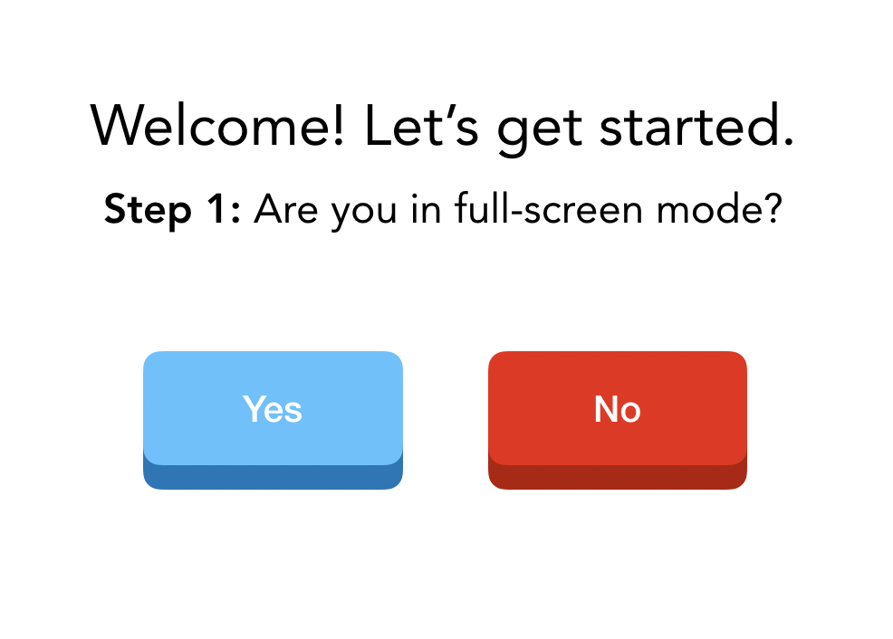
Step 2: Do you see our videos floating on top of the slides or anchored beside the slides?
On top
Beside
Notes:
[This slide is to check if participants have videos floating on top of the slides.]
Do you see our videos floating on top of the slides, or besides the slides?
[If “on top:”] Great! [double check:] If you click on our videos, can you move them around on the screen? [If yes - click the button ‘On top’.]
[If “beside”:] Ah, that probably means that you are in side-by-side mode. We’d like for our video to float on top of the slides. [Click “beside” to proceed to instructions.]
[If parent is using external monitor:] We’d like to set up your screen so that my video floats on top of the slides. If you’re viewing my video and the slides on separate monitors, would it be okay to disconnect the monitor for now?

Slide 7
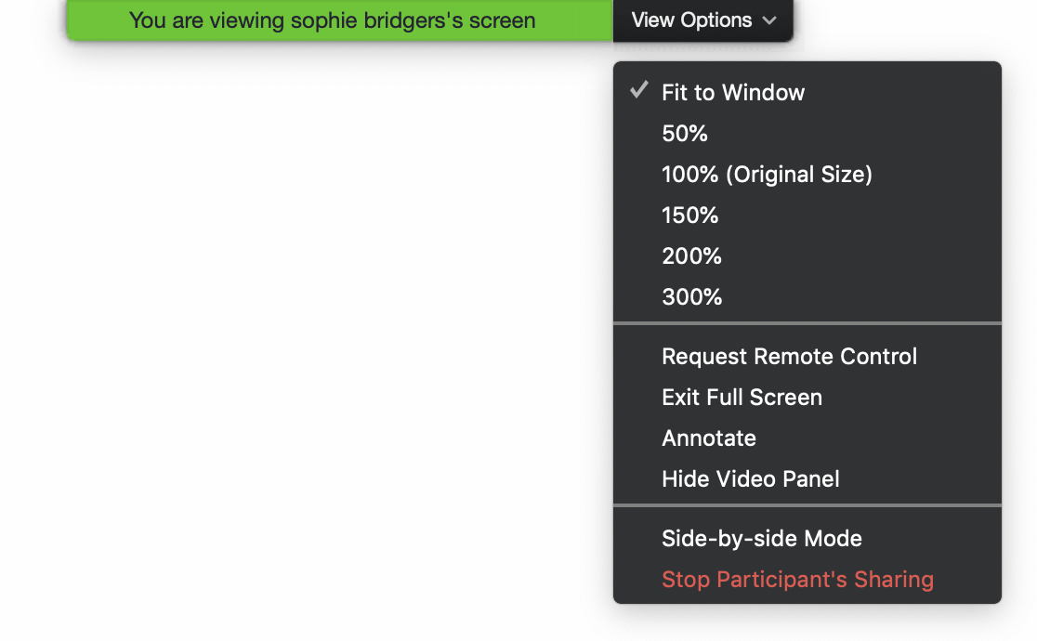
You should see our videos floating on top of this slide.
(If you are in side-by-side mode, please disable it in View Options!)
^
Notes:
Please move your mouse to the top of the screen and select “View Options,” like in this diagram. You should see an option called “Side-by-side Mode” near the bottom—please make sure that it’s unchecked.

Slide 8
Step 3: Can you see both of our videos on the screen, or just the experimenter?
Experimenter
Both videos
Notes:
[Researcher: and now can you see both our videos, or just my video?
[If “both”:] We’d like for you to just see my video. [Click ‘Both videos’ to proceed to instructions.]
[If “experimenter”:] Perfect! [Click ‘Experimenter’.]

Slide 9
Move your mouse over the upper right corner of your video.
Hover over the blue and white ellipsis and select Hide Self View from the dropdown menu that appears.
…
Notes:
If you move your mouse over your own video, you will see a blue square with an ellipsis. Please click on that, and then click ‘Self-View’.
Do you just see my video now?
[If “yes”: Skip to slide 14]
[If there are other people on the call, the parent might still be able to see their icons:] As I mentioned in the beginning of the game, we have a few researcher assistants sitting in. So we’re also going to hide them.

Slide 10
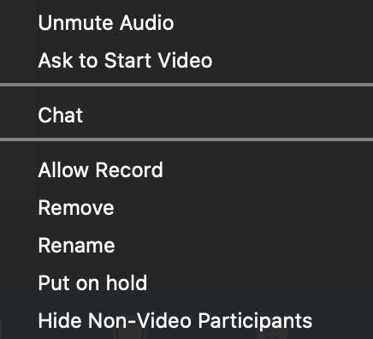

Move your mouse over the upper right corner of the non-video participant.
Hover over the blue and white ellipsis and select Hide Non-Video Participants from the dropdown menu that appears.
…
Notes:
Could you please move your mouse over to any one of the other participants, click the ellipsis icon, and select ‘Hide Non-Video Participants’?
[After they’re done:] So do you see just my video now? Wonderful!

Slide 11
Step 4: Move my video here!
* For this slide, researchers can change the video screen location to suit their studies.
Notes:
Last step, could you please drag my video over this rectangle? Great!
So [child] this screen is all set-up. We’re going to play a quick warm-up game to make sure everything is set up!

Slide 12

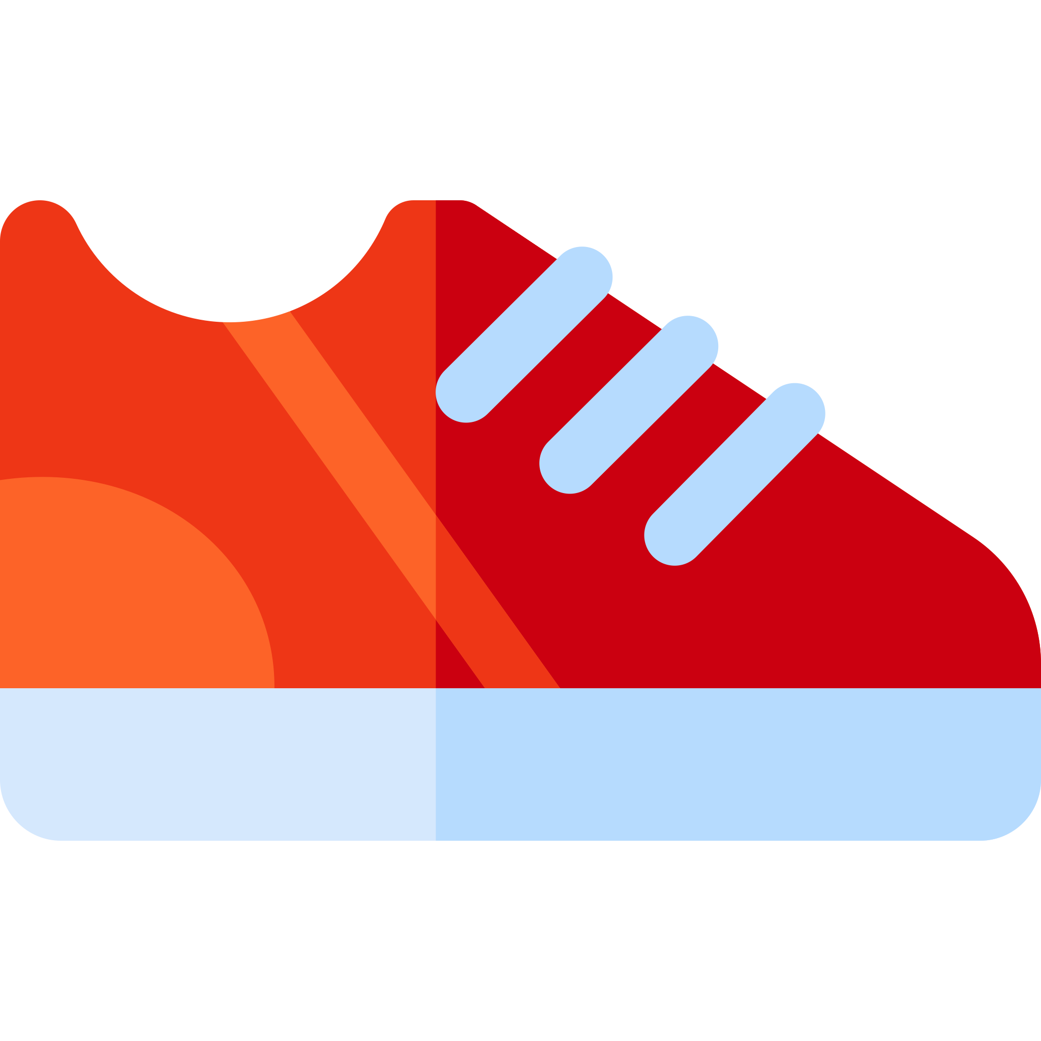
Notes:
Are you ready? Ok! Let’s get started.
Do you see the two things on the screen? Which of the two things is red?
And what color is the star?

Slide 13
Notes:
Do you see the two new things on the screen? Which of the two things is pink?
And what color is the tree?
Correct! Well done

Slide 14
Notes:
And two more things.
Which of the two things is brown?
And what color is the book?
Correct! Well done!

Slide 15
Let’s get started!
Notes:
Now let’s get started with the real game! For this game, we are going to read a story together and talk about it. And for this story, you’ll get to make choices about things. Do you want to check out the game?
Here we go!

Slide 16
Notes:
Story 1

Slide 17
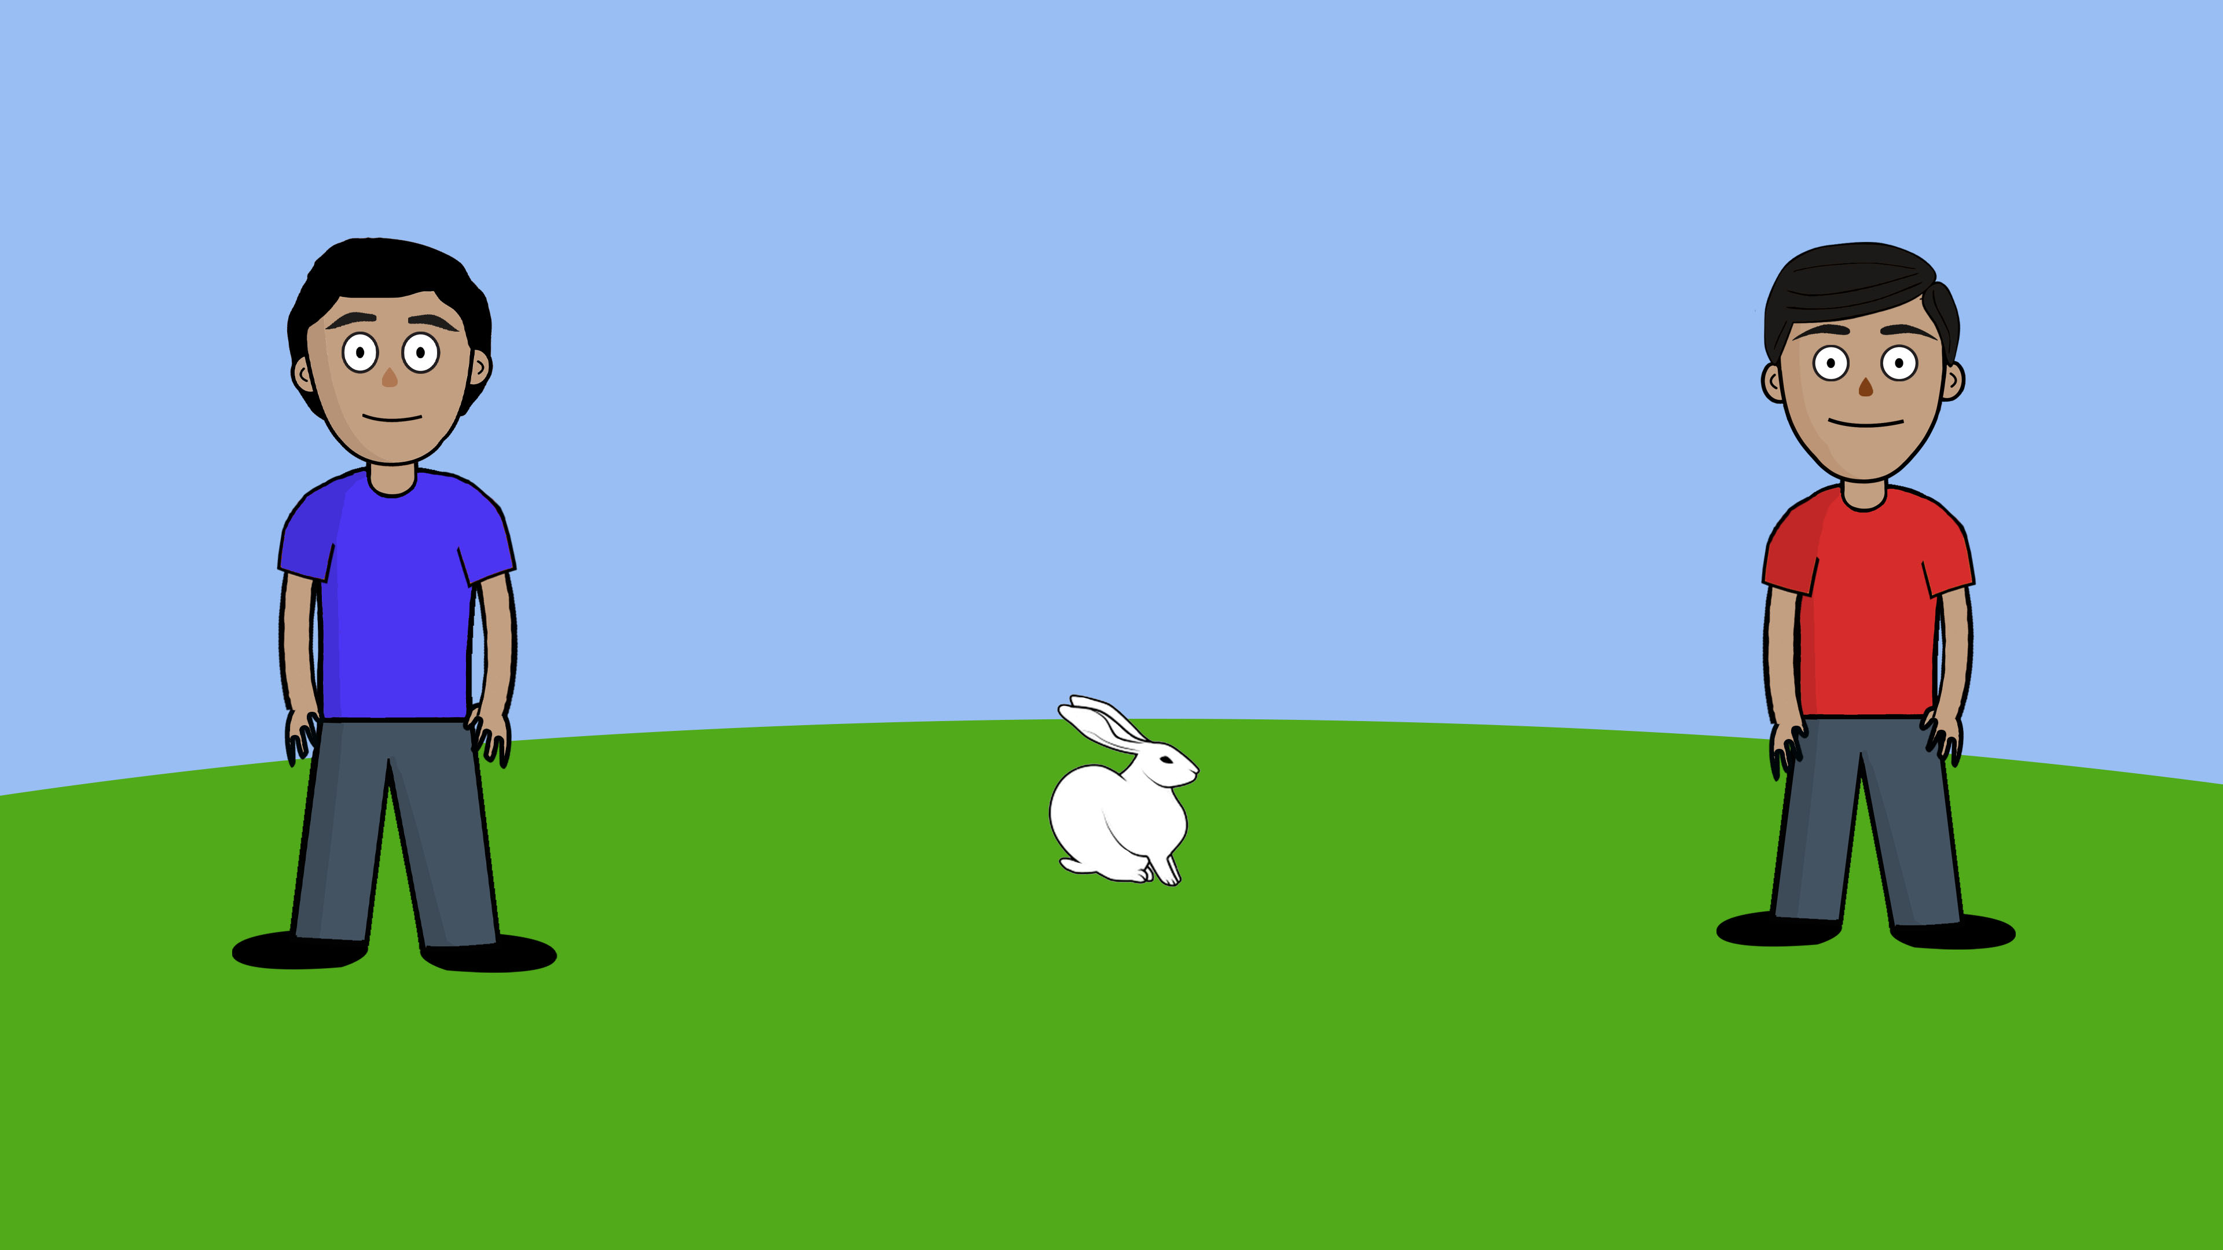
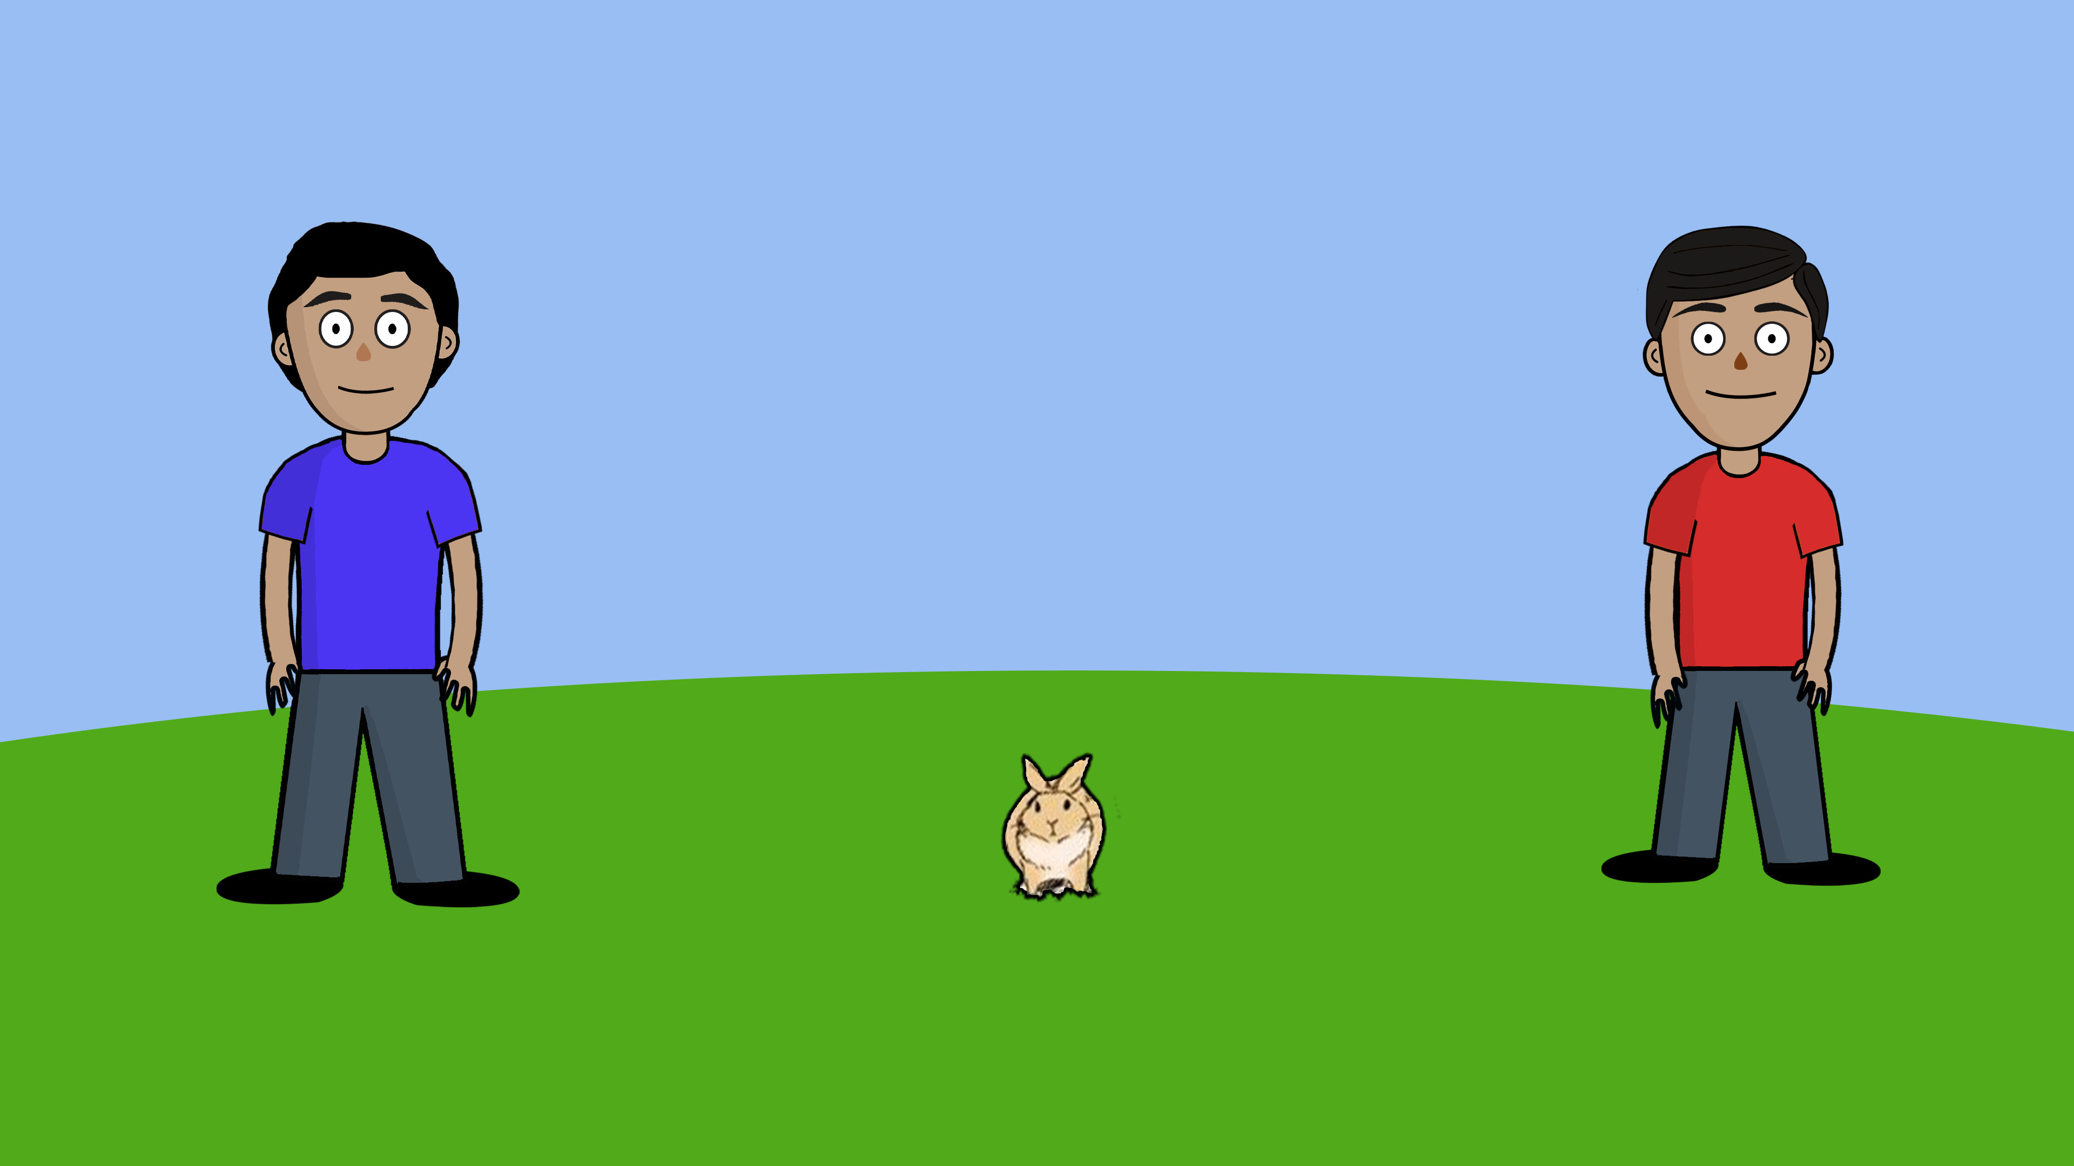
Notes:
*(Harold is blue, Devin is red)*
Hey [Child], I want you to meet two kids and their bunny. This is Devin. This is Harold. And this is their bunny (move cursor over bunny).

Slide 18
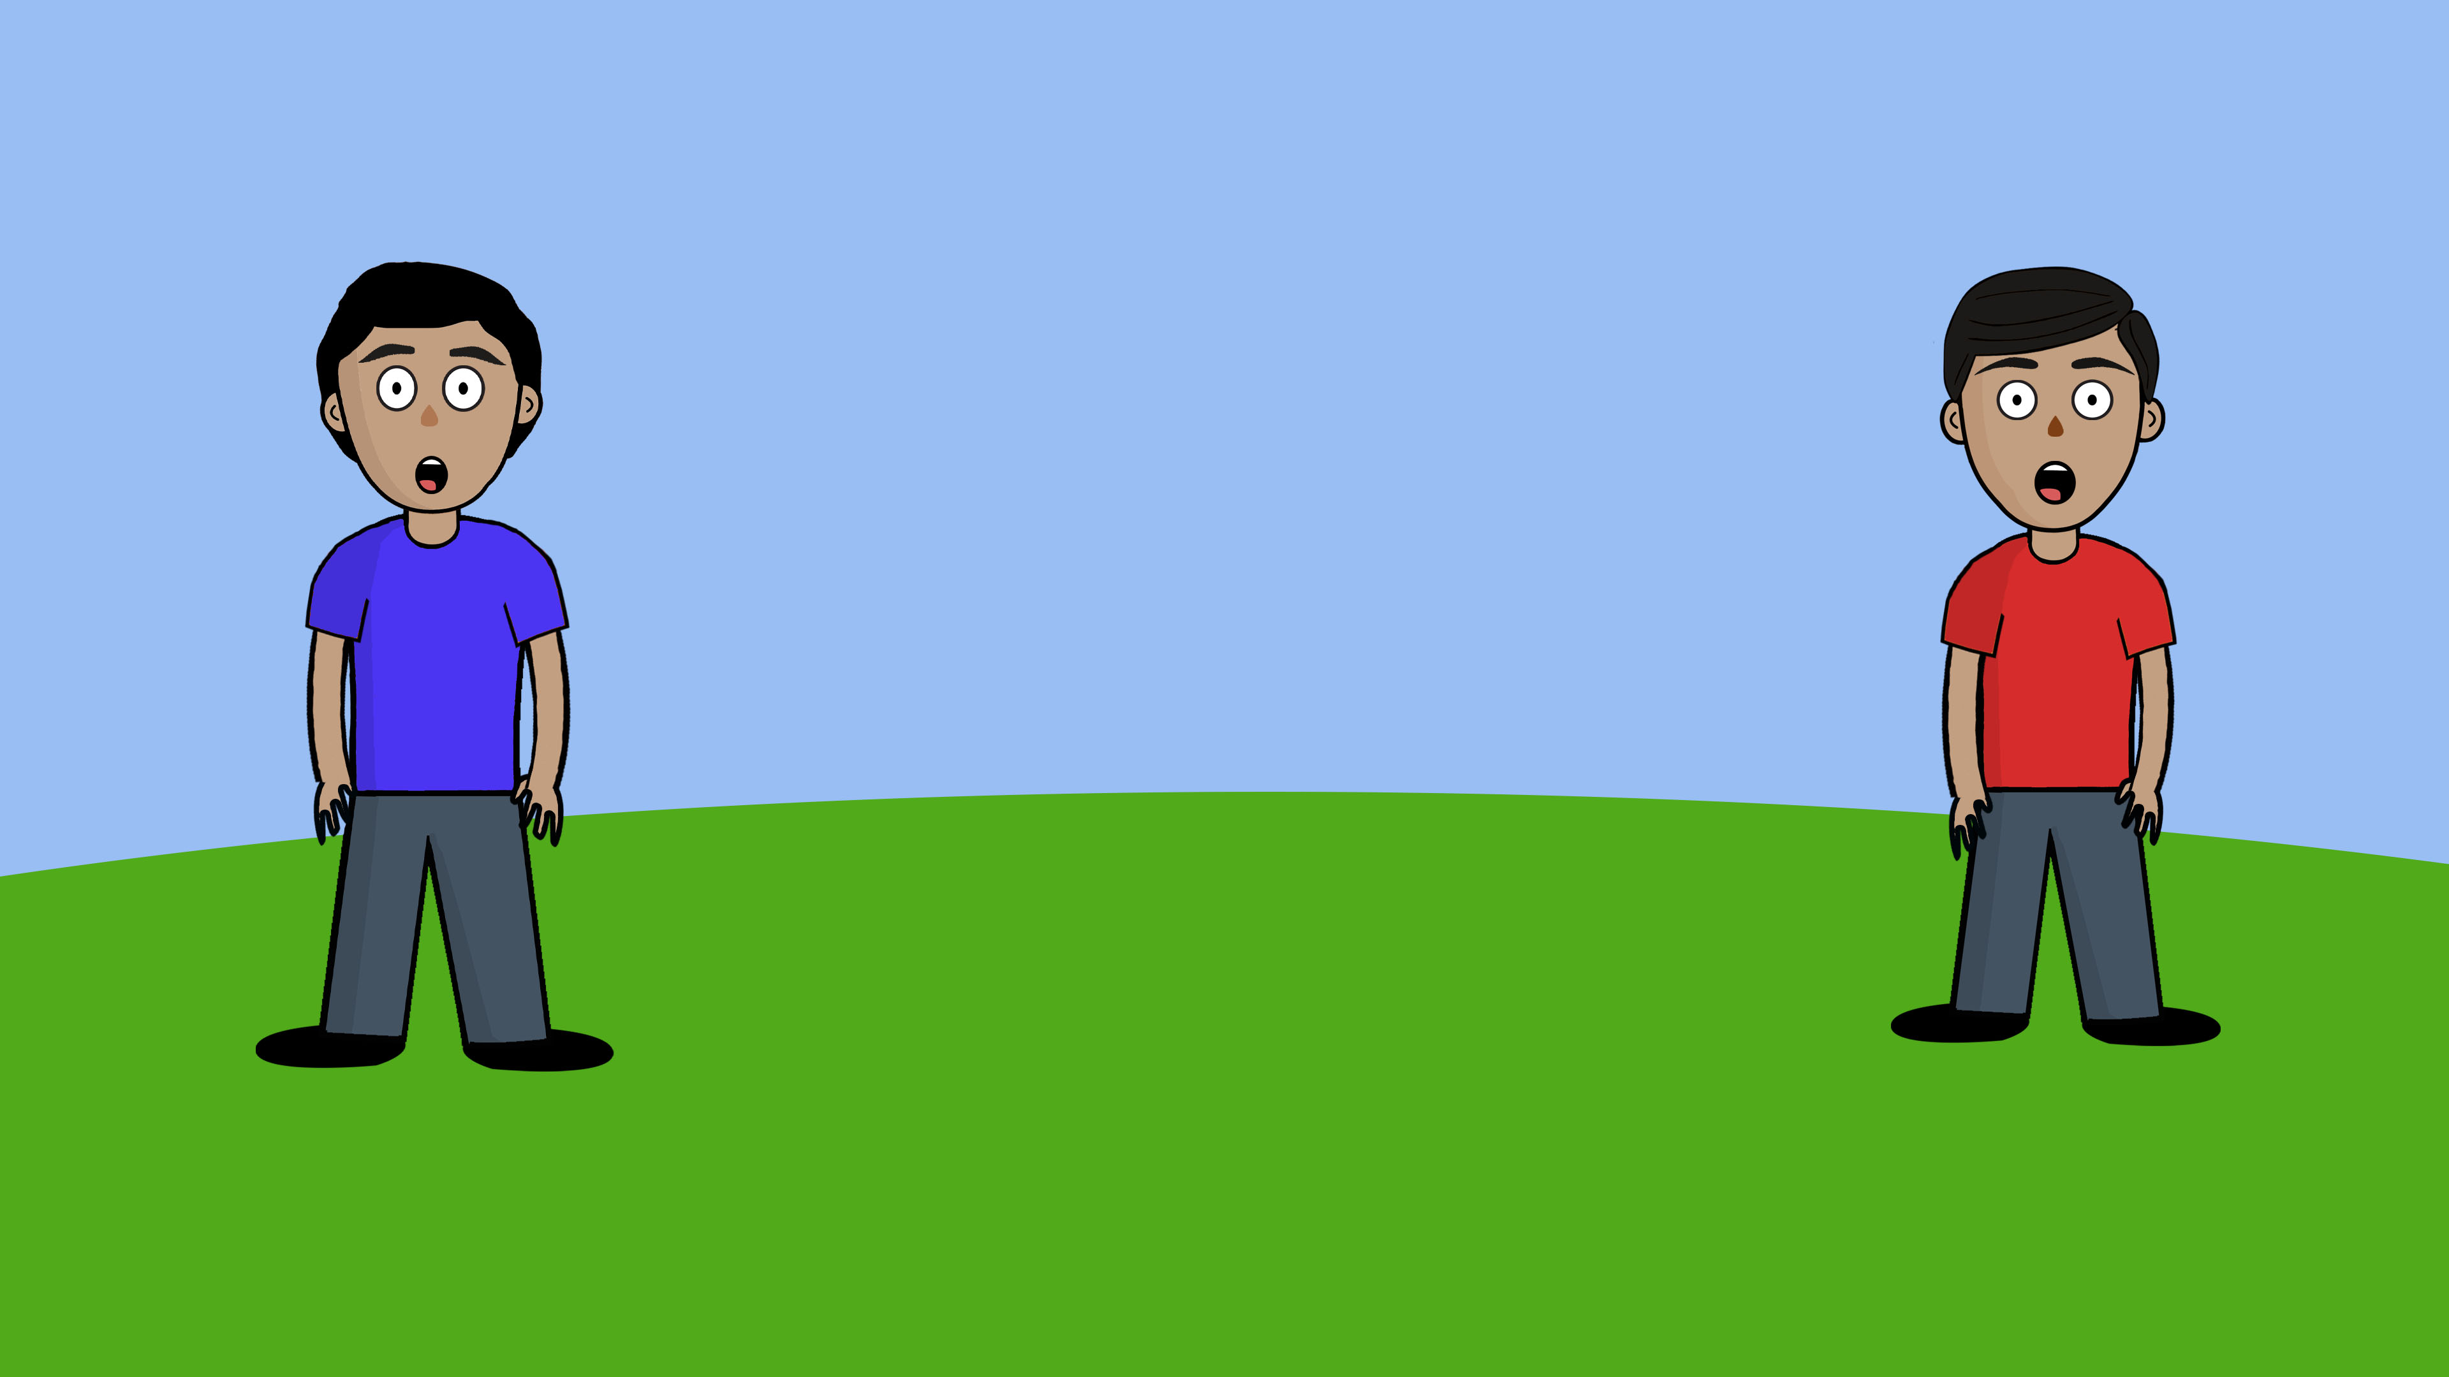
Notes:
*(Harold is blue, Devin is red)*
But guess what? The bunny has run away. So Harold and Devin are looking for their bunny.

Slide 19
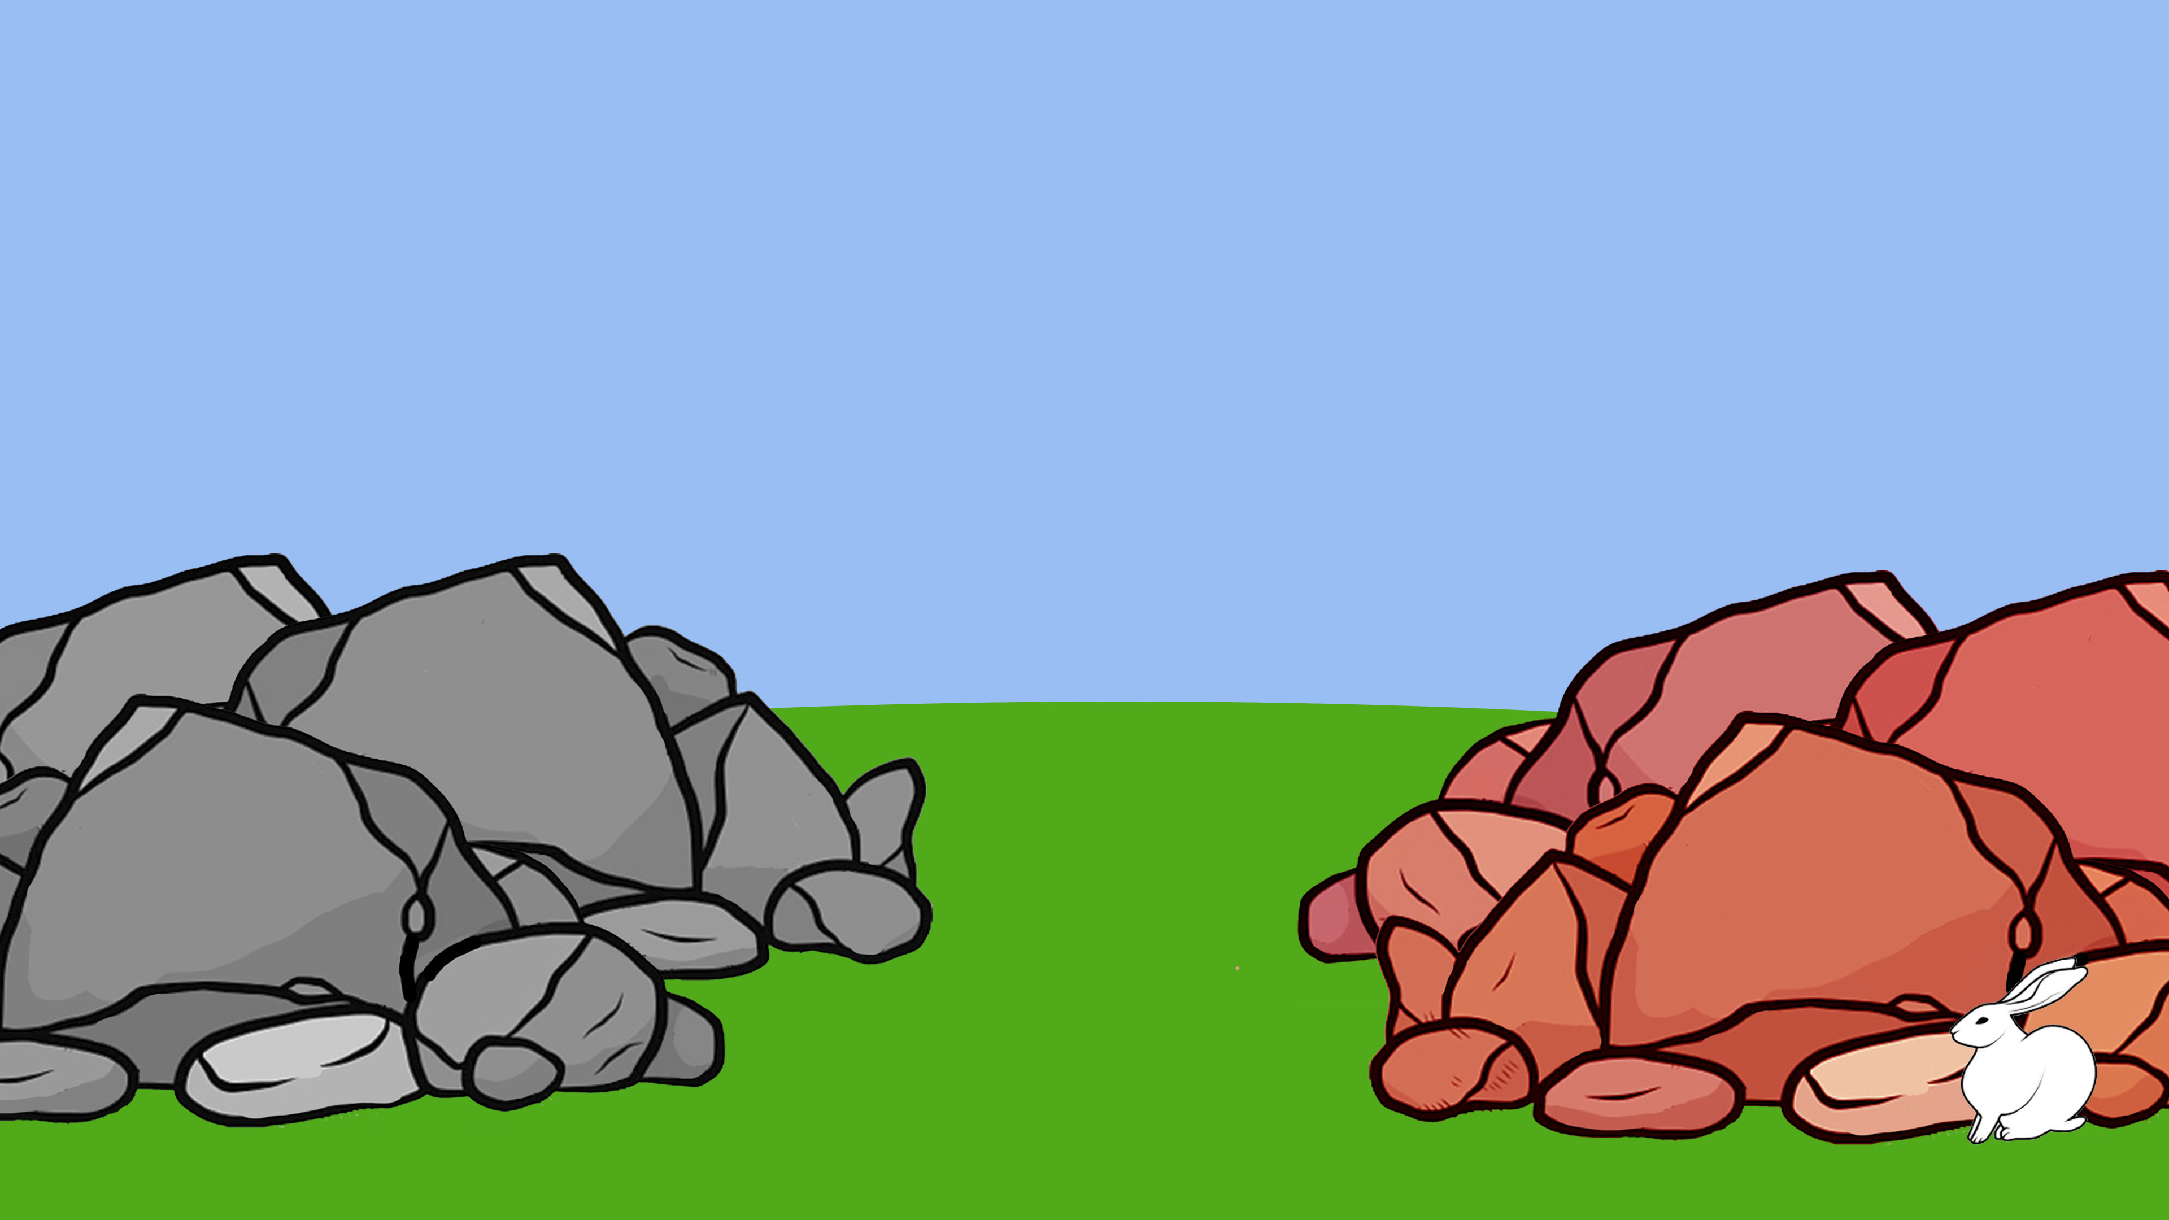
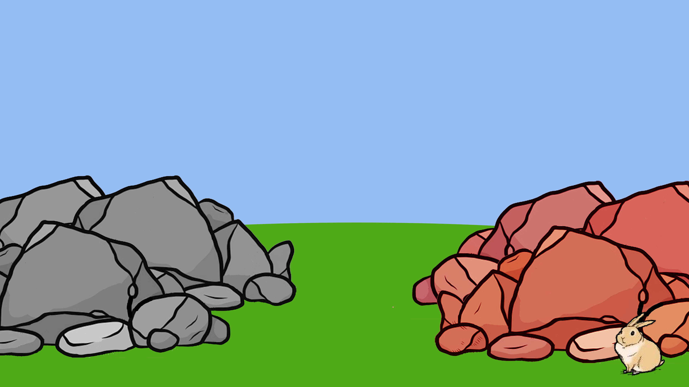
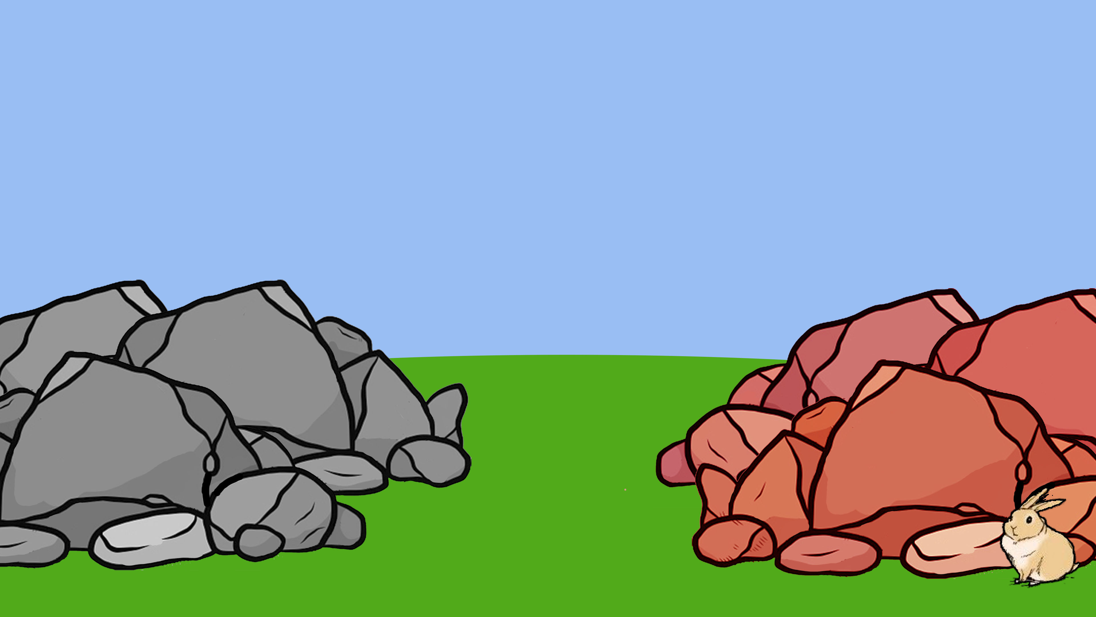
Notes:
Look! The bunny is behind the red stones. And there are grey stones over there.

Slide 20
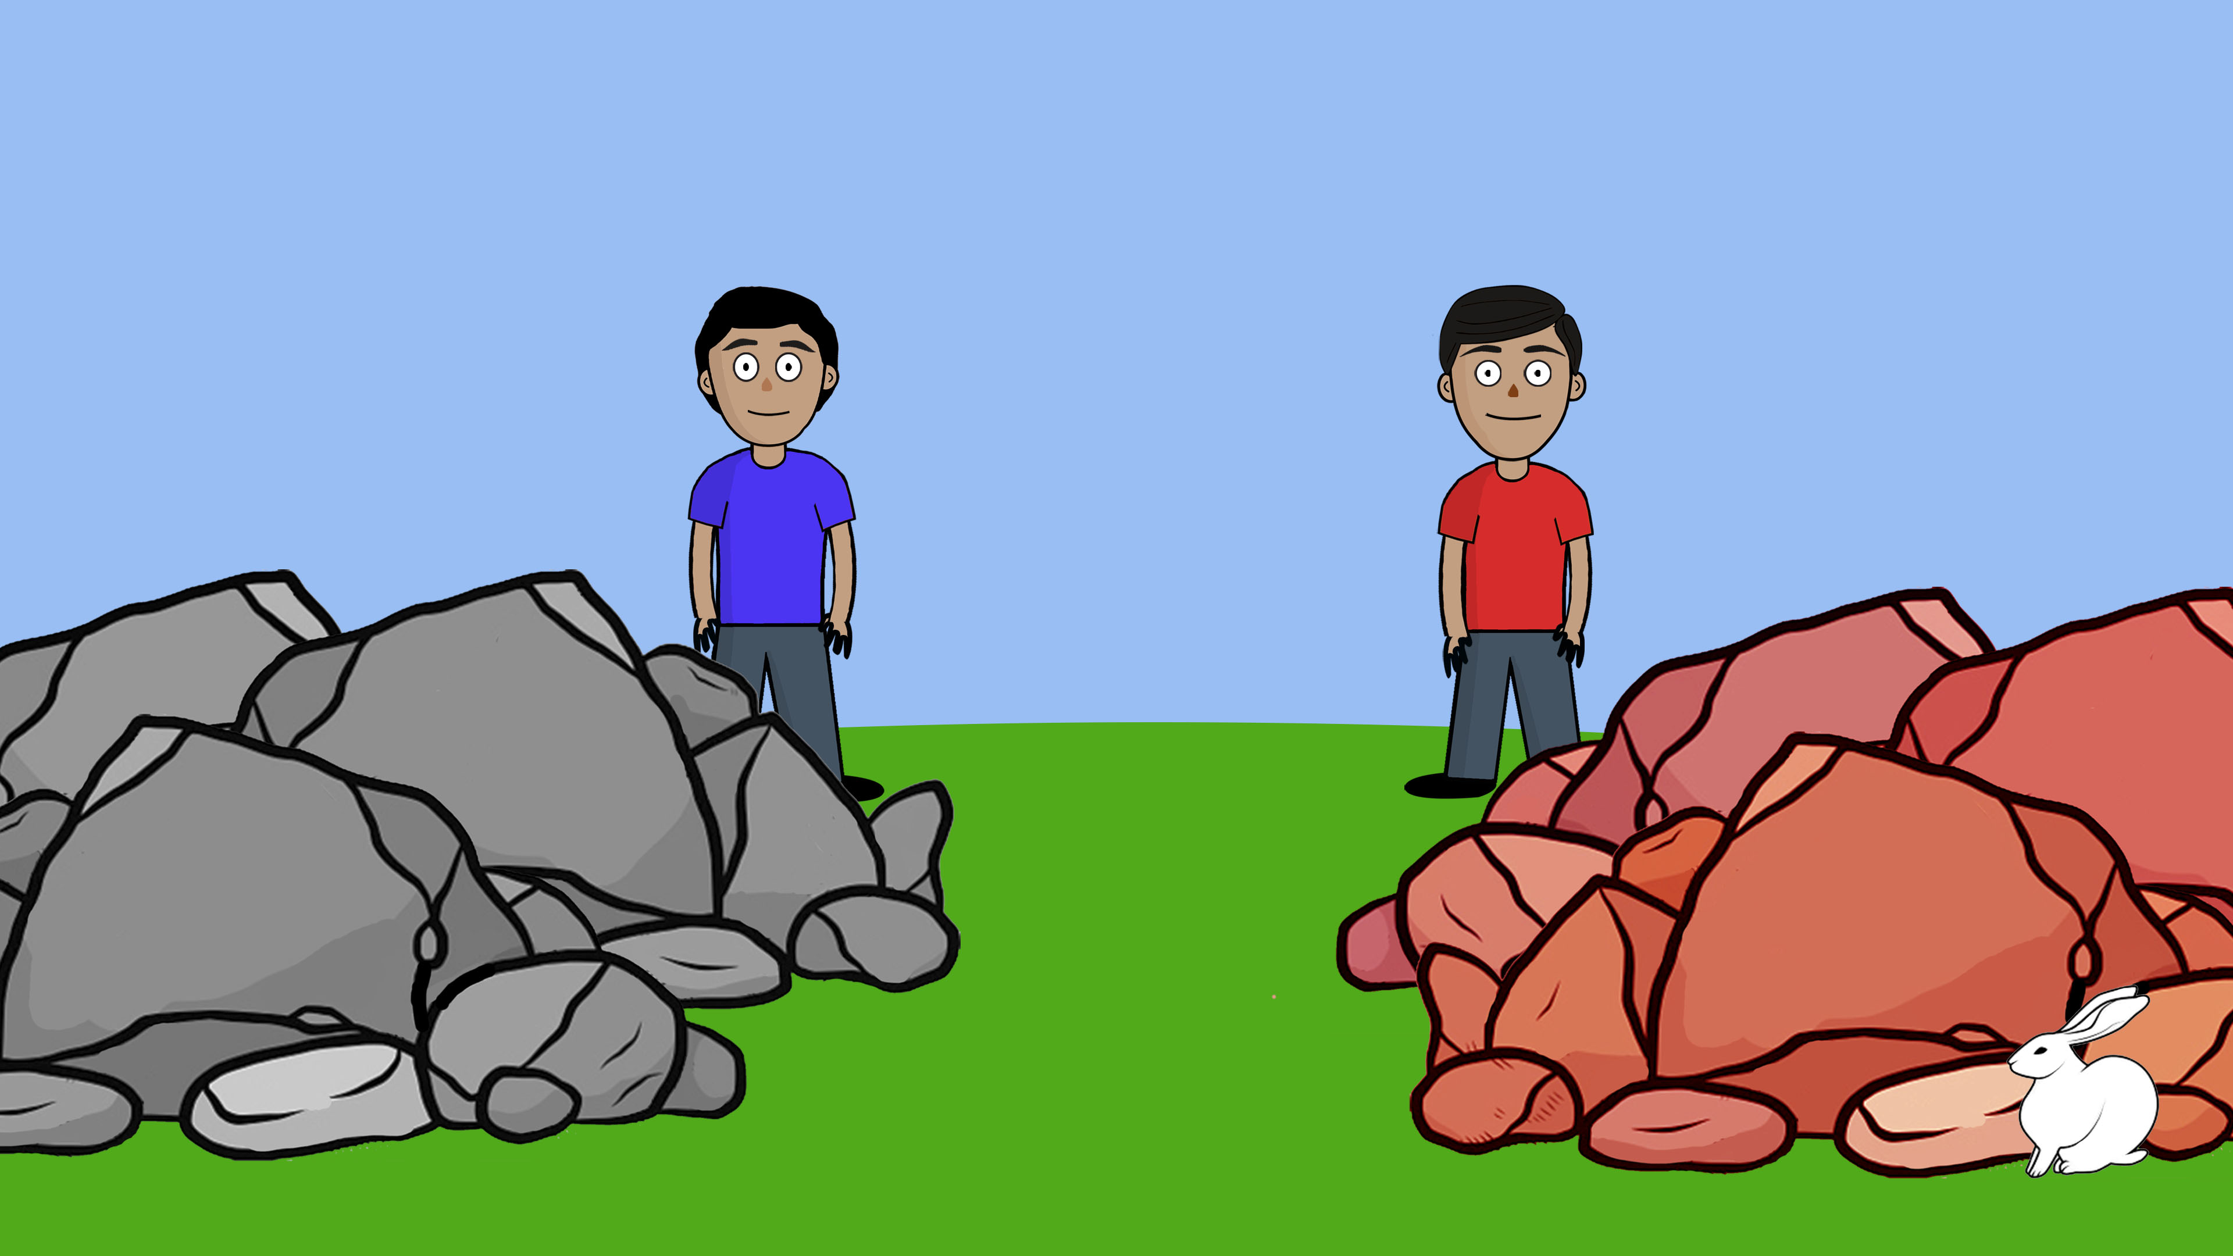
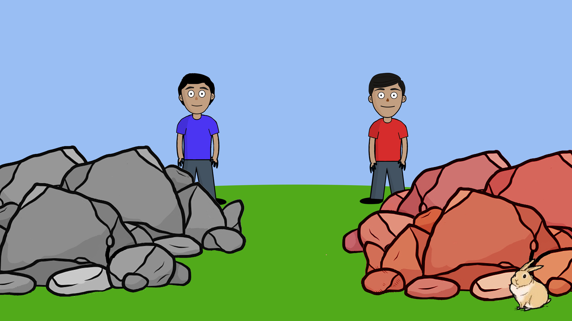
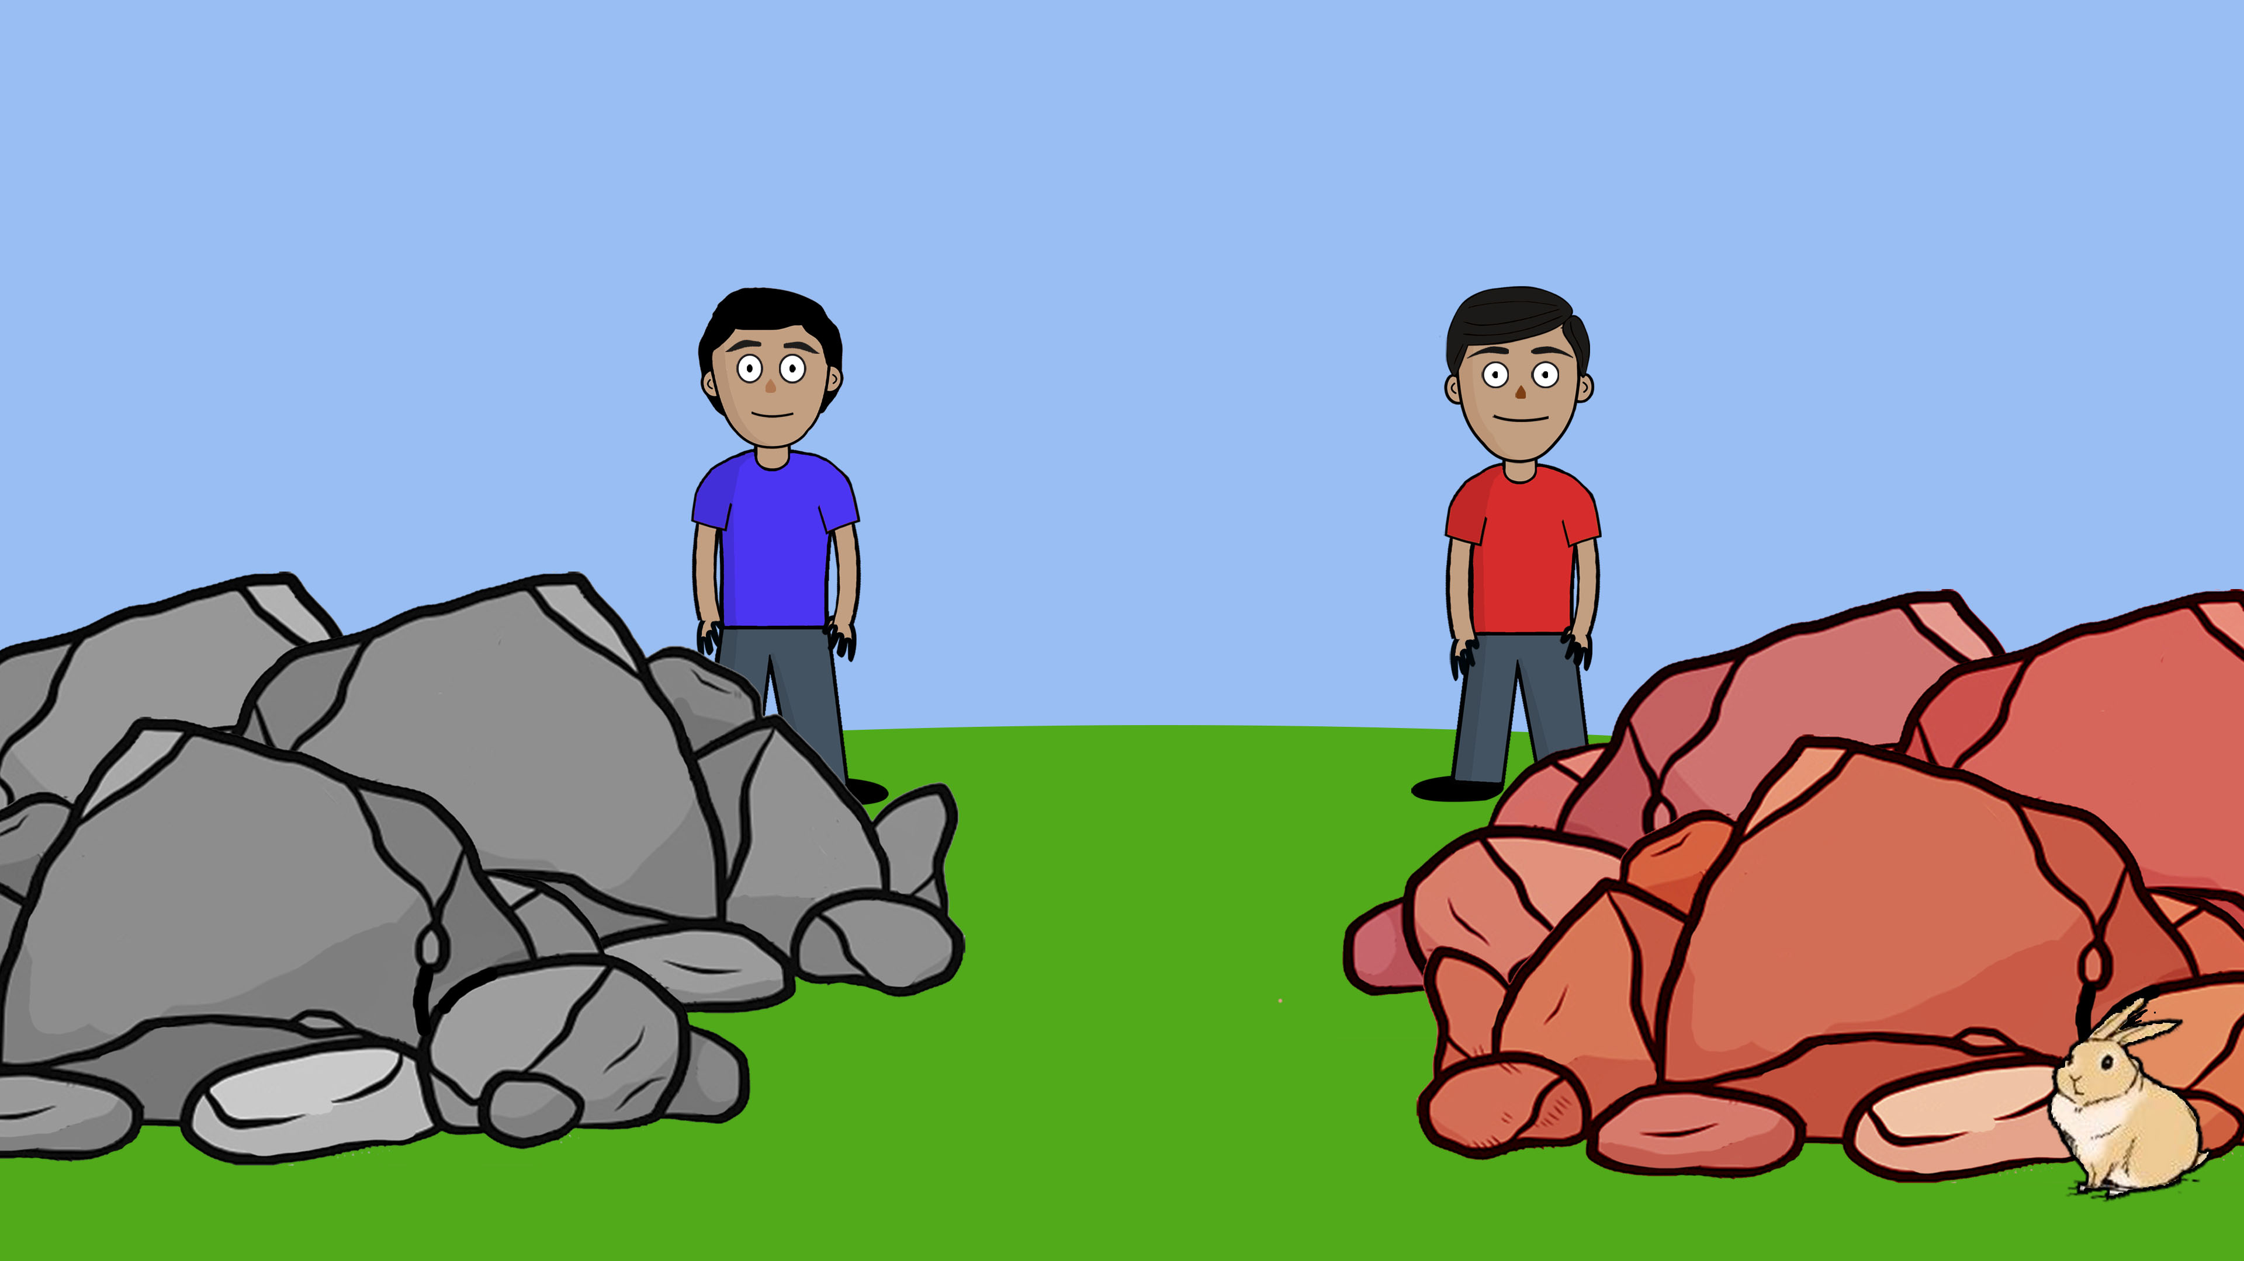
Notes:
*(Harold is blue, Devin is red)*
Here are Harold and Devin, looking for their bunny. They cannot see where their bunny is hiding. So they are trying to figure out whether the bunny is hiding behind the grey stones or behind the red stones.
First, Devin is trying to figure out where the bunny is hiding. Devin says: I don’t know where the bunny is hiding, but maybe I can find the bunny if I close my eyes and go eenie meenie minie mo.

Slide 21
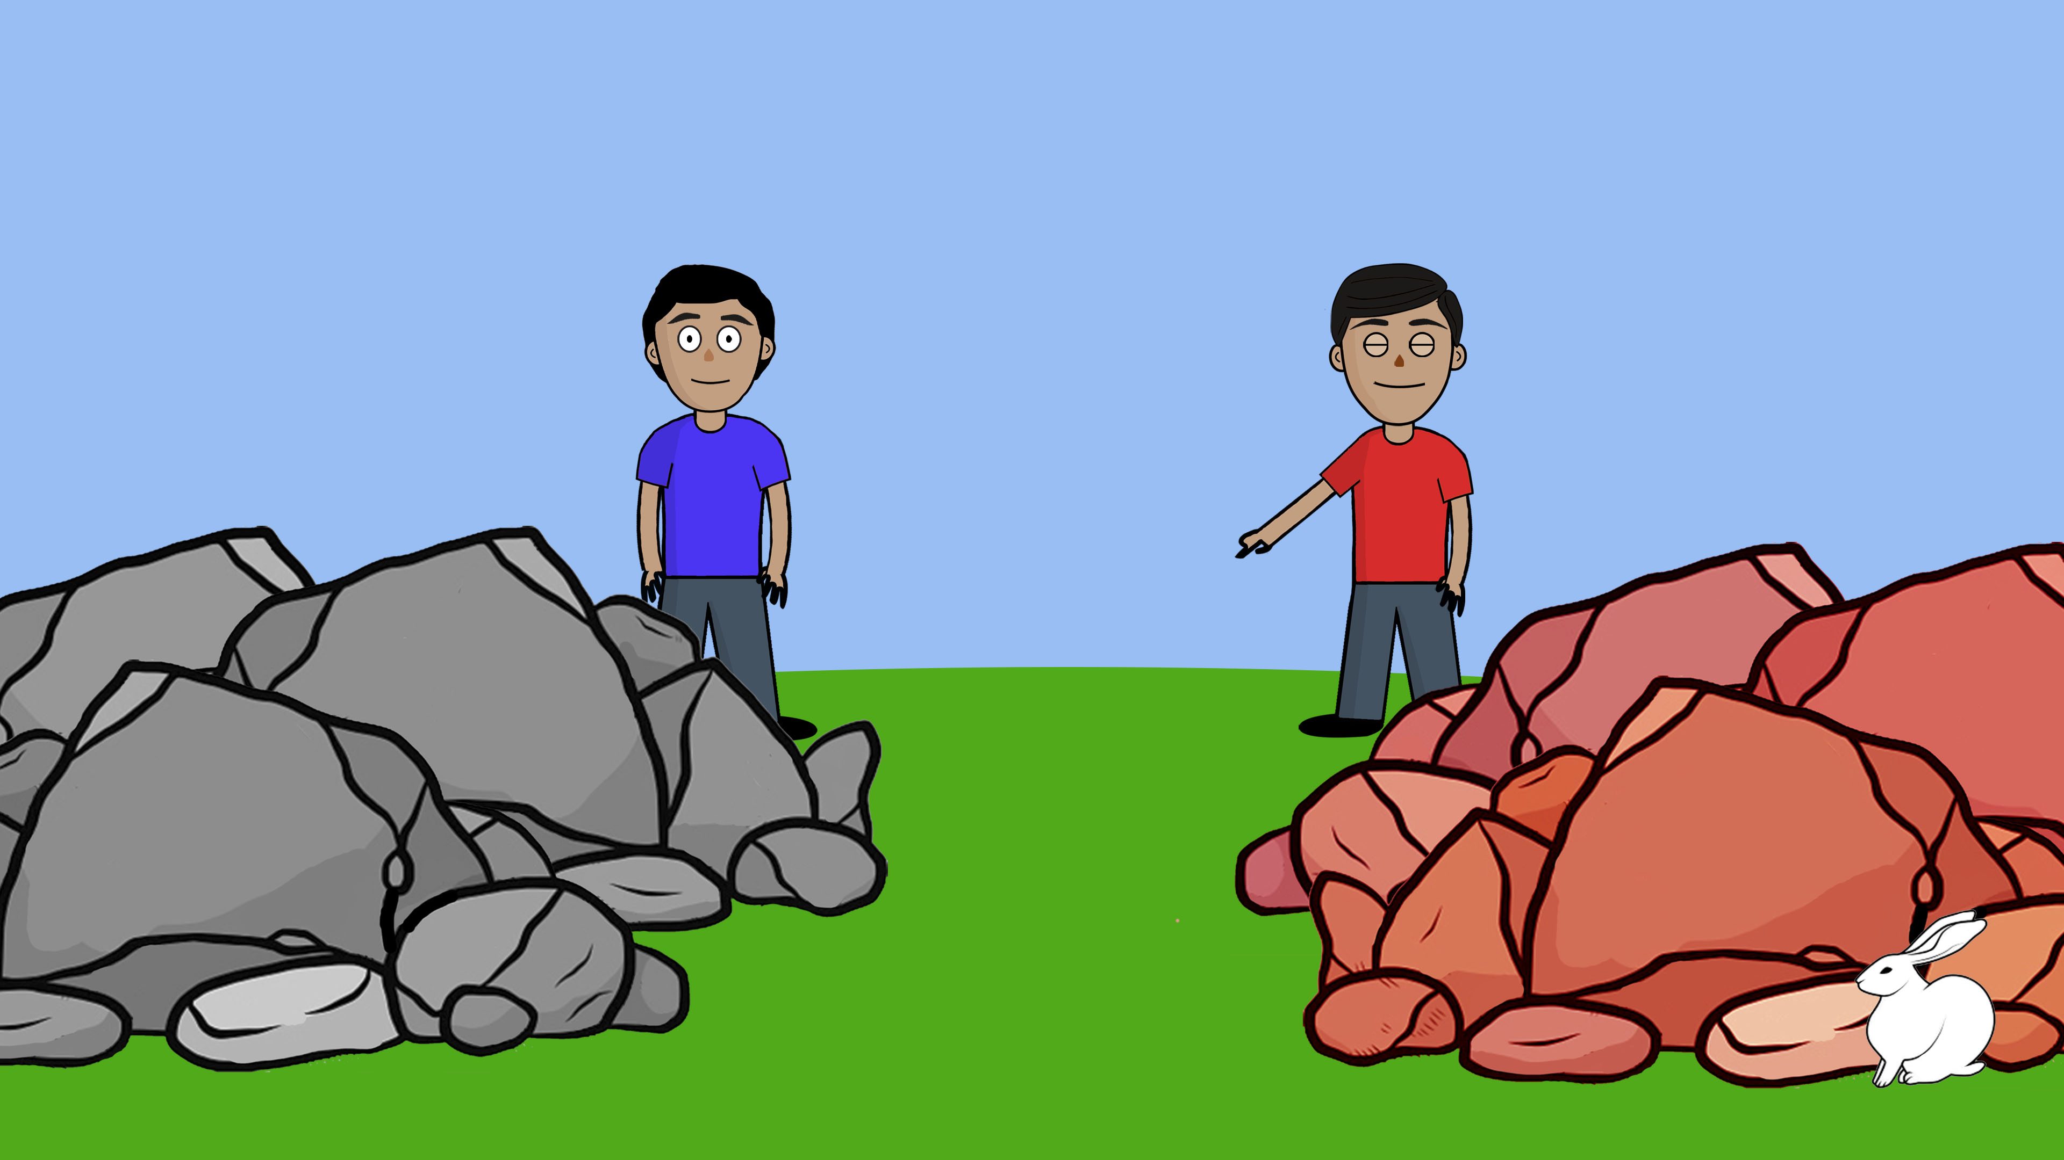


Notes:
Eenie…

Slide 22
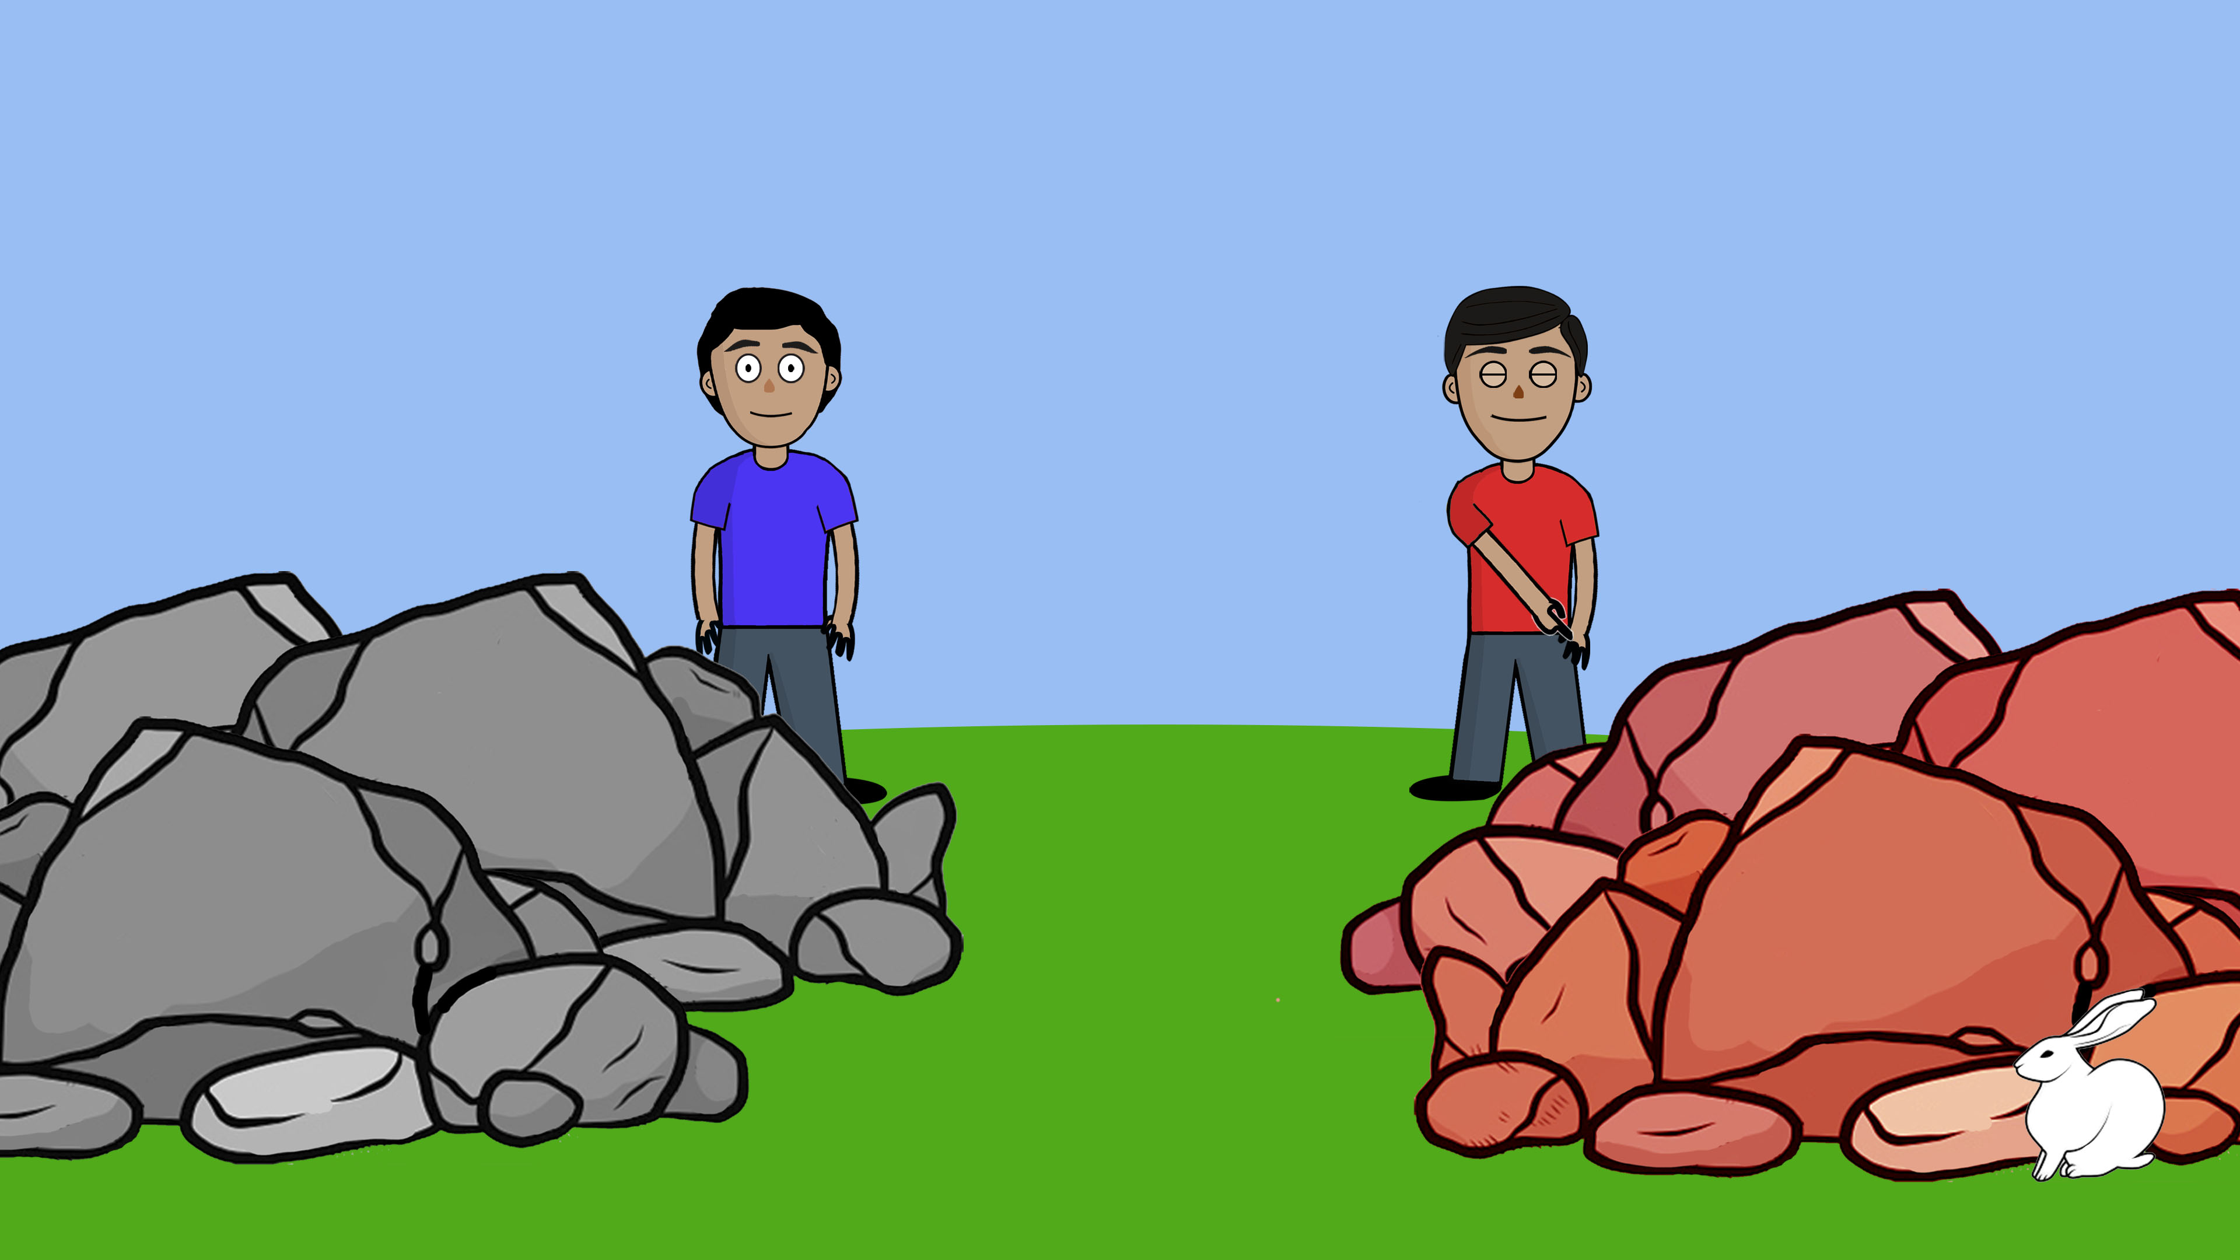
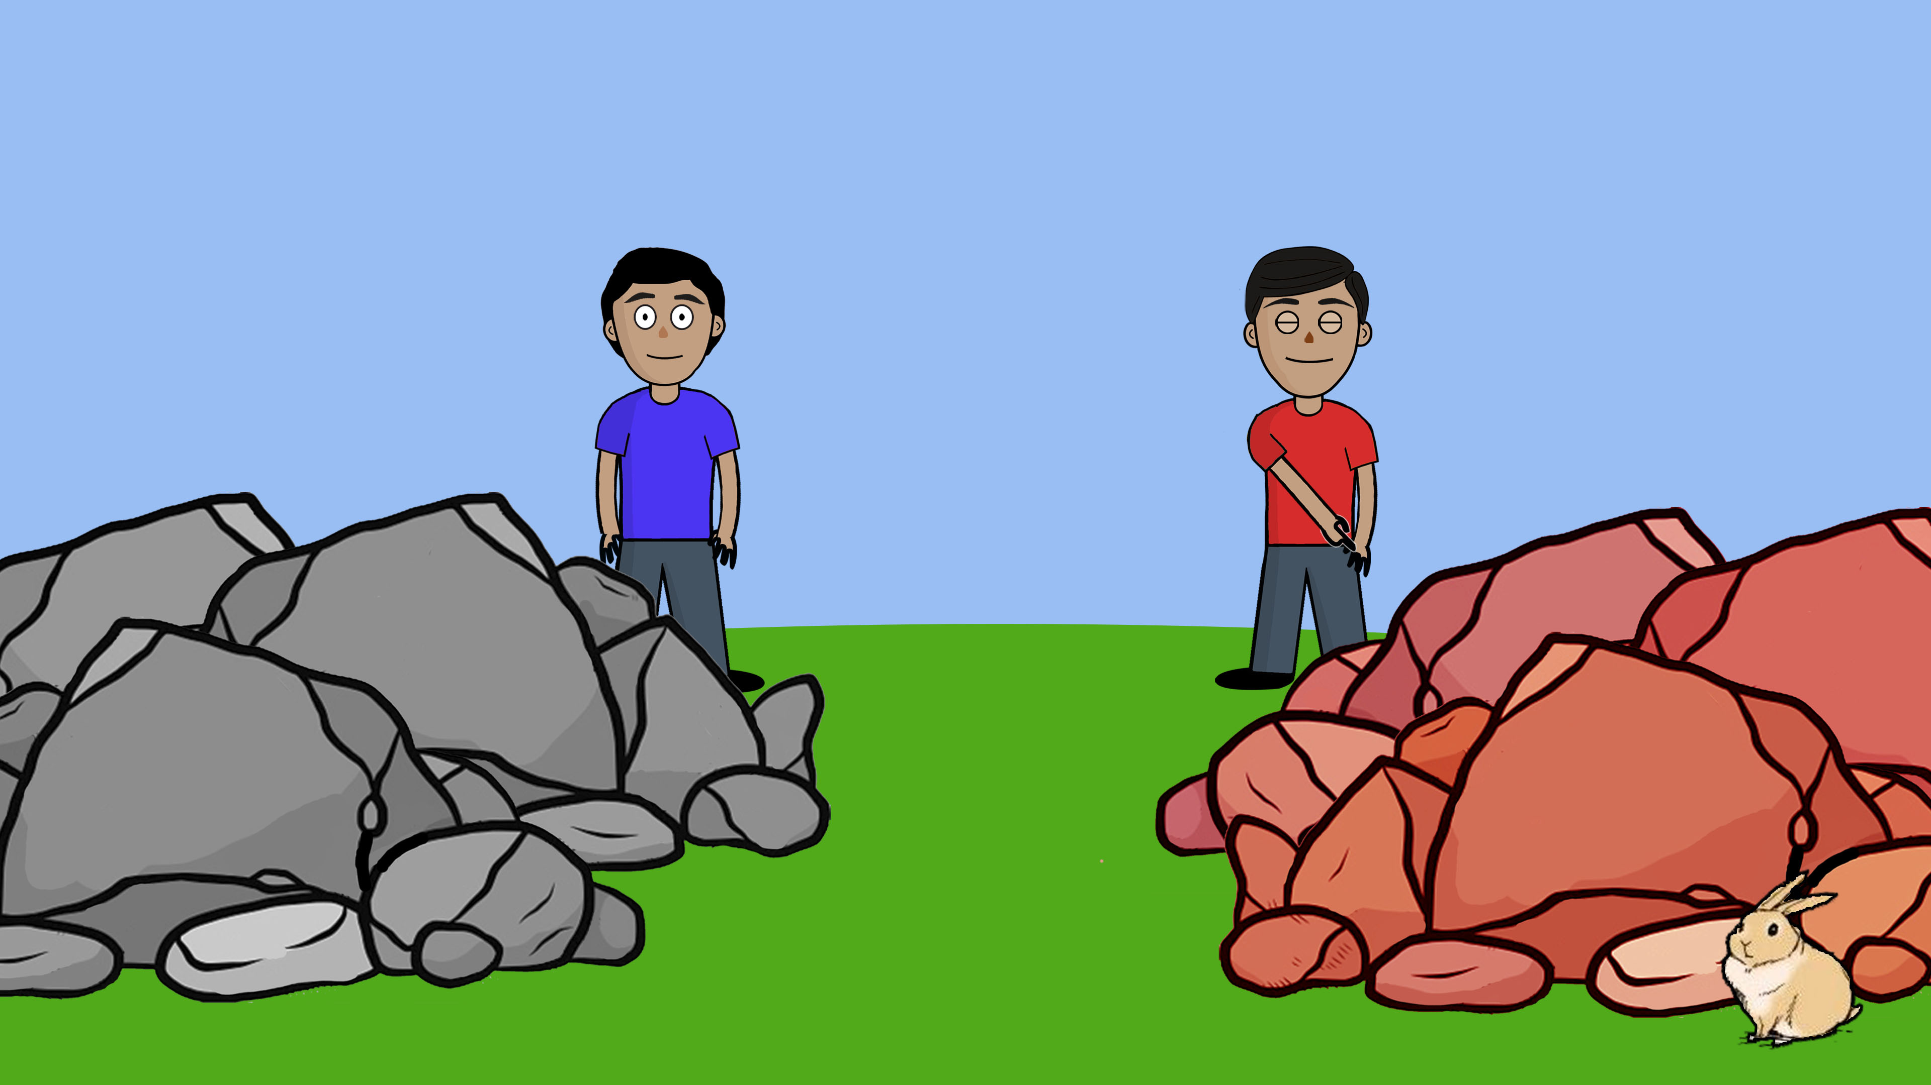
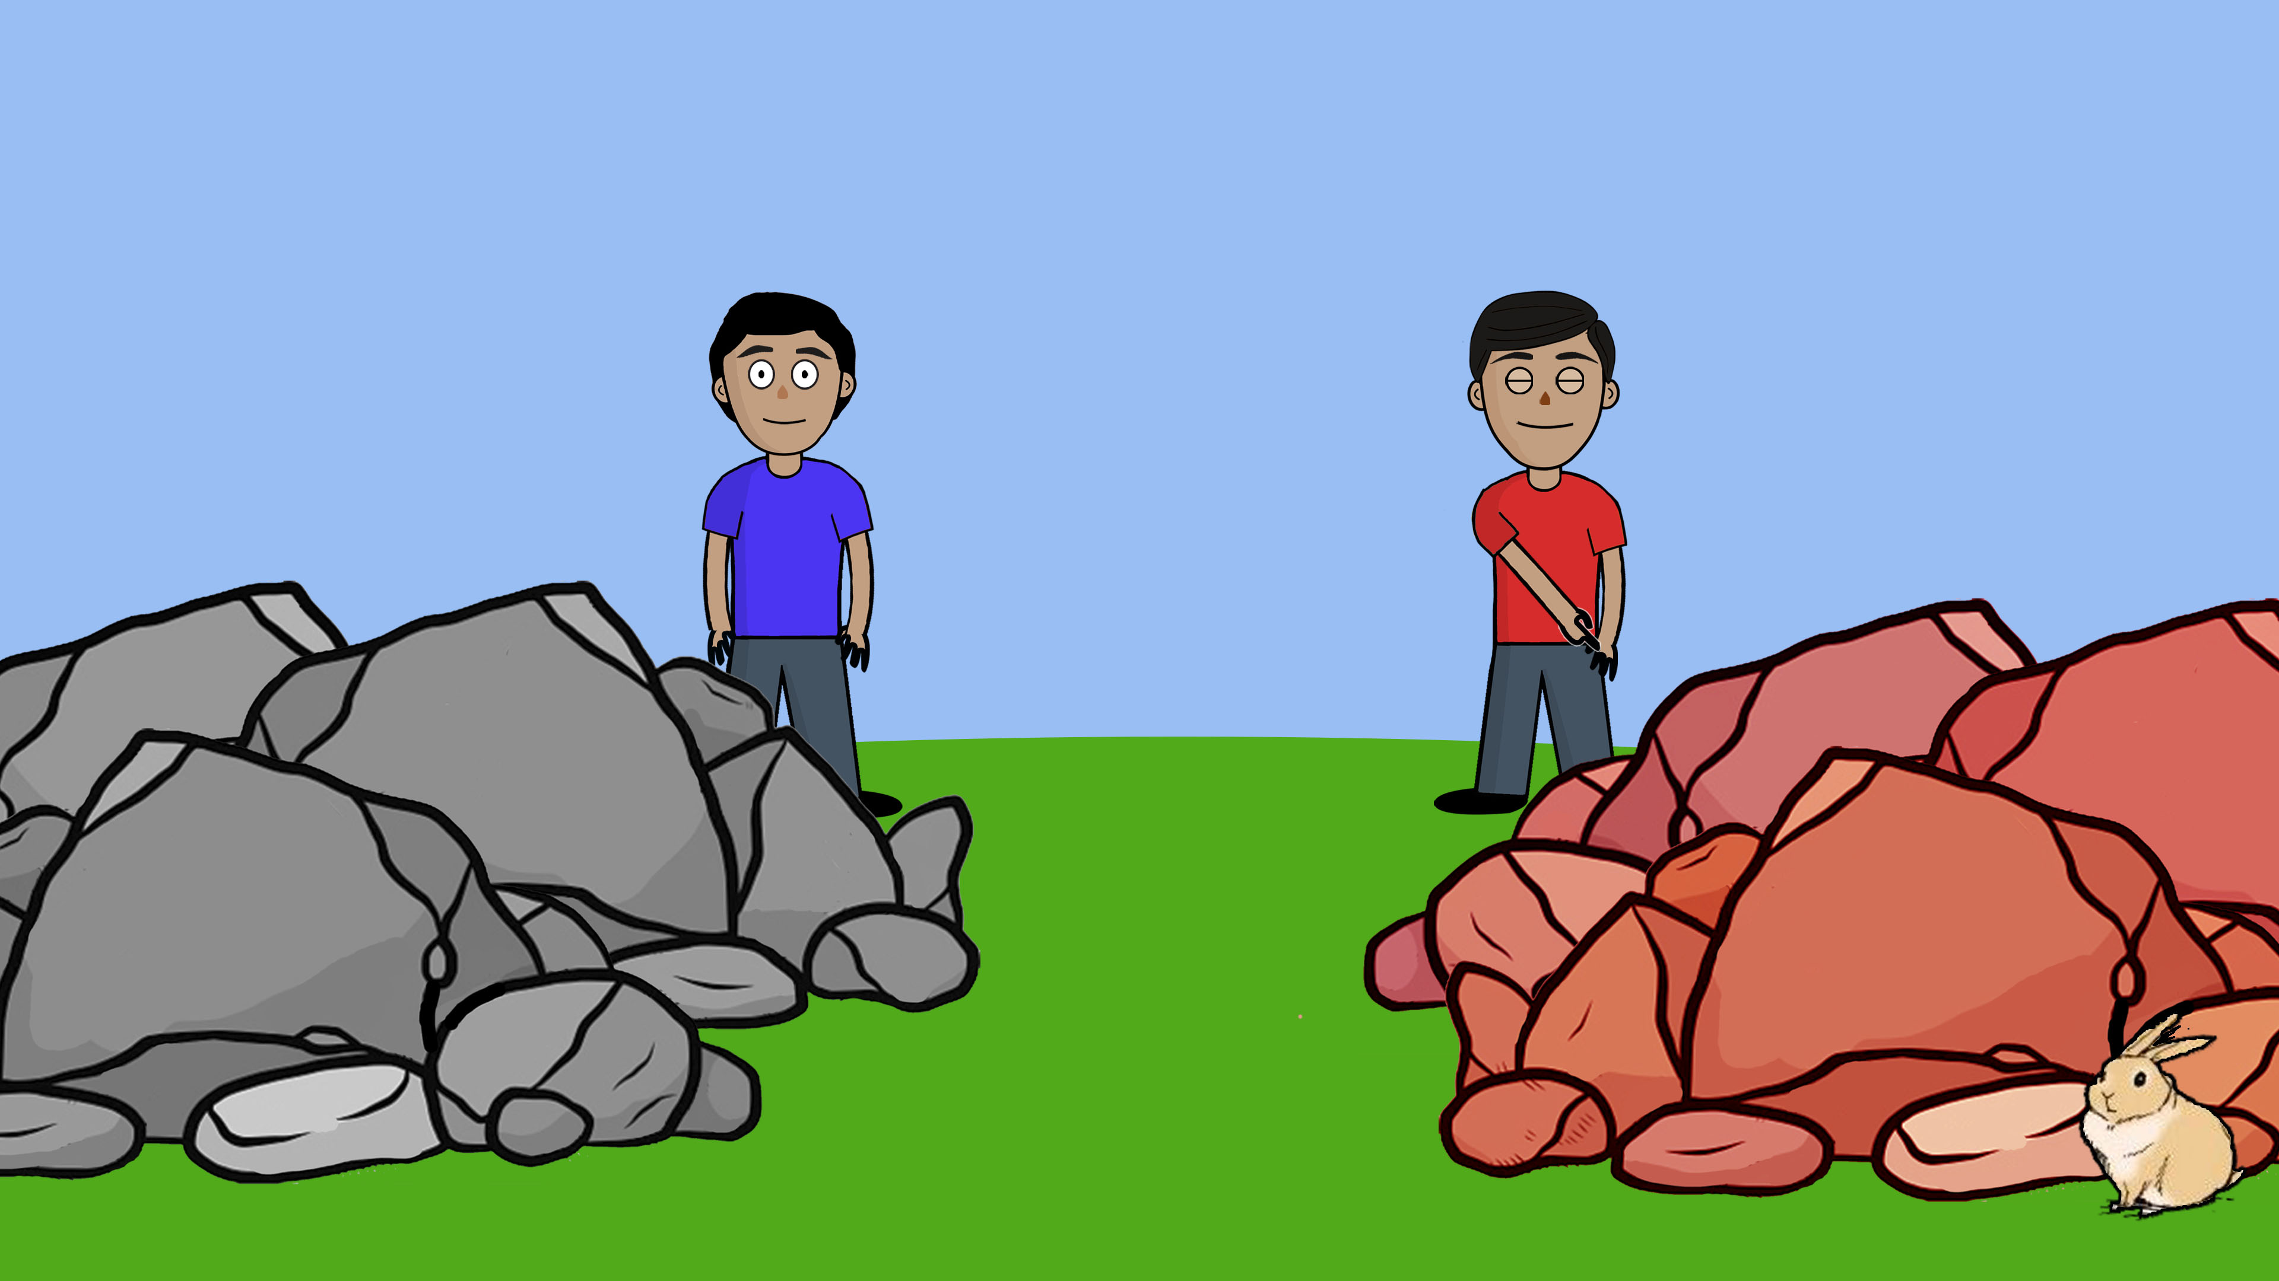
Notes:
Meenie…

Slide 23
Notes:
Minie….

Slide 24
Notes:
Mo…

Slide 25
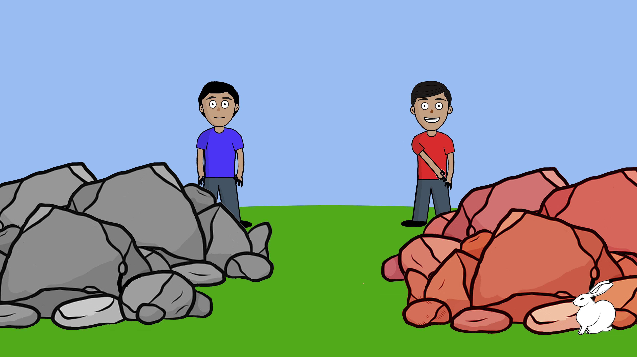
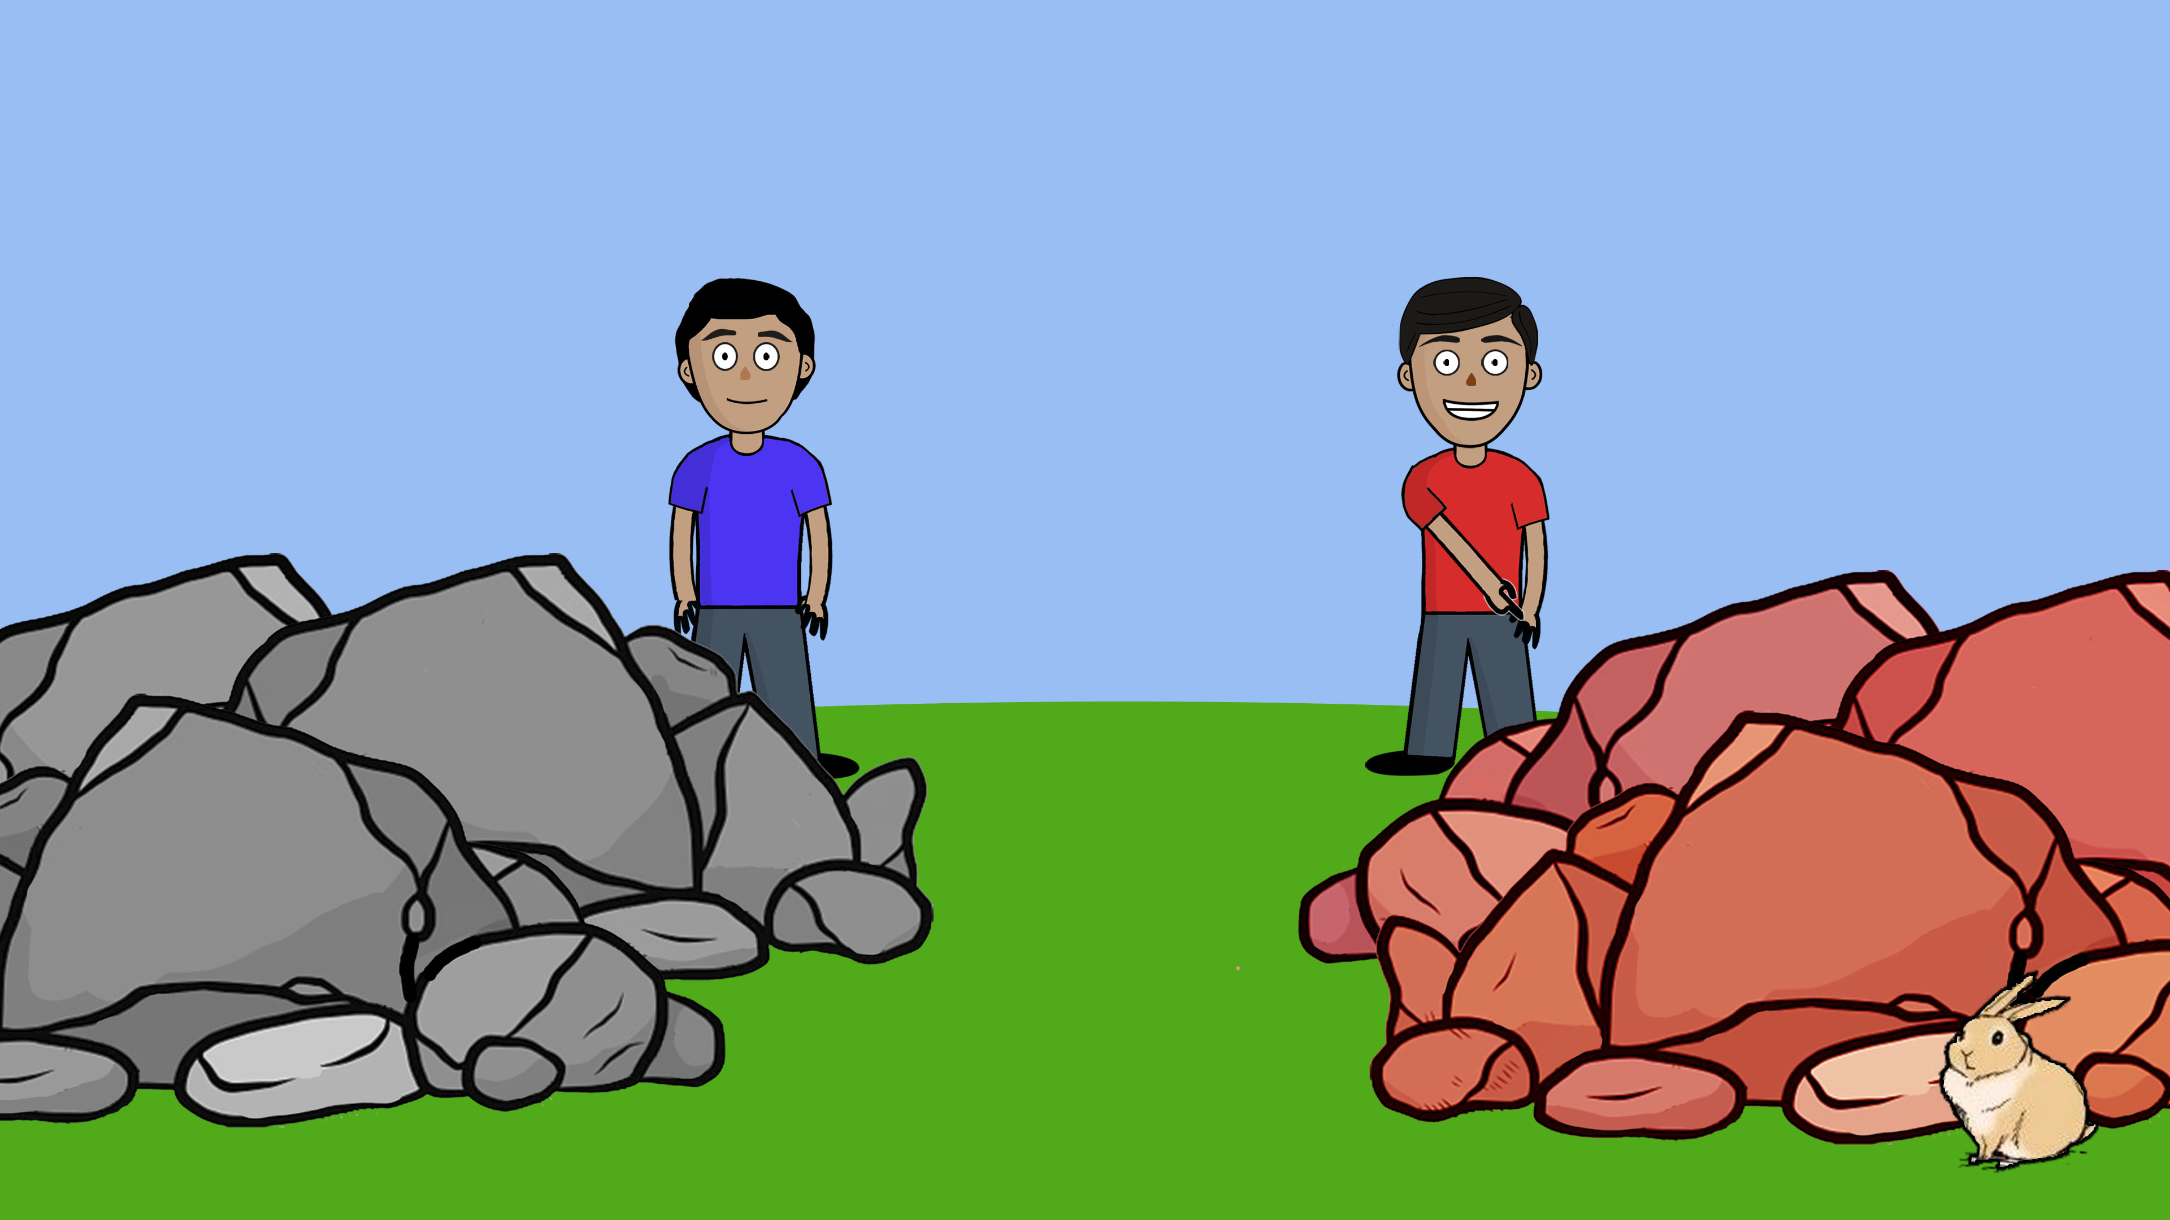

Notes:
Devin says: I think the bunny is hiding behind the red stones.
-break-
So Devin thinks that the bunny is hiding behind the red stones.

Slide 26
Notes:
*(Harold is blue, Devin is red)*
Now Harold is trying to figure out where the bunny is hiding. Harold says: I don’t know where the bunny is hiding, but maybe I can find the bunny if I close my eyes and go eenie, meenie, minie, mo.

Slide 27
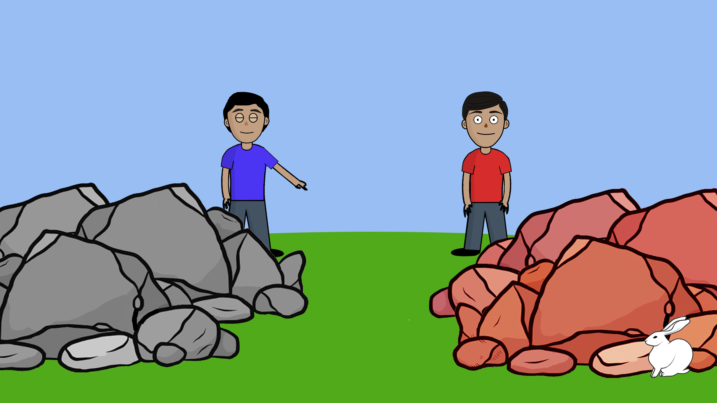
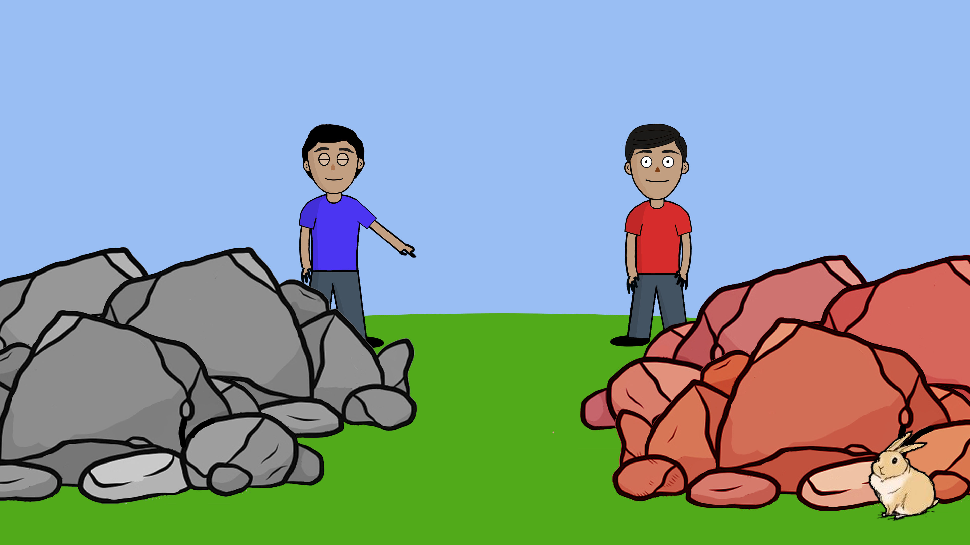

Notes:
Eenie …

Slide 28

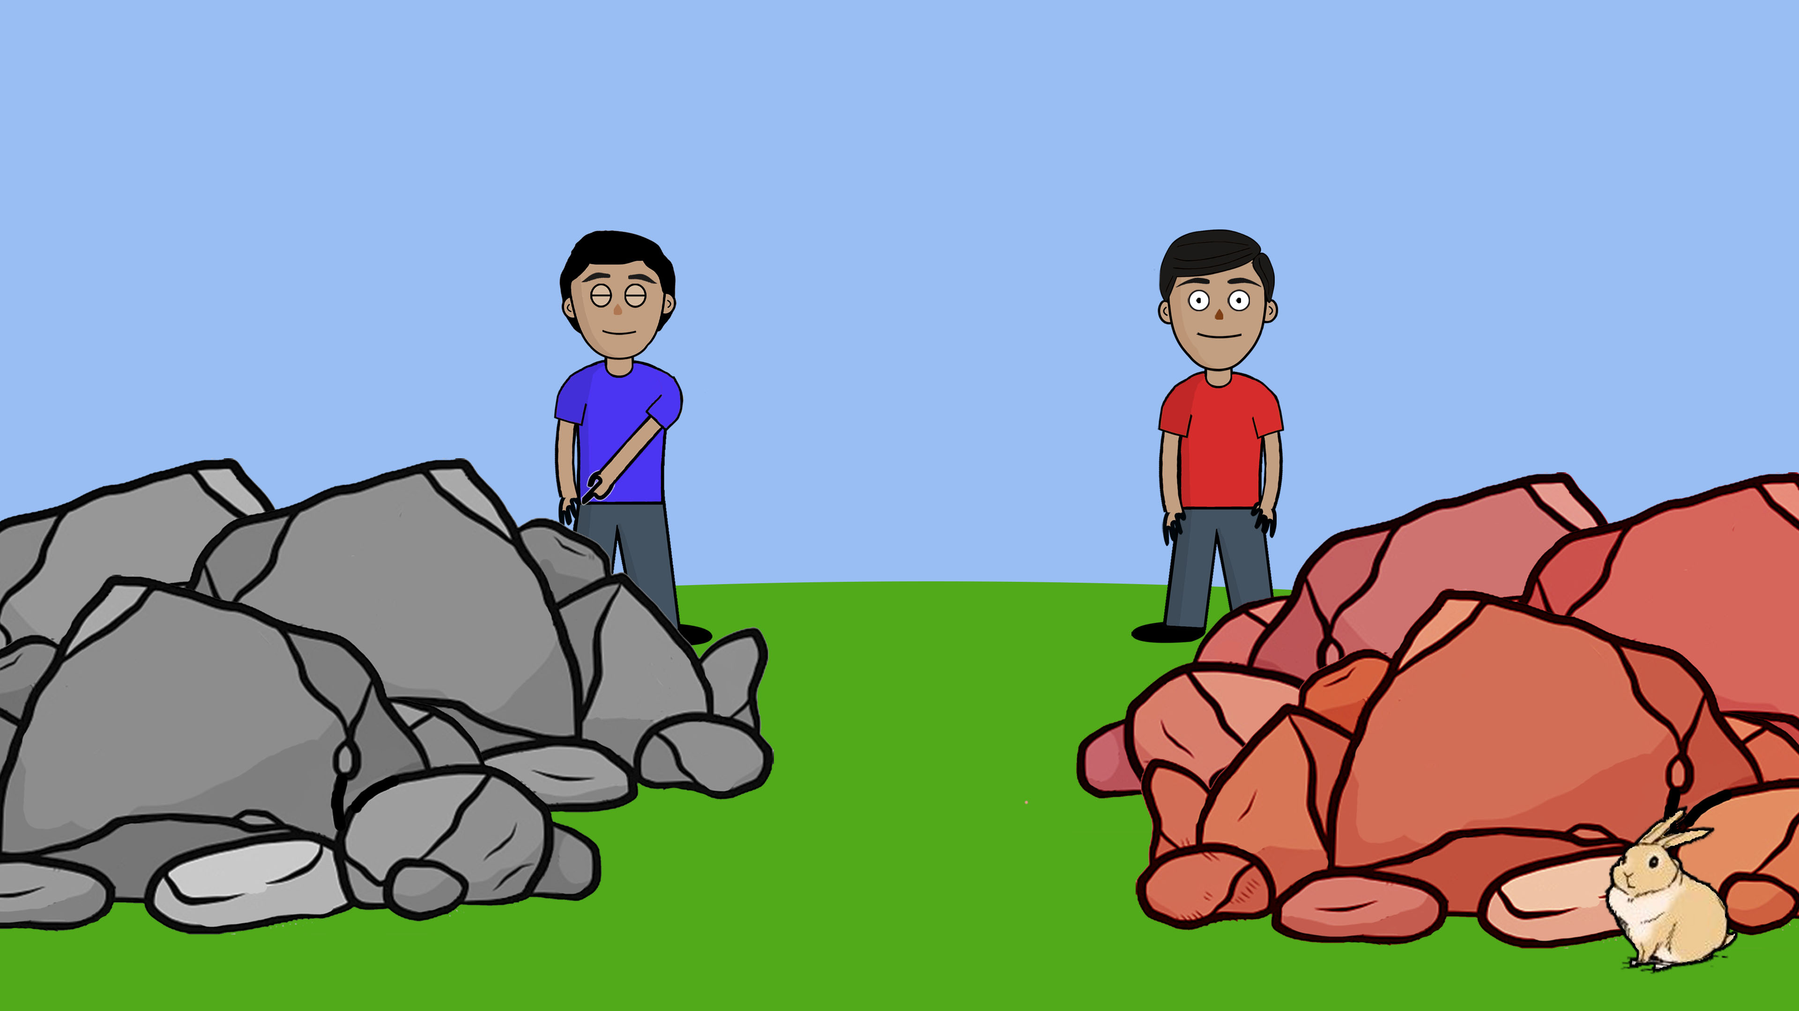
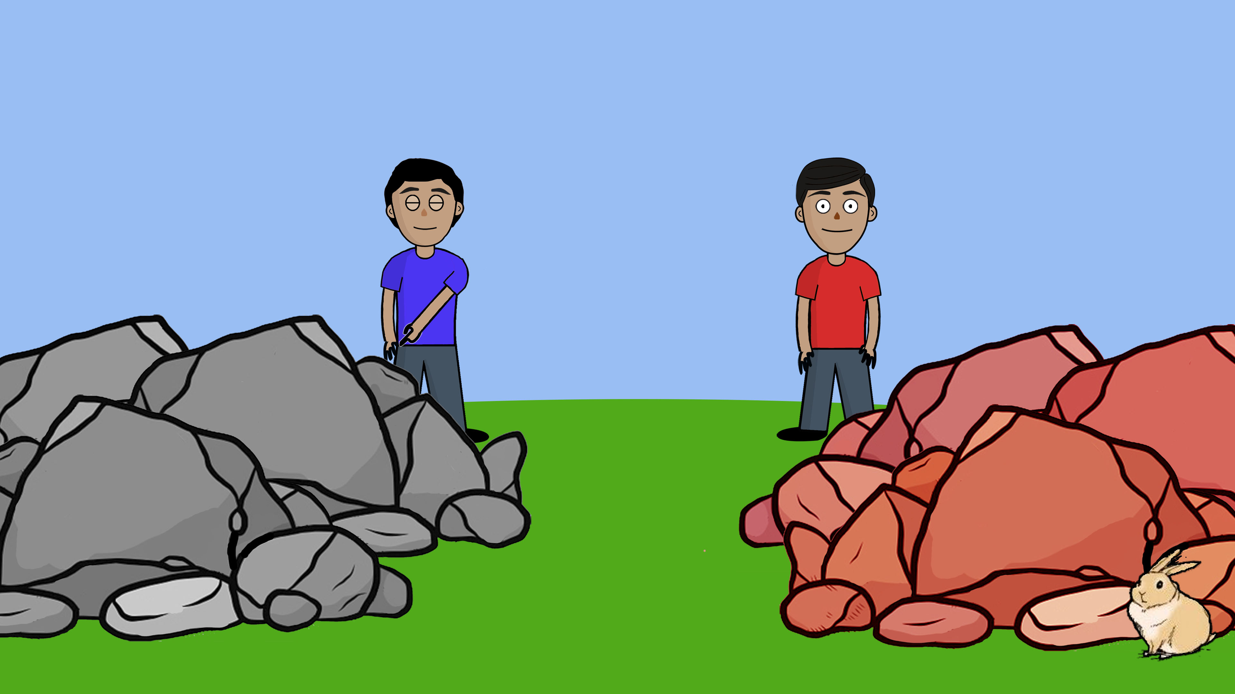
Notes:
Meenie ….

Slide 29
Notes:
Minie…

Slide 30
Notes:
Mo …

Slide 31

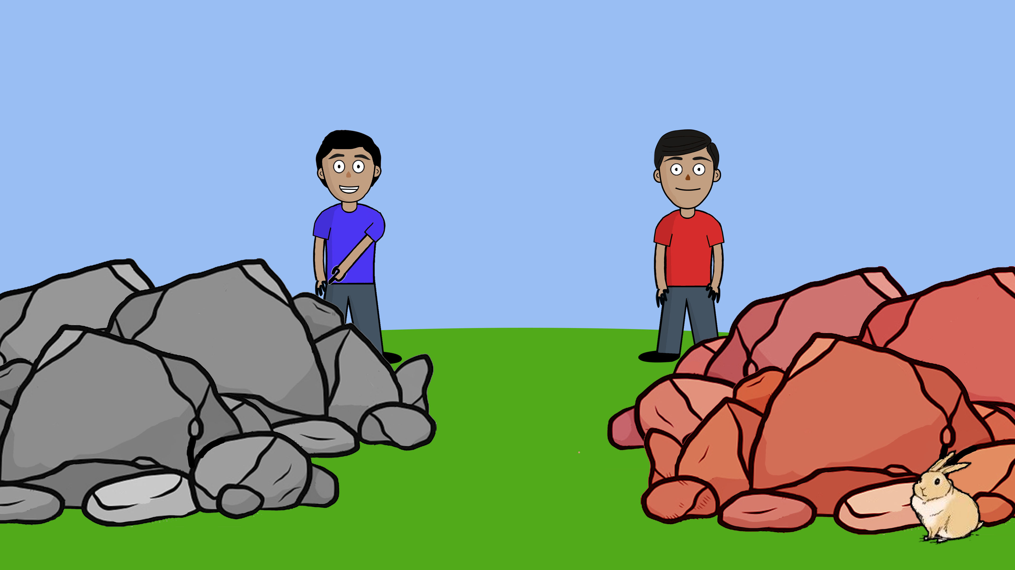

Notes:
Harold says: I think the bunny is hiding behind the grey stones.
-break-
So Harold thinks that the bunny is hiding behind the grey stones.

Slide 32
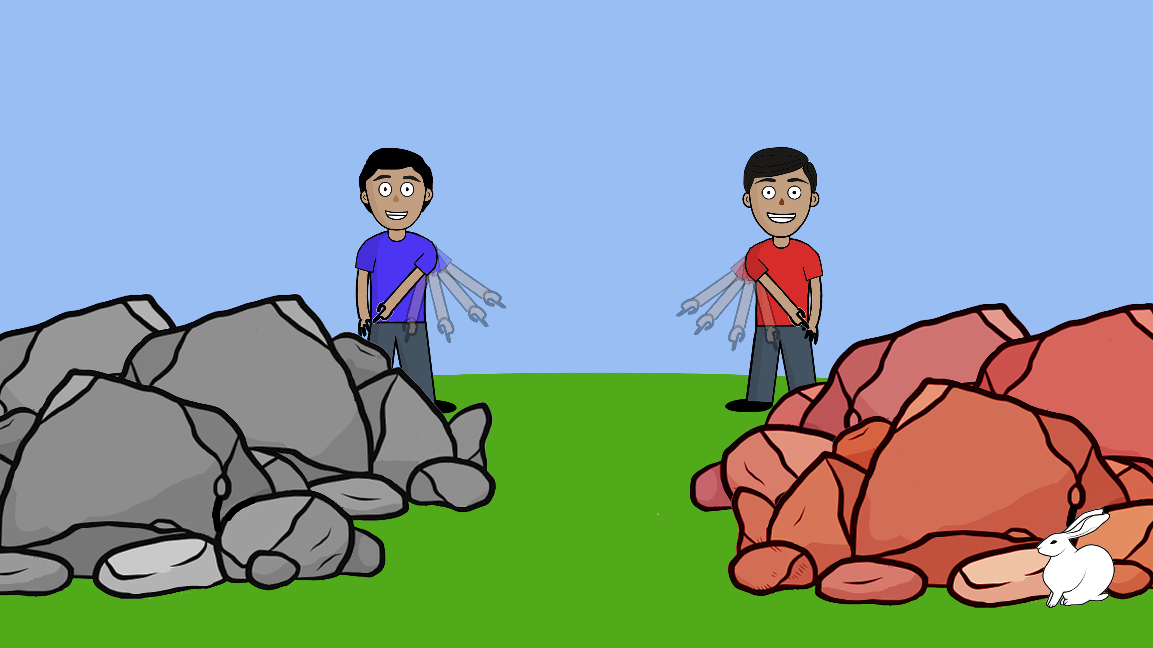
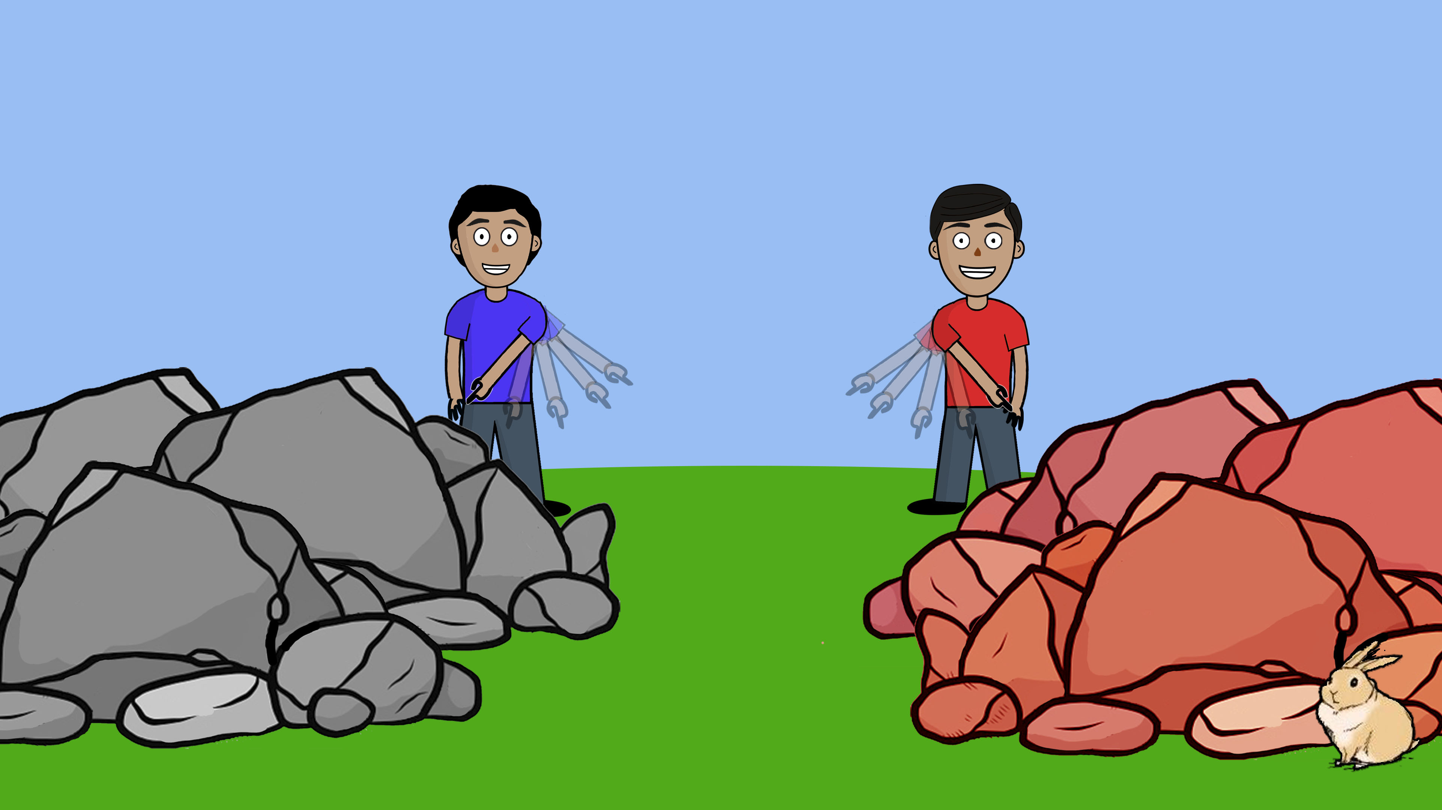
Notes:
*(Harold is blue, Devin is red)*
So, remember, [Child],
Devin did eenie meenie minie mo and thinks that the bunny is hiding behind the red stones.
Harold also did eenie meenie minie mo and thinks that the bunny is hiding behind the grey stones.
Now let me ask you, [Child]: Who do you think is doing a better job looking for the bunny? Devin, in the red shirt, or Harold, in the blue shirt?
-break(wait for answer)-
And why do you think so?
Now, imagine that you lose one of your favorite toys and you can’t find it, [Child]. Who would you want to ask for help in looking for your toy? Devin, in the red shirt or Harold, in the blue shirt?
-break(wait for answer)-
And why do you want to ask Devin/Harold?
Thanks so much [Child]! Now we’re gonna look at two other children and their pet…

Slide 33
Notes:
Story 2

Slide 34
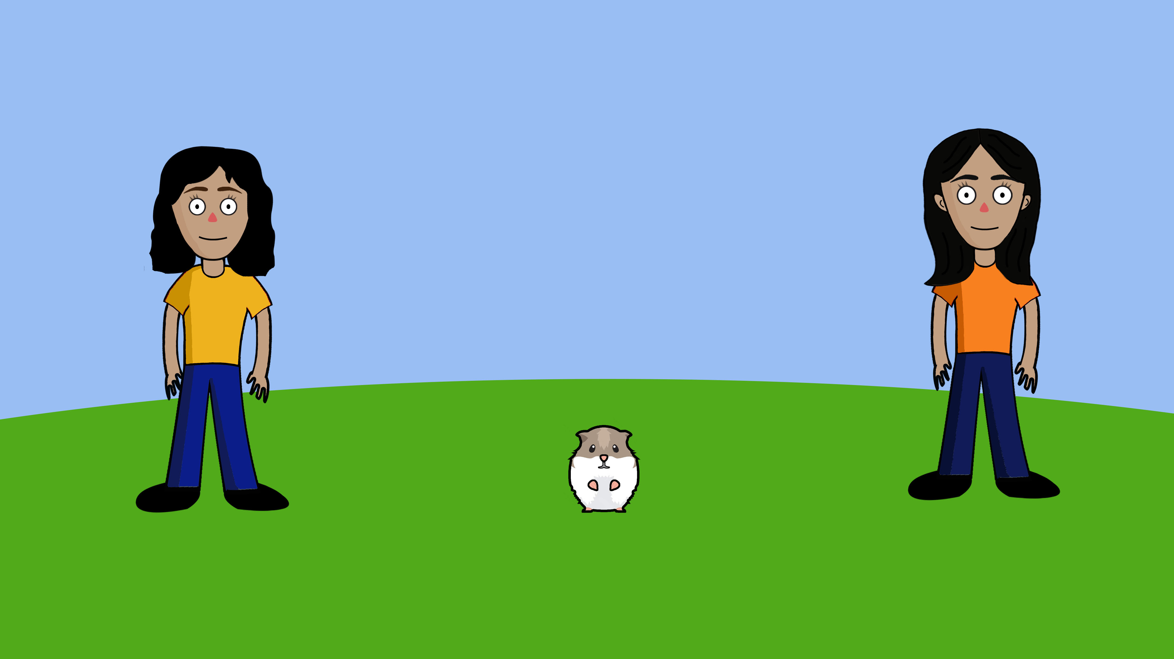
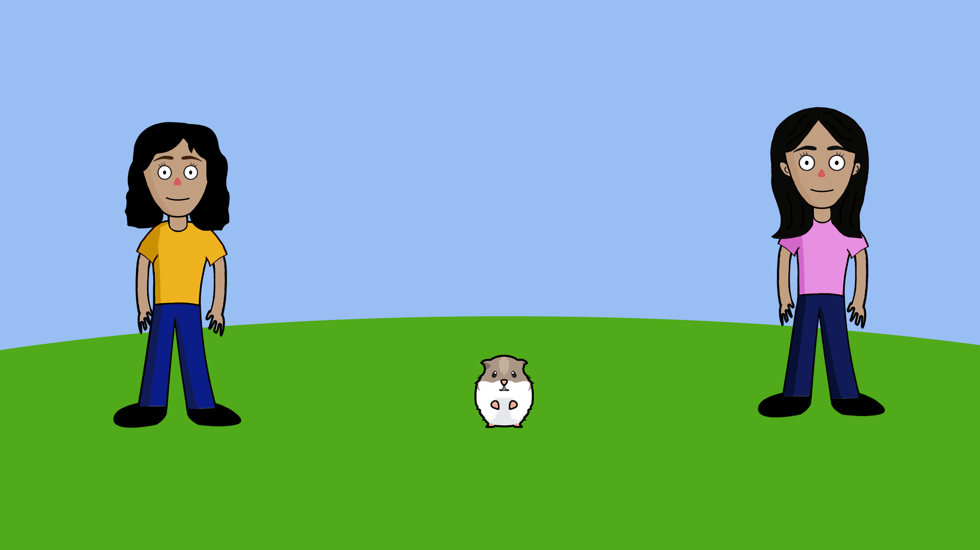
Notes:
*(Jenna in pink, Misty in yellow)*
This is Jenna. This is Misty. And this is their hamster.

Slide 35
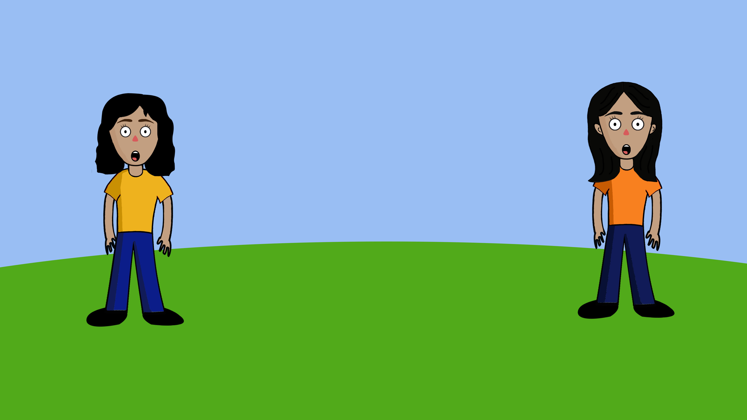
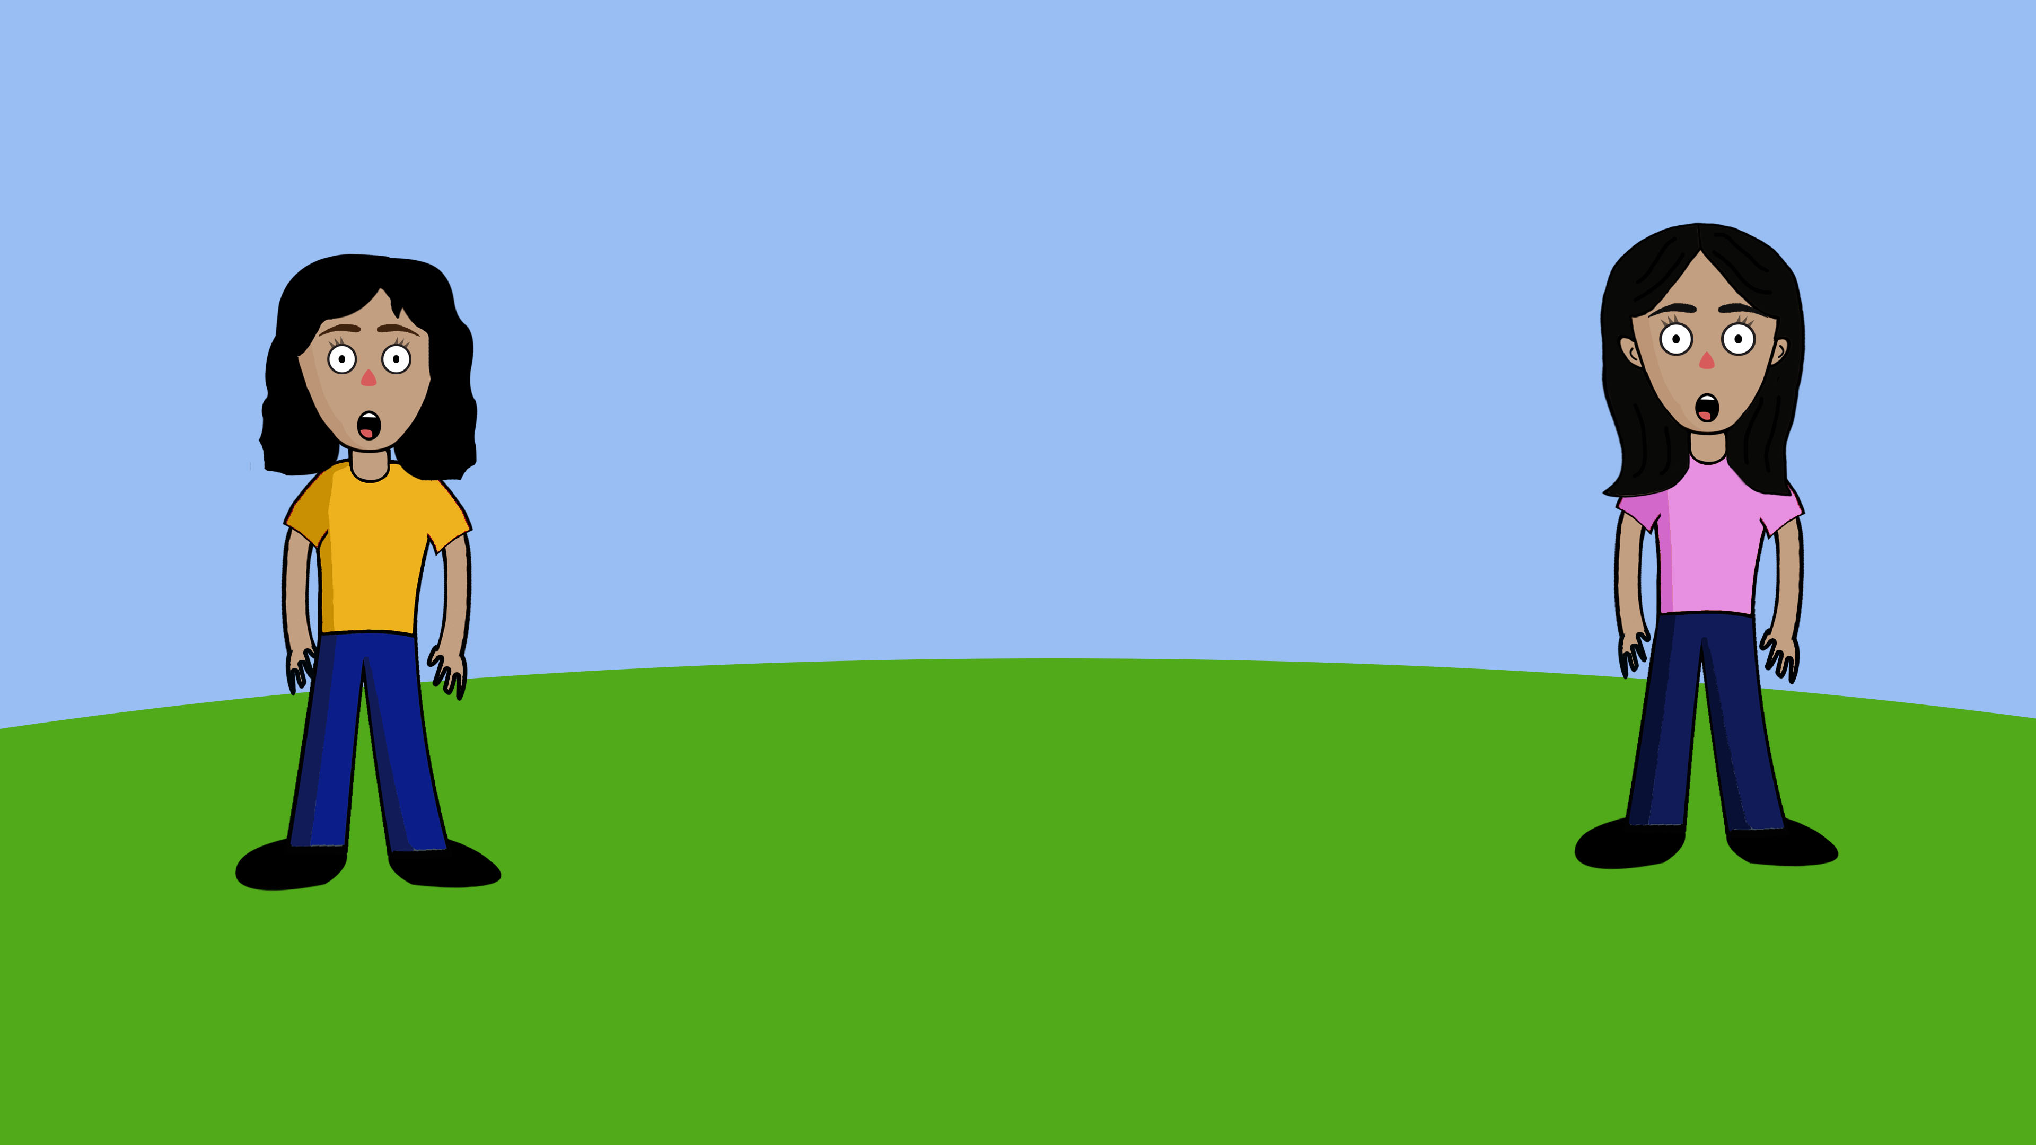
Notes:
*(Jenna in pink, Misty in yellow)*
But oh no! The hamster has run away. So Jenna and Misty are looking for their hamster.

Slide 36
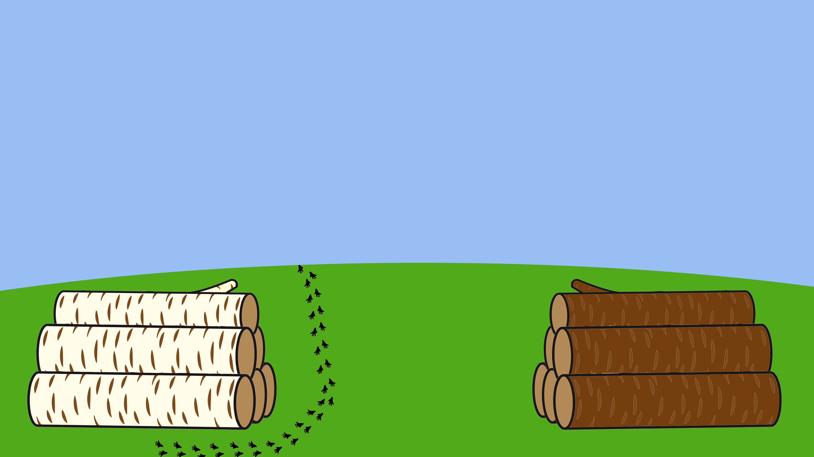
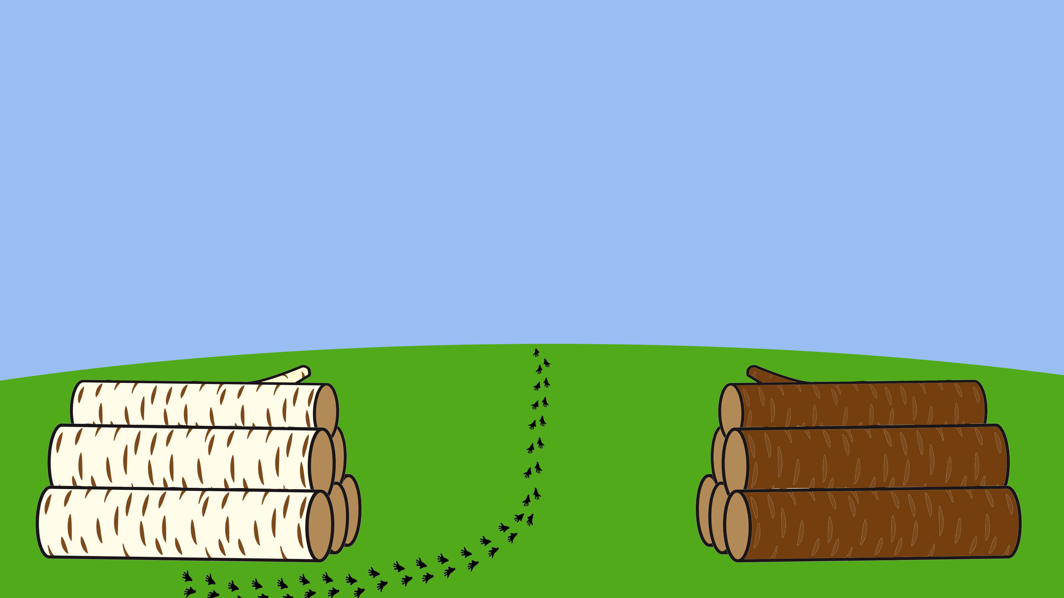
Notes:
Look, there are some brown logs and some white logs, and the hamster left some traces. But now the hamster has gone somewhere else.

Slide 37
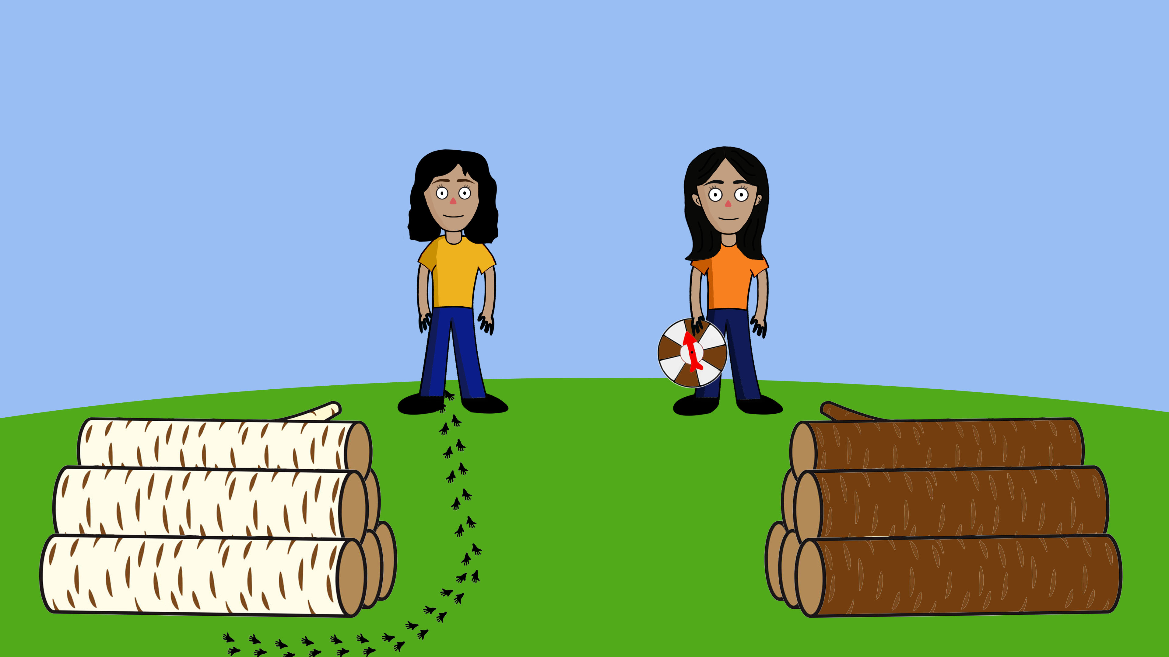
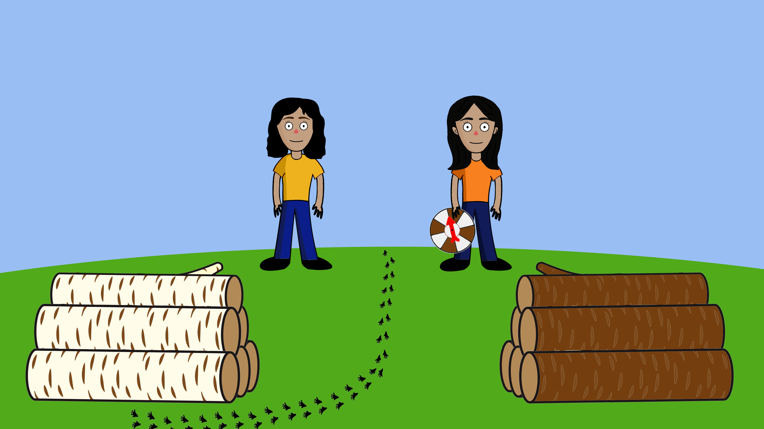
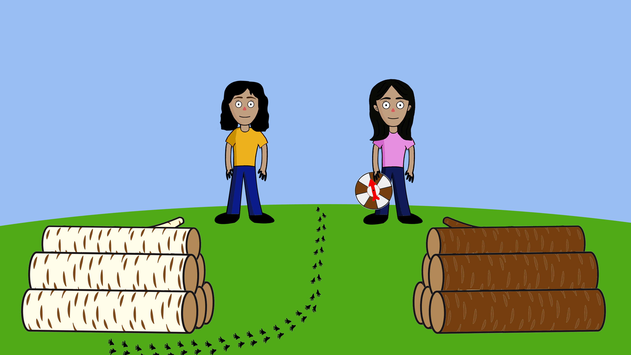
Notes:
*(Jenna in pink, Misty in yellow)*
Here are Jenna and Misty, looking for their hamster. They cannot see where their hamster is hiding. So they are trying to figure out whether the hamster is hiding behind the white logs or behind the brown logs.
First, Jenna is trying to figure out where the hamster is hiding. Jenna has a spinning wheel. When she spins the wheel, the arrow sometimes points to a white part and sometimes to a brown part.
Jenna says: I don’t know where the hamster is hiding, so maybe I will just close my eyes and spin this wheel. If the arrow points to the brown part, then I believe the hamster is hiding behind the brown logs. If the arrow points to the white part, then I believe the hamster is hiding behind the white logs.

Slide 38
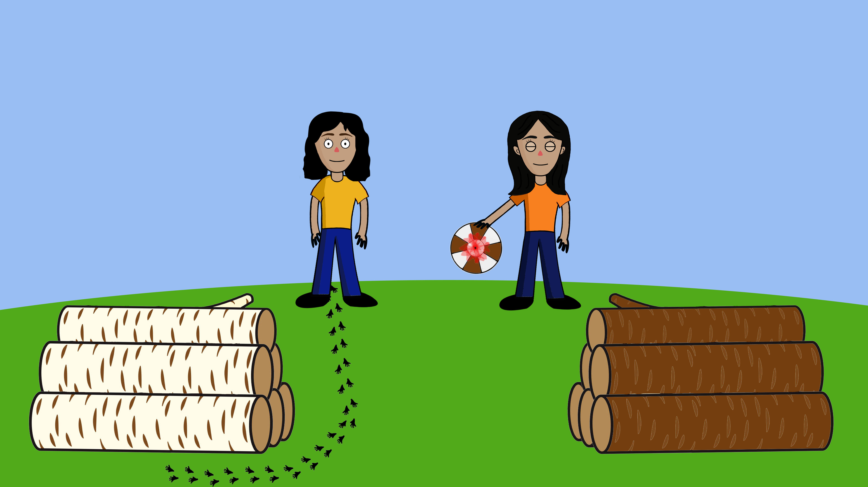

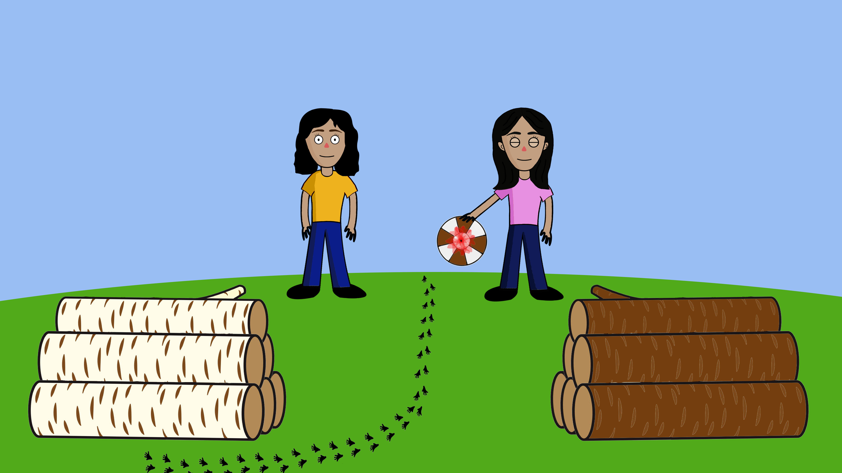
Notes:
Now Jenna spins the wheel.

Slide 39



Notes:
Jenna says: The arrow is pointing to the brown part, so I believe that our hamster is hiding behind the brown logs.
-break-
So Jenna believes the hamster is hiding behind the brown logs.

Slide 40


Notes:
*(Jenna in pink, Misty in yellow)*
Now Misty is trying to figure out where the hamster is hiding.
Misty says: I don’t know where the hamster is hiding, but maybe I can find something that will help me find the hamster. I am going to see whether I can find some of the hamster’s traces somewhere.

Slide 41



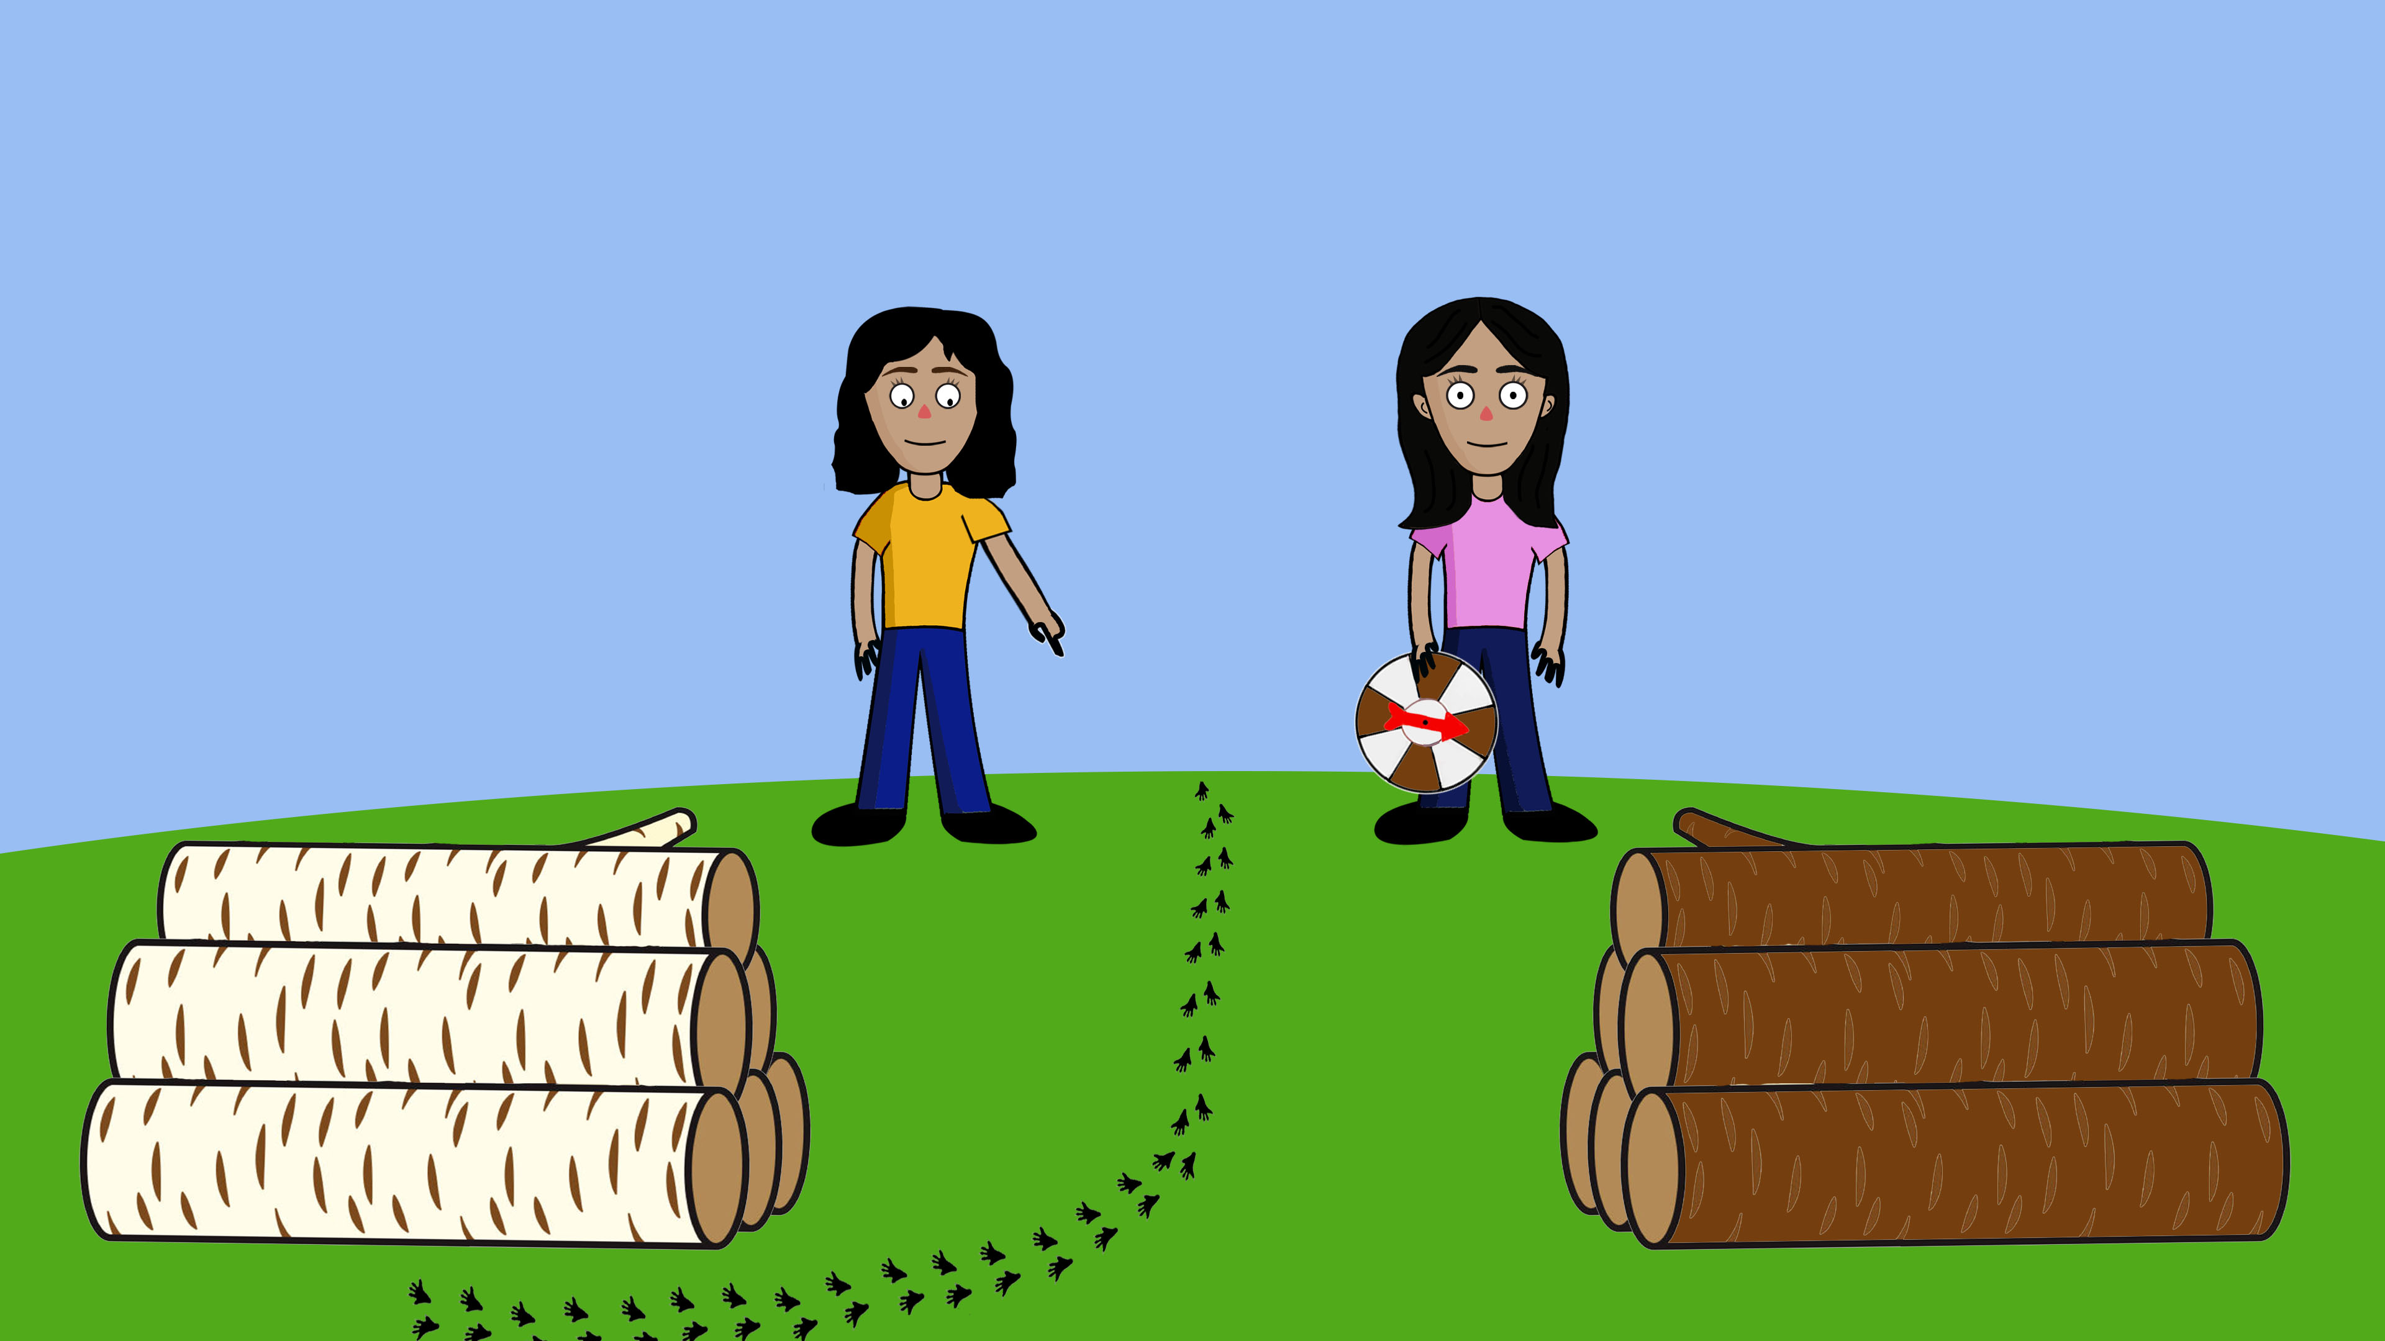
Notes:
Oh yes, I can see some traces here.

Slide 42



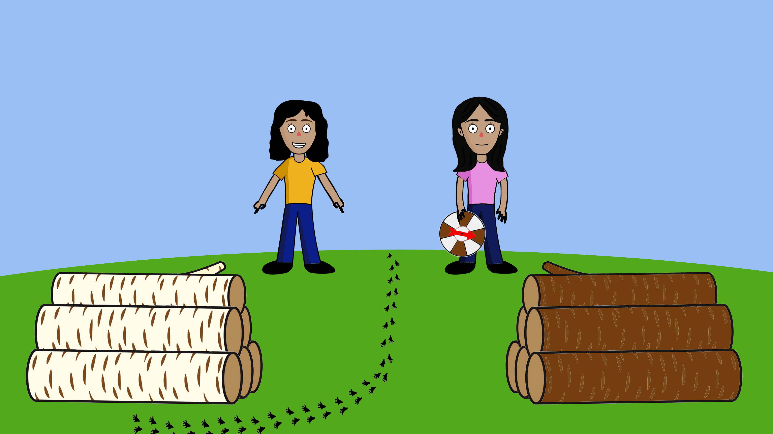
Notes:
Misty says: The hamster’s traces are next to the white logs, so I believe that our hamster is hiding behind the white logs.
-break-
So Misty believes the hamster is hiding behind the white logs.

Slide 43

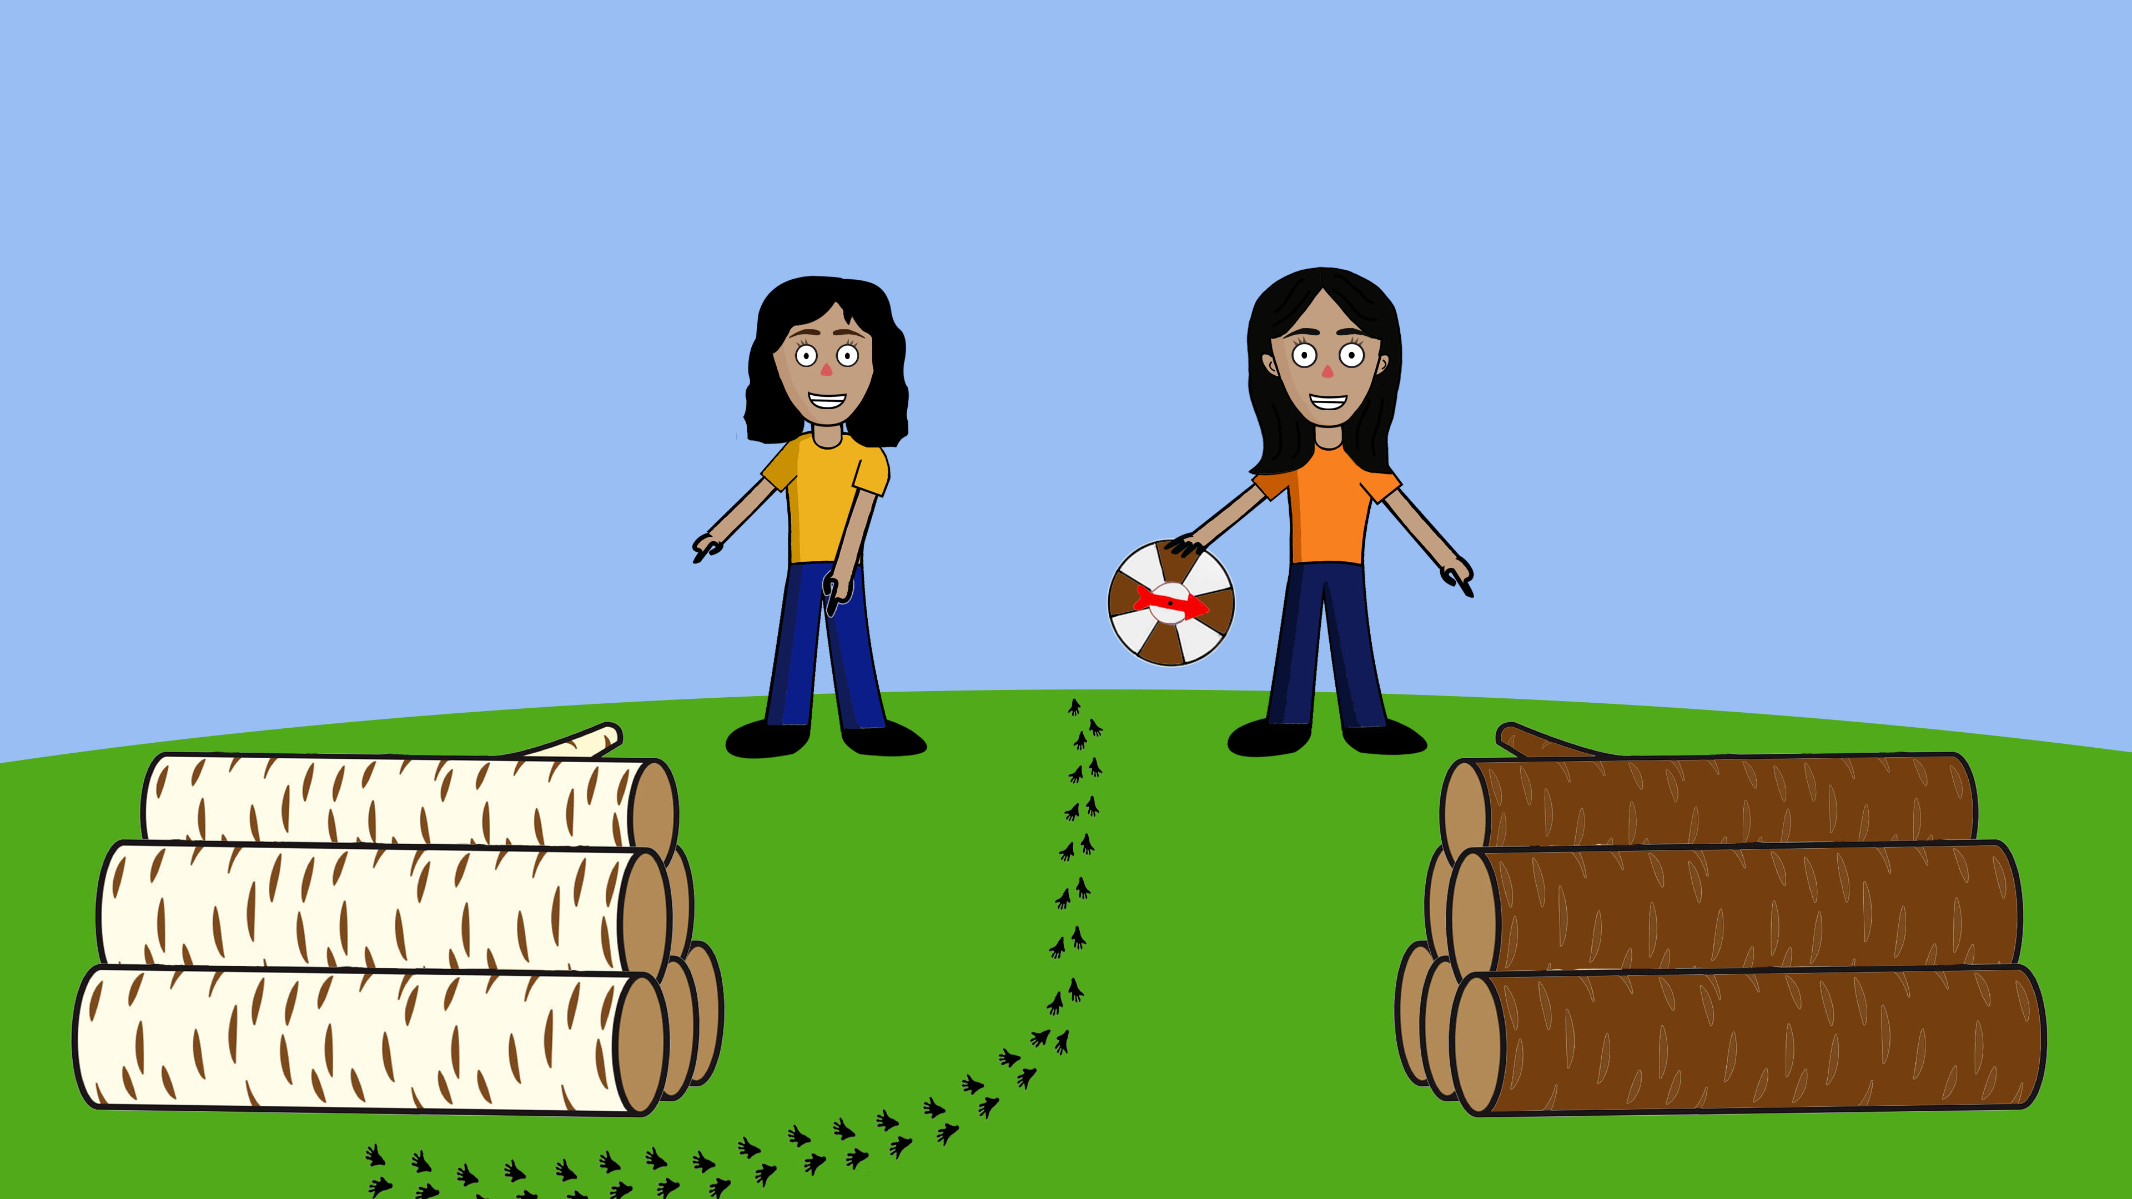


Notes:
*(Jenna in pink, Misty in yellow)*
So, remember, [Child],
Jenna used her spinning wheel and thinks that the hamster is hiding behind the brown logs.
Misty looked for the hamster’s traces and since the traces are next to the white logs, Misty thinks that the hamster is hiding behind the white logs.
Now let me ask you, [Child]: Who do you think is doing a better job looking for the hamster? Jenna, in the pink shirt or Misty, in the yellow shirt?
-break (wait for answer)-
And why do you think so?
Now imagine that you lose one of your favorite toys and you can’t find it, [Child]. Who would you want to ask for help in looking for your toy? Jenna, in the pink shirt or Misty, in the yellow shirt?
-break (wait for answer)-
And why do you want to ask Jenna/Misty?
Thanks so much [Child]! Now we’re gonna look at two other children and their pet…

Slide 44
Notes:
Story 3

Slide 45
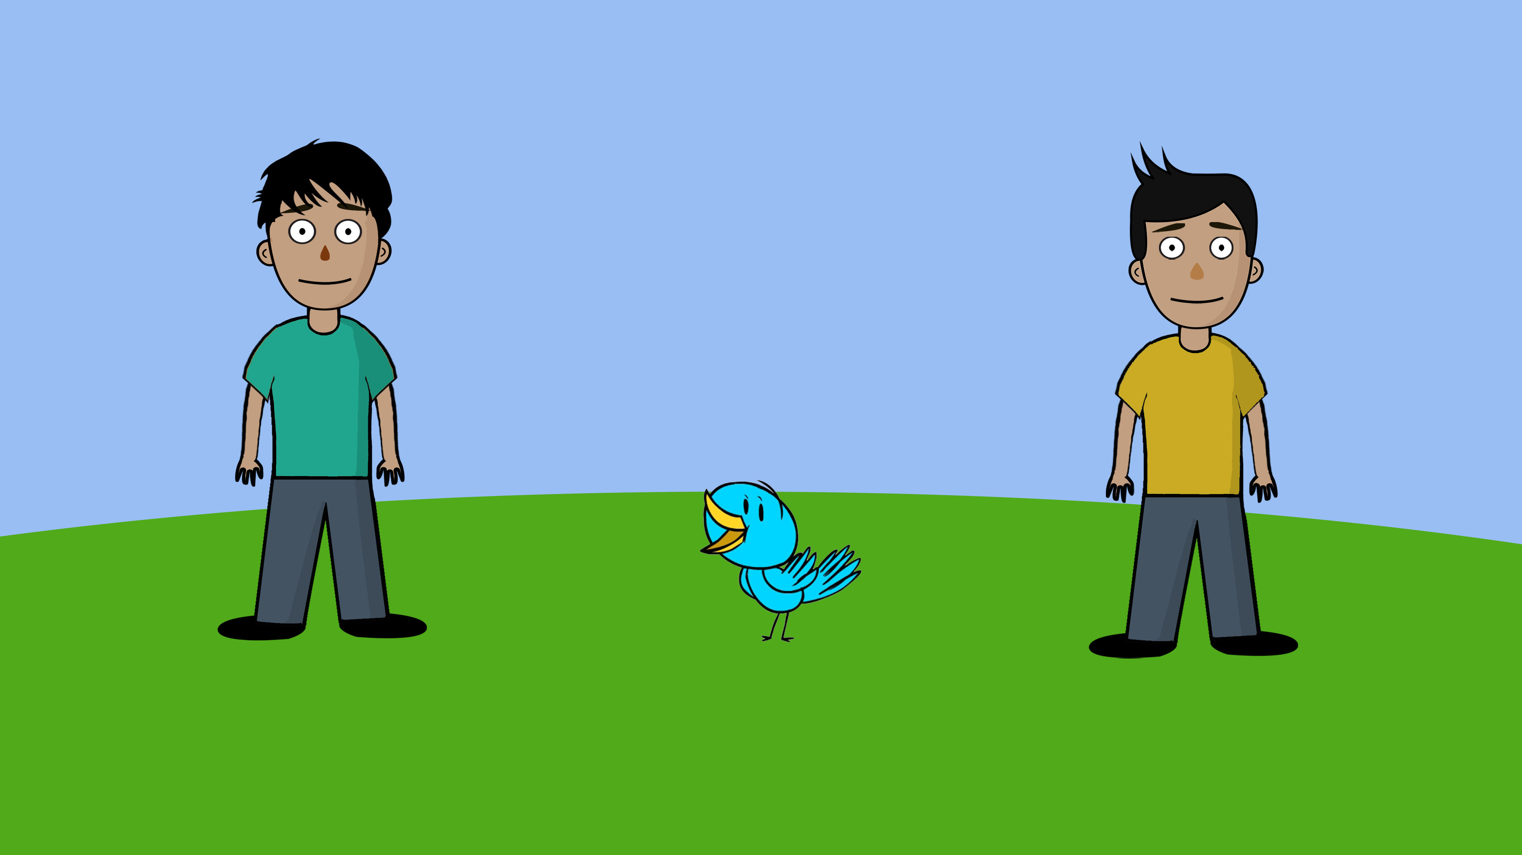

Notes:
*(Freddie in yellow, Oliver in green)*
This is Freddie. This is Oliver. And this is their bird.

Slide 46

Notes:
*(Freddie in yellow, Oliver in green)*
But guess what? The bird has flown away. So Freddie and Oliver are looking for their bird.

Slide 47
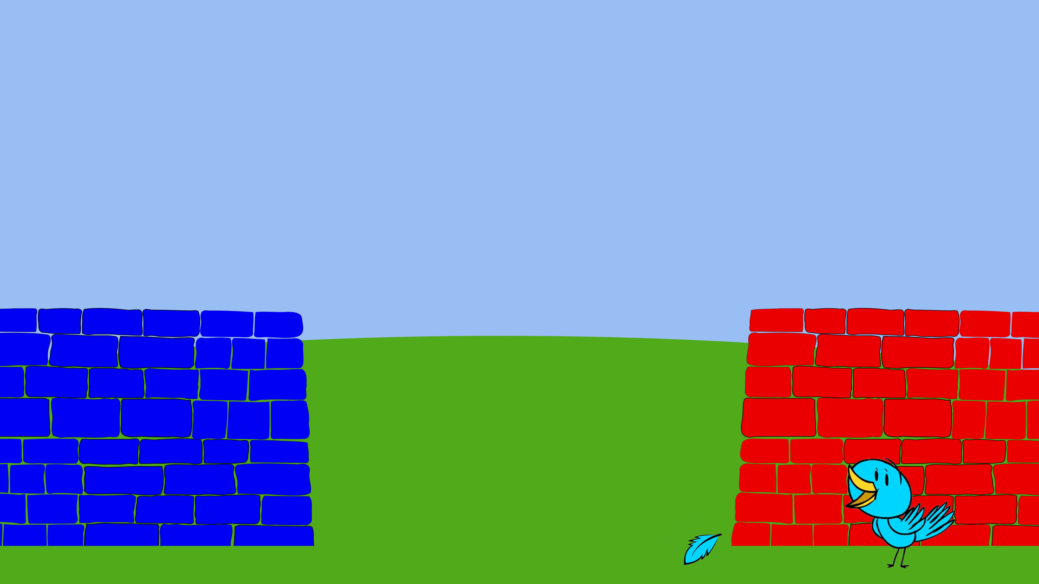
Notes:
Look, the bird is here. The bird is hiding behind the red wall. Look, the bird lost its feather next to the red wall. And there is a blue wall over there.

Slide 48
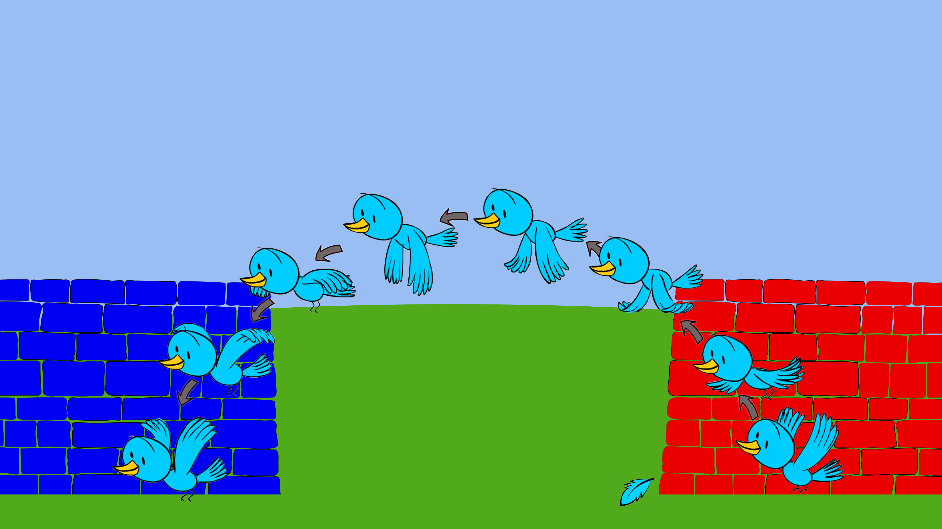
Notes:
Look, the bird is flying to the blue wall.

Slide 49
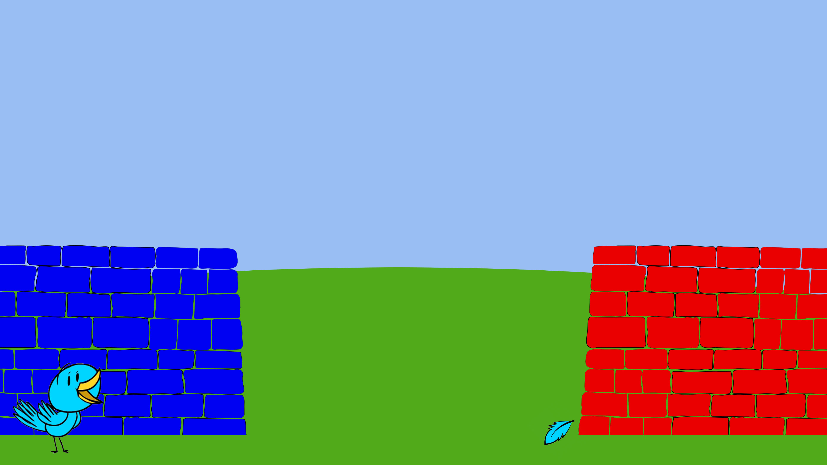
Notes:
Now the bird is behind the blue wall.

Slide 50
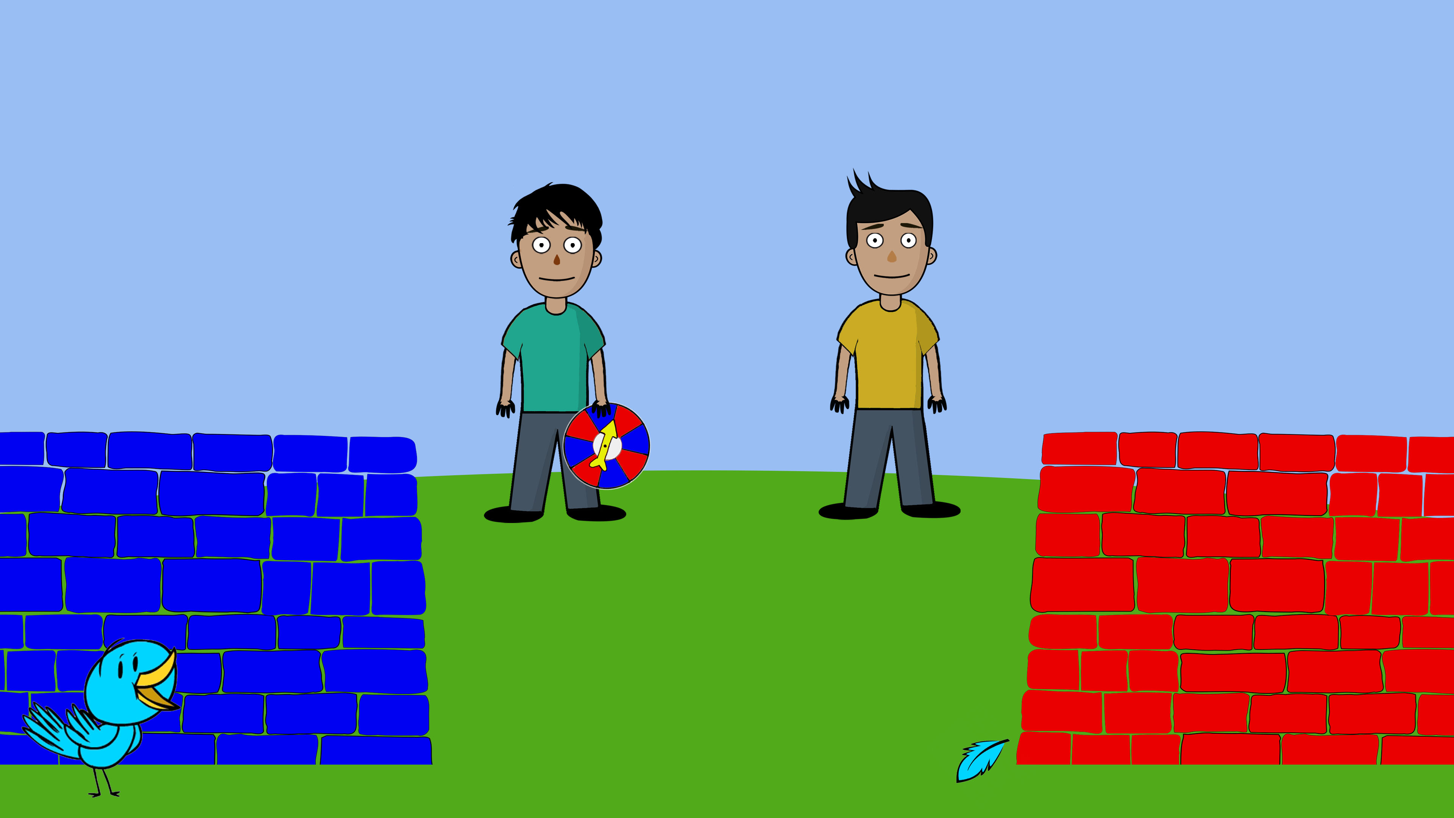
Notes:
*(Freddie in yellow, Oliver in green)*
Here are Freddie and Oliver, looking for their bird. They cannot see where their bird is hiding, so they are trying to figure out whether their bird is hiding behind the blue wall or behind the red wall.
Look, first, Freddie is trying to figure out where the bird is hiding. Freddie says: I don’t know where the bird is hiding, but maybe I can find something that will help me find the bird. I am going to look whether I can find some of the bird’s feathers somewhere.

Slide 51

Notes:
Oh yes, I can see her feathers here.
*(Freddie in yellow, Oliver in green)*

Slide 52

Notes:
Freddie says: The bird’s feathers are next to the red wall, so I believe that our bird is hiding behind the red wall.
So Freddie believes the bird is hiding behind the red wall.

Slide 53
Notes:
*(Freddie in yellow, Oliver in green)*
Now, Oliver is trying to figure out where the bird is hiding. Oliver has a spinning wheel. When he spins the wheel, the arrow sometimes points to a blue part and sometimes to a red part.
Oliver says: I don’t know where the bird is hiding, so maybe I will just close my eyes and spin this wheel. If the arrow points to the blue part, then I believe the bird is hiding behind the blue wall. If the arrow points to the red part, then I believe the bird is hiding behind the red wall.

Slide 54
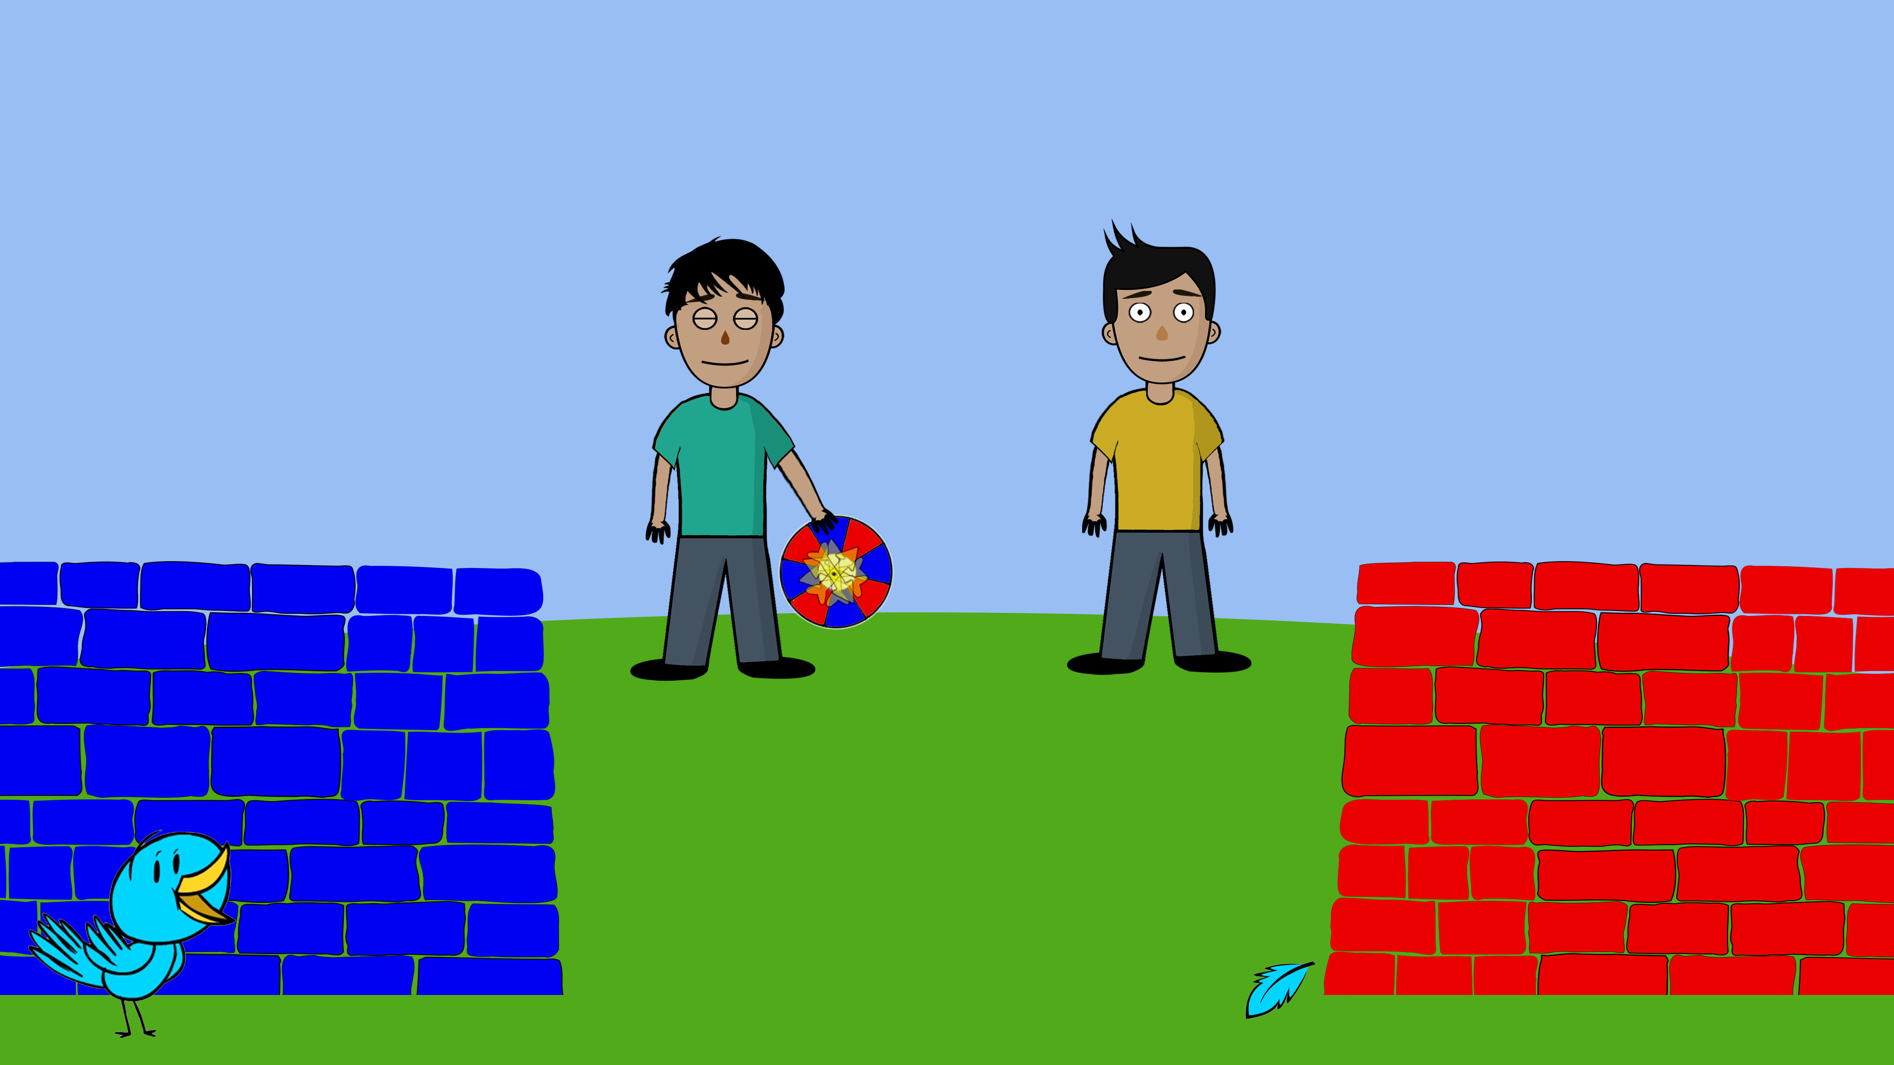
Notes:
Look, now Oliver spins the wheel.

Slide 55

Notes:
Oliver says: The arrow is pointing to the blue part, so I believe that our bird is hiding behind the blue wall.
-break-
So Oliver believes the bird is hiding behind the blue wall.

Slide 56
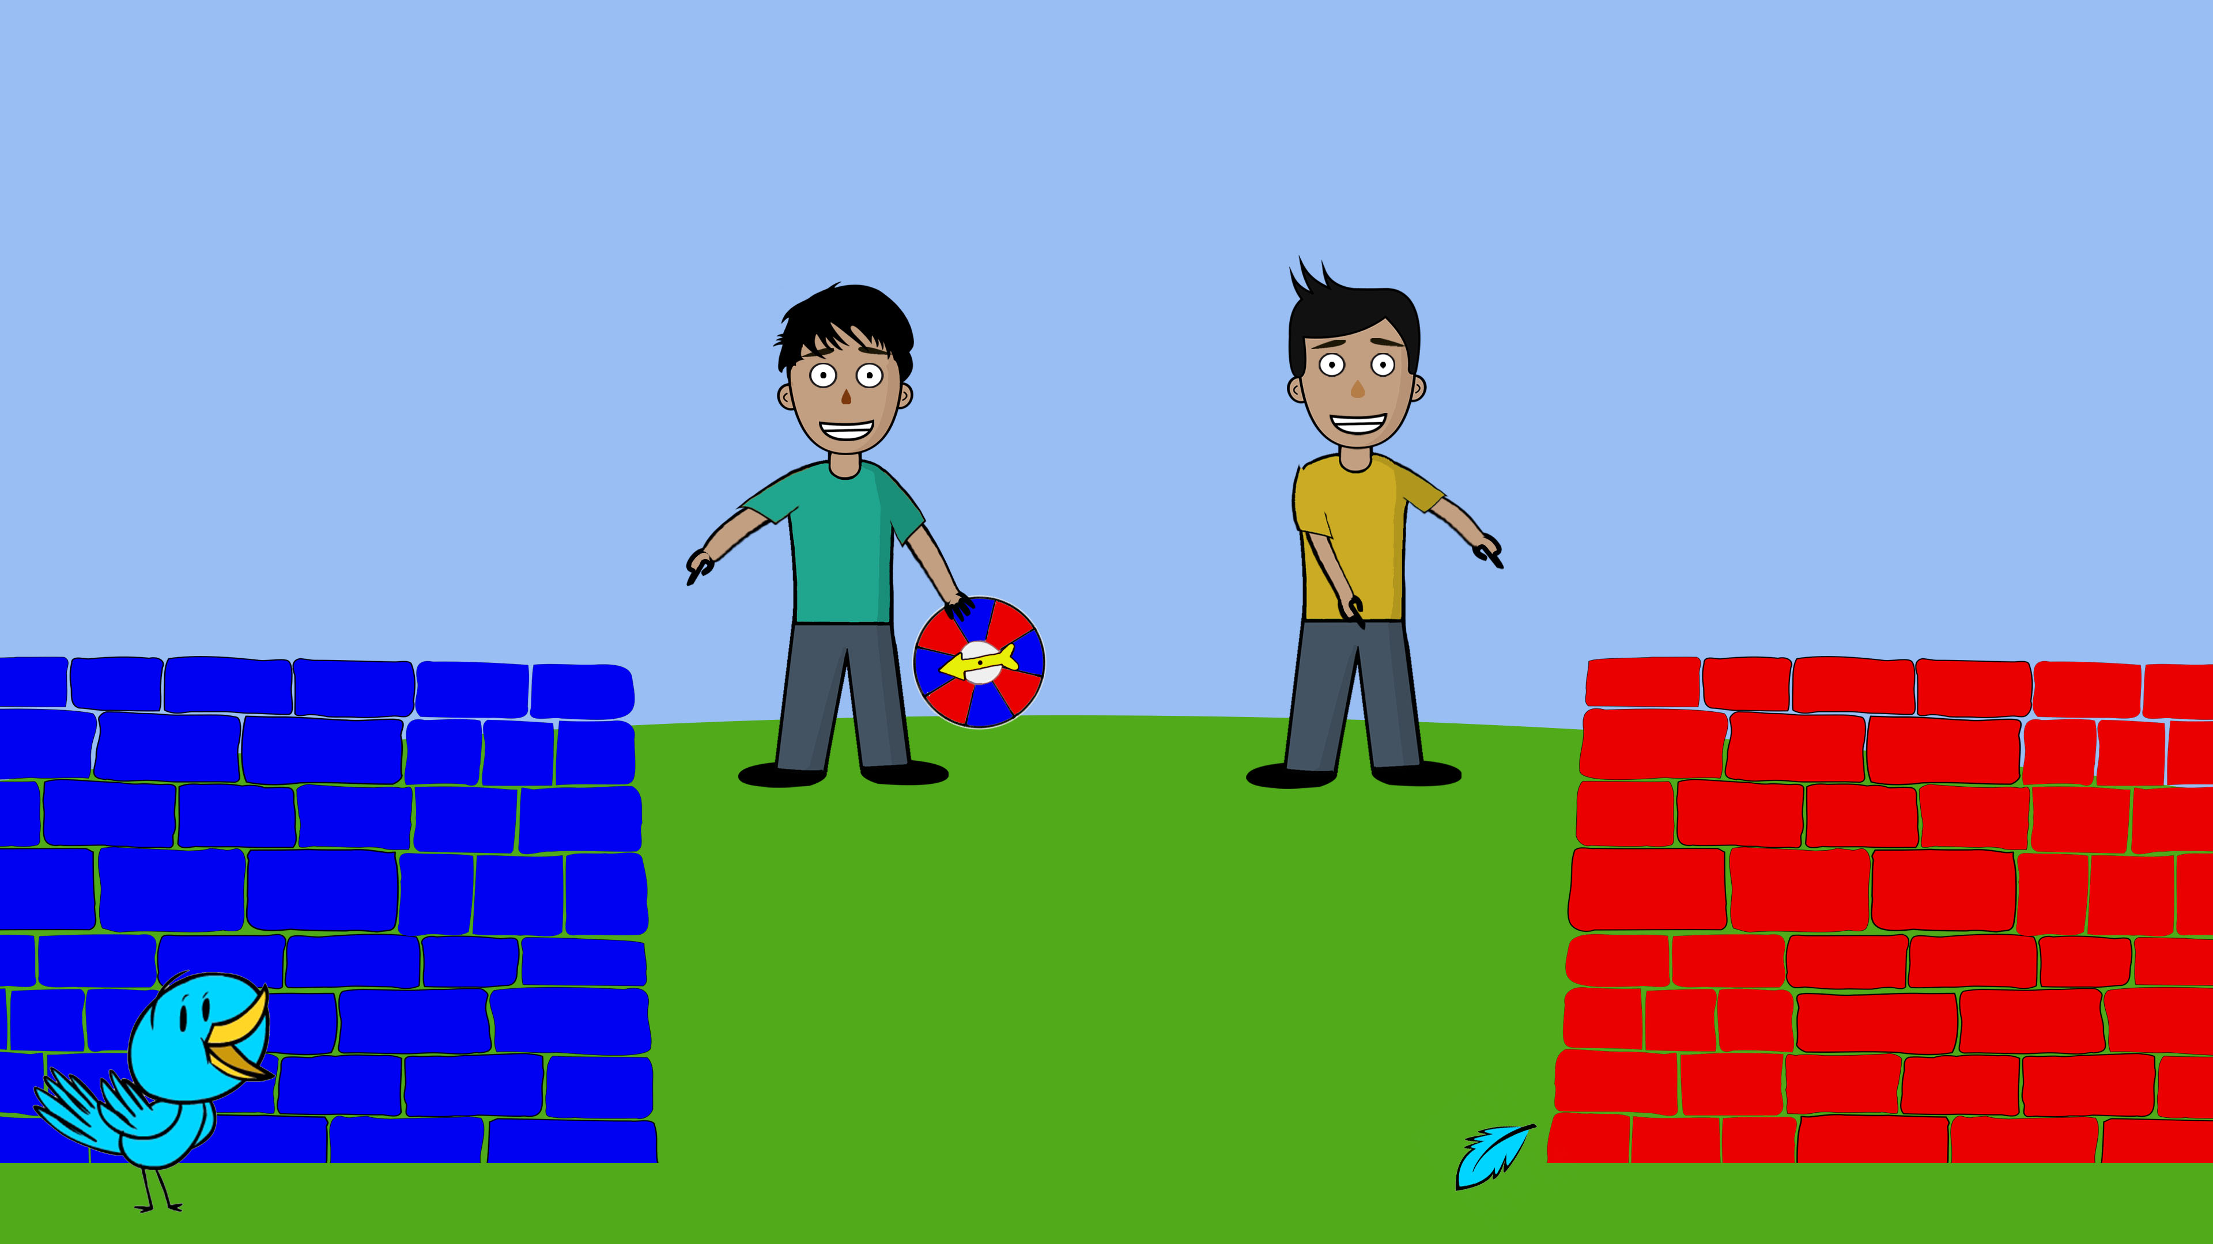
Notes:
*(Freddie in yellow, Oliver in green)*
So, remember, [Child],
Oliver used his spinning wheel and thinks that the bird is hiding behind the blue wall.
Freddie looked for the bird’s feathers and since the feather is next to the red wall, Freddie thinks that the bird is hiding behind the red wall.
Now let me ask you, [Child]: Who do you think is doing a better job looking for the bird? Oliver, in the green shirt or Freddie, in the yellow shirt?
-break (wait for answer)-
And why do you think so?
And imagine that you lose one of your favorite toys and you can’t find it, [Child]. Who would you want to ask for help in looking for your toy? Oliver, in the green shirt or Freddie, in the yellow shirt?
-break (wait for answer)-
And why do you want to ask Oliver/Freddie?
Thanks so much [Child]! Now we’re gonna look at two other children and their pet…

Slide 57
Notes:
Story 4

Slide 58
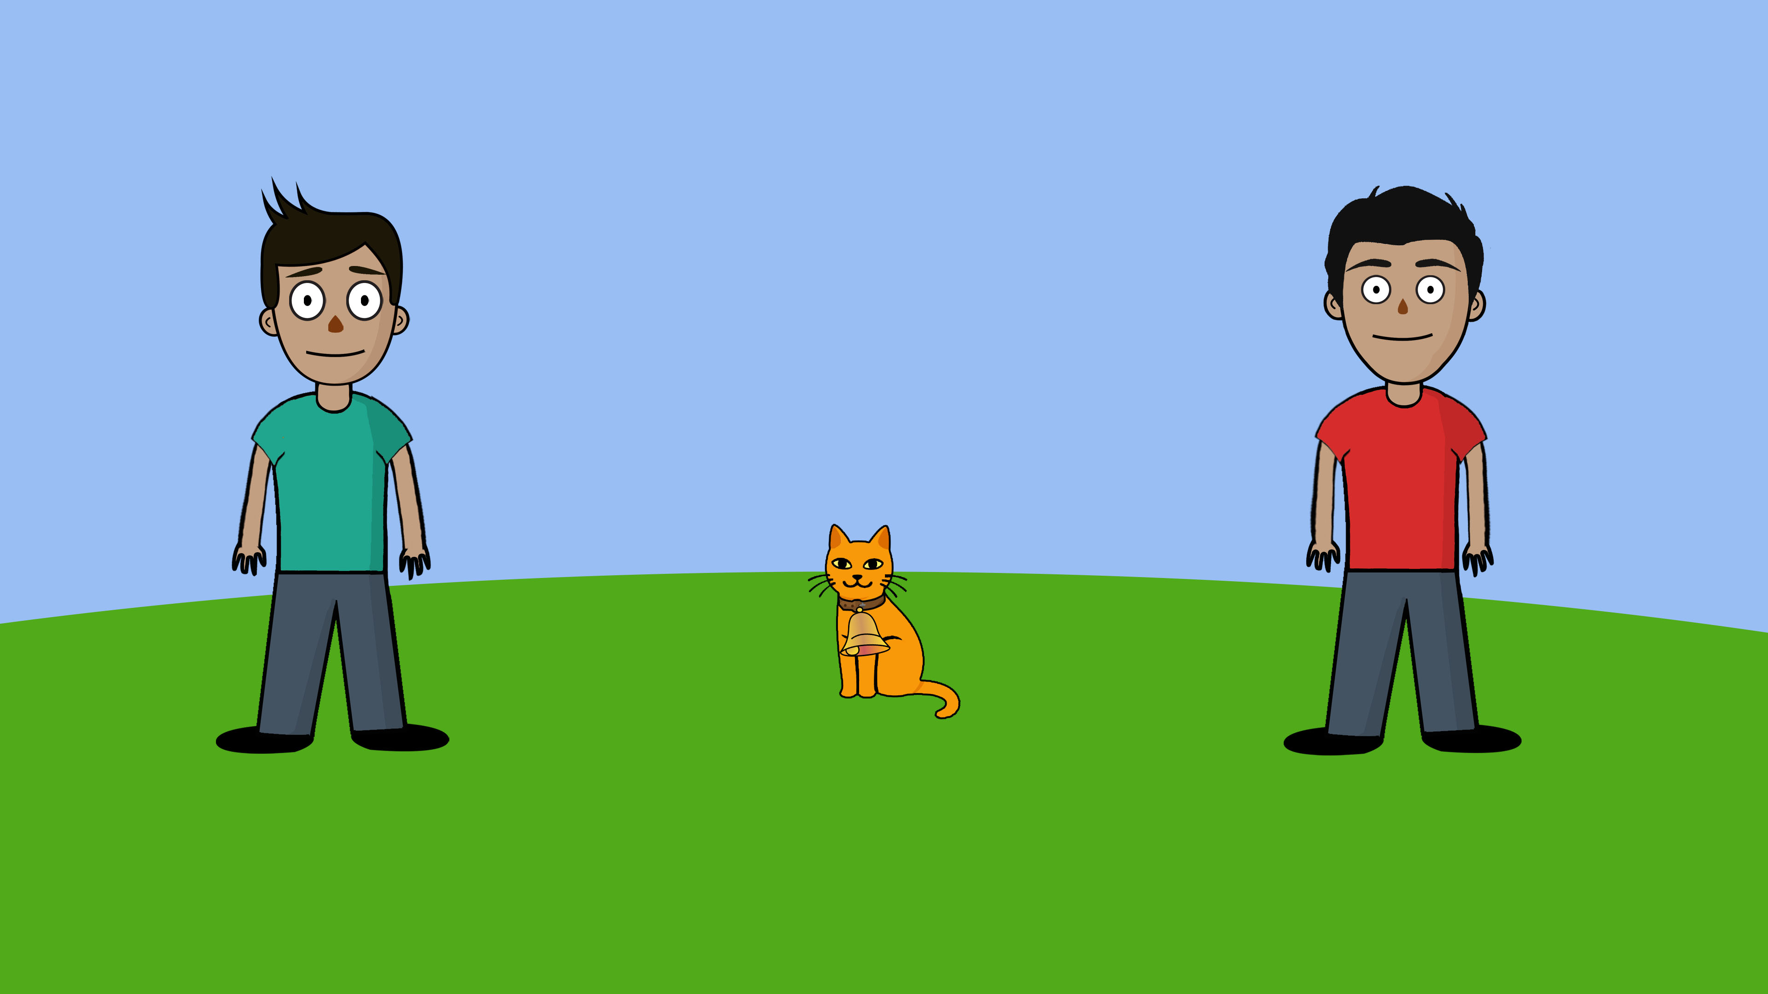

Notes:
*(Julian in red, Lucas in green)*
This is Julian. This is Lucas. And this is their cat. The cat wears a bell on her collar.

Slide 59

Notes:
*(Julian in red, Lucas in green)*
But guess what? The cat has also run away. So Lucas and Julian are looking for their cat.

Slide 60
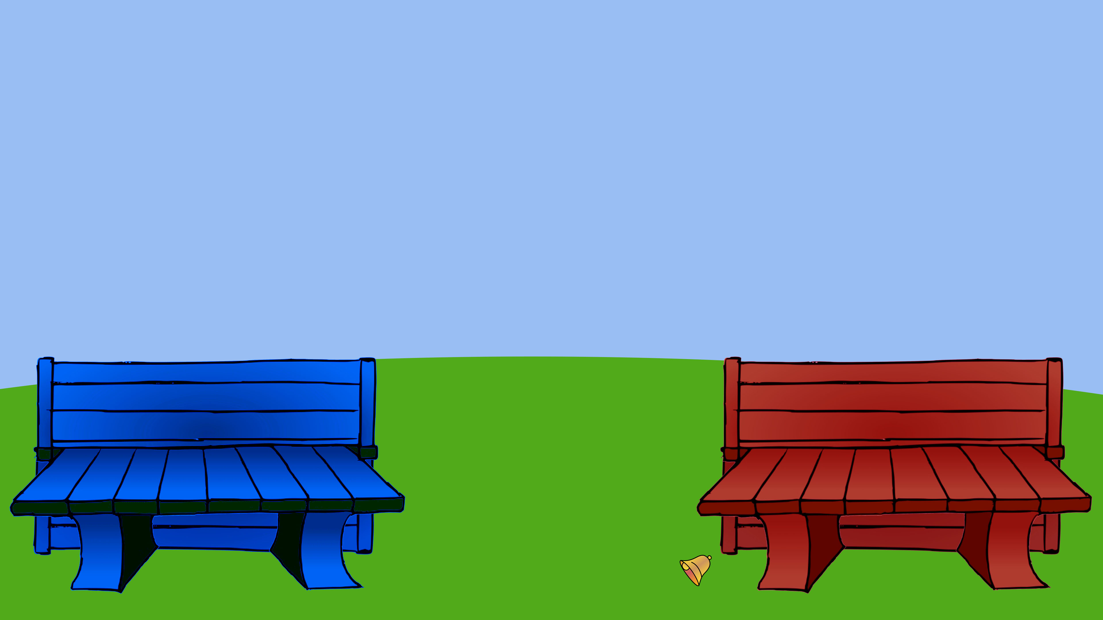
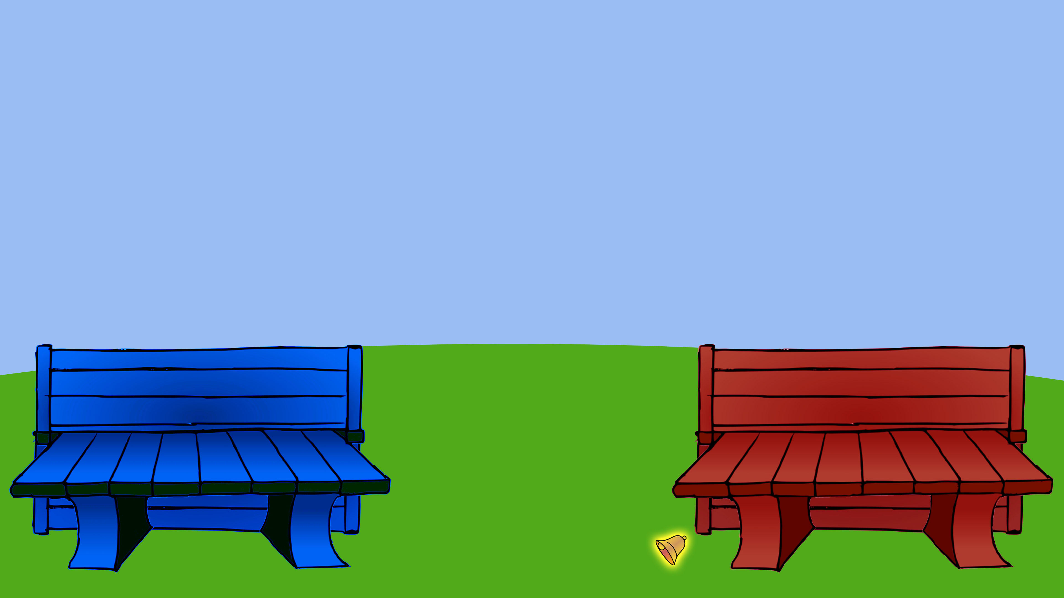
Notes:
Look, there is a blue bench and a red bench, and the cat lost her bell. But now the cat has gone somewhere else.

Slide 61


Notes:
*(Julian in red, Lucas in green)*
Here are Lucas and Julian, looking for their cat. They are trying to figure out whether their cat is hiding behind the blue bench or behind the red bench.
First, Julian is trying to figure out where the cat is hiding. Julian says: I don’t know where the cat is hiding, but maybe I can find something that will help me find the cat. I am going to see whether I can find the cat’s bell somewhere.

Slide 62


Notes:
Oh yes, I can see her bell there.

Slide 63


Notes:
Julian says: The cat’s bell is next to the red bench. So I believe that our cat is hiding behind the red bench.
-break-
So Julian believes the cat is behind the red bench.

Slide 64
Notes:
Now, Lucas is trying to figure out where the cat is hiding. Lucas says: I don’t know where the cat is hiding, but maybe I can find the cat if I close my eyes and go eenie, meenie, minie, mo.

Slide 65


Notes:
Eenie..

Slide 66


Notes:
Meenie…

Slide 67
Notes:
Minie…

Slide 68
Notes:
Mo…

Slide 69


Notes:
Lucas says: I think the cat is hiding behind the blue bench.
-break-
So Lucas thinks that the cat is hiding behind the blue bench.

Slide 70


Notes:
*(Julian in red, Lucas in green)*
So, remember, [Child],
Lucas did eenie meenie minie mo and thinks that the cat is hiding behind the blue bench.
Julian looked for the cat’s bell and since the cat’s bell is next to the red bench, Julian thinks that the cat is hiding behind the red bench.
Now let me ask you, [Child]: Who do you think is doing a better job looking for the cat? Lucas, in the green shirt or Julian, in the red shirt?
-break(wait for answer)-
And why do you think so?
Okay, imagine that you lose one of your favorite toys and you can’t find it, [Child]. Who would you want to ask for help in looking for your toy? Lucas, in the green shirt or Julian, in the red shirt?
-break(wait for answer)-
And why do you want to ask Lucas/Julian?
Thanks so much [Child]! Now we’re gonna look at two other children and their pet…

Slide 71
Notes:
Story 5

Slide 72

Notes:
*(Talia in purple, Liza in red)*
This is Talia. This is Liza. And this is their duck.

Slide 73

Notes:
*(Talia in purple, Liza in red)*
But oh no! The duck has flown away. Talia and Liza are going to look for their duck.

Slide 74

Notes:
Look! The duck is behind the yellow fence. And there is a blue fence over there.

Slide 75

Notes:
*(Talia in purple, Liza in red)*
Here are Talia and Liza, looking for their duck. They are trying to figure out whether their duck is behind the yellow fence or the blue fence.
Look, first, Talia is trying to figure out where the duck is hiding. Talia has a spinning wheel. When she spins the wheel, the arrow sometimes points to a blue part and sometimes to a yellow part.
Talia says: I don’t know where the duck is hiding, so maybe I will just close my eyes and spin this wheel. If the arrow points to the blue part, then I believe the duck is hiding behind the blue fence. If the arrow points to the yellow part, then I believe the duck is hiding behind the yellow fence.

Slide 76


Notes:
Now Talia spins the wheel.

Slide 77


Notes:
Talia says: The arrow is pointing to the blue part, so I believe that our duck is hiding behind the blue fence.
-break-
So Talia believes the duck is hiding behind the blue fence.

Slide 78

Notes:
*(Talia in purple, Liza in red)*
Now, Liza is trying to figure out where the duck is hiding. Liza also has a spinning wheel. When she spins the wheel, the arrow sometimes points to a blue part and sometimes to a yellow part.
Liza says: I don’t know where the duck is hiding, so maybe I will just close my eyes and spin this wheel. If the arrow points to the blue part, then I believe the duck is hiding behind the blue fence. If the arrow points to the yellow part, then I believe the duck is hiding behind the yellow fence.

Slide 79


Notes:
Now Liza spins the wheel.

Slide 80


Notes:
Liza says: The arrow is pointing to the yellow part, so I believe that our duck is hiding behind the yellow fence.
-break-
So Liza believes the duck is hiding behind the yellow fence.

Slide 81

Notes:
*(Talia in purple, Liza in red)*
So, remember, [Child],
Talia used her spinning wheel and thinks that the duck is hiding behind the blue fence.
Liza used her spinning wheel and thinks that the duck is hiding behind the yellow fence.
Now let me ask you, [Child]: Who do you think is doing a better job looking for the duck? Talia, in the purple shirt or Liza, in the red shirt?
-break (wait for answer)-
And why do you think so?
And imagine that you lose one of your favorite toys and you can’t find it, [Child]. Who would you want to ask for help in looking for your toy? Talia, in the purple shirt or Liza, in the red shirt?
-break (wait for answer)-
And why do you want to ask Talia/Liza?
Thanks so much [Child]! Now we’re gonna look at two other children and their pet…

Slide 82
Notes:
Story 6

Slide 83

Notes:
*(Claire in green, Ruby in yellow)*
This is Claire. This is Ruby. And this is their dog.

Slide 84

Notes:
But guess what? The dog has run away! Claire and Ruby are looking for their dog.
*(Claire in green, Ruby in yellow)*

Slide 85


Notes:
Look, the dog is here. The dog is hiding behind the yellow bush. Look, the dog’s traces are next to the yellow bush. And there is a pink bush over there.

Slide 86


Notes:
Look, the dog is jumping to the pink bush.

Slide 87


Notes:
Now the dog is behind the pink bush.

Slide 88


Notes:
*(Claire in green, Ruby in yellow)*
Here are Claire and Ruby, looking for their dog. They are trying to figure out whether their dog is hiding behind the yellow bush or behind the pink bush.
First, Claire is trying to figure out where the dog is hiding. Claire says: I don’t know where the dog is hiding, but maybe I can find the dog if I close my eyes and go eenie, meenie, minie, mo.

Slide 89


Notes:
Eenie..

Slide 90


Notes:
Meenie..

Slide 91
Notes:
Minie..

Slide 92
Notes:
Mo..

Slide 93


Notes:
Claire says: I think the dog is hiding behind the pink bush.
-break-
So Claire thinks that the dog is hiding behind the pink bush.

Slide 94
Notes:
*(Claire in green, Ruby in yellow)*
Now Ruby is trying to figure out where the dog is hiding. Ruby says: I dont know where the dog is hiding, but maybe I can find something that will help me find the dog. I am going to see whether I can find the dog’s paw prints somewhere.

Slide 95



Notes:
Oh yes, I can see some paw prints here.

Slide 96


Notes:
Ruby says: The paw prints are next to the yellow bush. So I believe that our dog is hiding behind the yellow bush.
-break-
So Ruby believes the dog is behind the yellow bush.

Slide 97


s
Notes:
*(Claire in green, Ruby in yellow)*
So, remember, [Child],
Claire did eenie meenie minie mo and thinks that the dog is hiding behind the pink bush.
Ruby looked for the dog’s paw prints and since the paw prints are next to the yellow bush, Ruby thinks that the dog is hiding behind the yellow bush.
Now let me ask you, [Child]: Who do you think is doing a better job looking for the dog? Claire, in the green shirt or Ruby, in the orange shirt?
-break(wait for answer)-
And why do you think so?
Okay, imagine that you lose one of your favorite toys and you can’t find it, [Child]. Who would you want to ask for help in looking for your toy? Claire, in the green shirt or Ruby, in the orange shirt?
-break(wait for answer)-
And why do you want to ask Claire/Ruby?
Thanks so much [Child]! That’s the end of our game, you did great!

Slide 98
Thank you!
Notes:
To child:
Really good job [Child], I could not have done that without you!
Our mission is complete, is your mom/dad right there? Could I speak to them now?
To parent:
[Child] really did great today. This study can be quite demanding because children have to remember multiple names and events and have to focus their attention on different aspects of the story. And I do want to emphasize that we really appreciate both of you participating with us today. Without your support, especially in times like these, we wouldn’t be able to conduct our research. So thank you for supporting science!

Slide 99

Follow up questions?
Do you have any questions about the study?
Notes:
Debrief:
For this study we are essentially interested in how children think about reasoning. Such as, what do children believe are better or more rational forms of thinking? And what do children believe are less good or less rational ways of thinking?
Specifically in this study, we are trying to see if children care more about whether someone uses rational reasoning to come to a conclusion or if it just matters more that someone came to the right conclusion, even if only by chance. And we test different age groups to see how this thinking changes as children develop.

Slide 100
Follow up questions?
How was the video quality?
1
2
3
4
5
Very poor
Poor
Moderate
Good
Very good

Slide 101
Follow up questions?
How was the sound quality?
1
2
3
4
5
Very poor
Poor
Moderate
Good
Very good

Slide 102
Follow up questions?
How fun was the game?
1
2
3
4
5
No fun
Not that fun
A little fun
Fun
A lot of fun
Notes:
To child

Slide 103

Thank you!
Notes:
Thank you for joining us today! I will also be sending you a follow up email at the end of the study.
I hope you enjoy the rest of your day!

